Slide 1
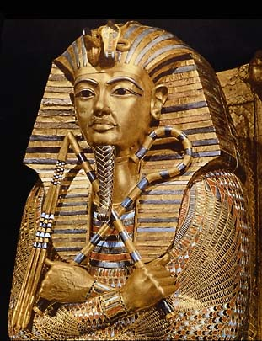
Ancient Egypt

Slide 2
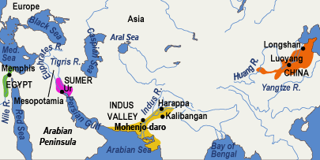
Quick Review!
The first civilizations began in the river valleys of Africa and Asia. The river valley civilizations are:
Tigris and Euphrates River
Yellow River
Nile River
Indus River
The world’s first civilization, Sumer, developed in the fertile crescent. However, Sumer would soon be invaded many other empires including: the Akkadians, Babylonians, Hittites, Assyrians, Persians.

Slide 3
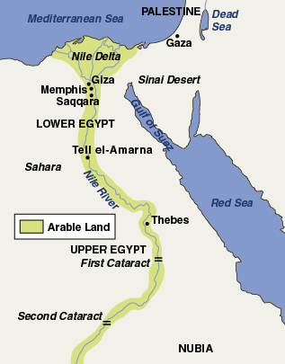
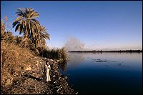
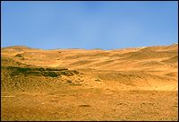
Kingdom of the Nile
The Egyptian civilization was built on the banks of the Nile River in Africa.
“Black Land” ~ rich fertile soils along the Nile River.
“Red Land” ~ desert that stretches across North Africa.
Egypt was divided into two regions:
Upper Egypt ~ stretched from the Nile’s first Cataract (waterfall).
Lower Egypt ~ along the delta (rich land at the mouth of the river) where the Nile empties into the Mediterranean Sea.

Slide 4
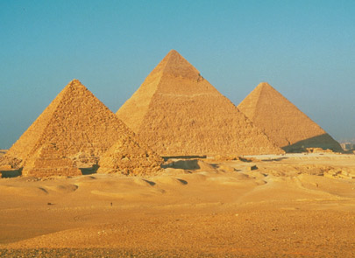
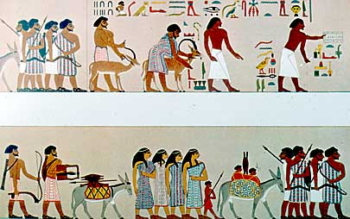
Kingdoms of Egypt
Old Kingdom (2575 B.C. – 2130 B.C.)
Pharaohs organized a strong government with a bureaucracy and viziers.
Bureaucracy ~ government with many different jobs and levels (like our government)
Vizier ~ helped the pharaoh by supervising the government
During the Old Kingdom, the Egyptians built the great pyramids at Giza to honor the pharaohs.
Middle Kingdom (1938 B.C. – 1630 B.C.)
A time of trouble with many rebellions and corrupt (dishonest) leaders.
At the end of the Middle Kingdom, foreign invaders called the Hyksos took over Egypt.

Slide 5
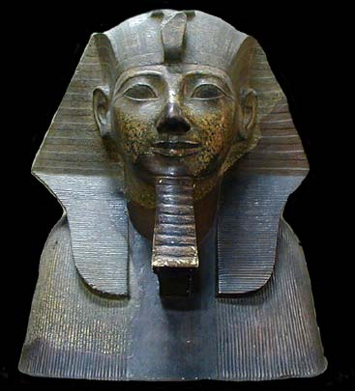
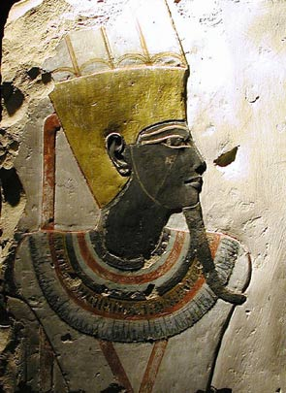
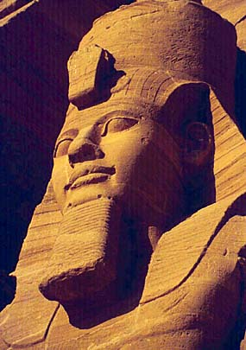
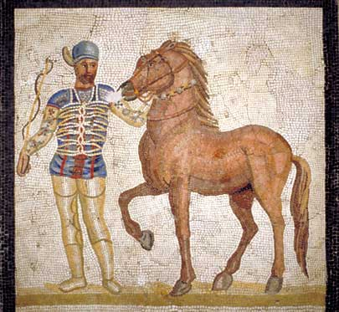
New Kingdom (1539 B.C. – 1075 B.C.)
Powerful and ambitious pharaohs created a strong and large empire.
Hatshepsut ~ the first female ruler who expanded trade and helped Egypt prosper.
Thutmose III ~ a great military leader and expanded Egypt’s borders to their greatest extent ever!
Ramses II ~ ruled for 66 years and successfully conquered many of the lands around Egypt including Syria and Nubia.
Decline of Egypt
After 1100 B.C., Egypt was invaded and conquered by the Assyrians and Persians.
In 332 B.C., the last Egyptian dynasty ended when the Greeks took control. Later Roman armies would replace the Greeks.

Slide 6
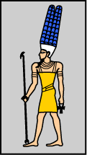
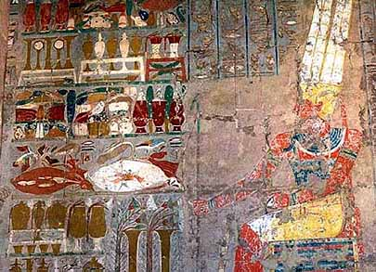
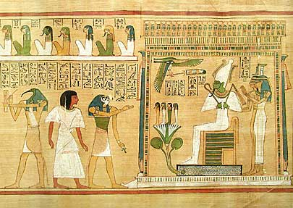
Egyptian Religion
Like most early civilizations, the Ancient Egyptians were polytheistic, believing in many gods.
The Chief God was Amon-Re ~ the sun god.
The Pharaohs, who were viewed as gods and Kings, received their right to rule from Amon-Re.
Egyptians also believed in the afterlife, or life after death.
Each soul had to pass a test to win eternal life – your heart would be weighed against the feather of truth.
The Book of the Dead helped Egyptians survive the dangerous journey into the underworld providing spells, charms, and formulas.

Slide 7
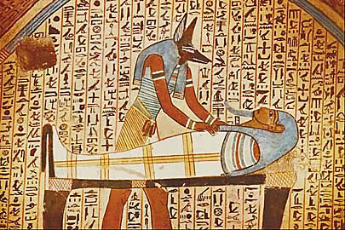
The Afterlife
Egyptians believed that Osiris and Isis promised them eternal life after death. This belief in the afterlife affected every Egyptian.
Each soul had to pass a test to win eternal life.
1. Ferried across lake of Fire to Osiris
2. Heart was weighed against the feather of truth
If lighter = afterlife
If heavier = fed to crocodile eater of the dead.
The Book of the Dead helped Egyptians survive the dangerous journey into the underworld providing spells, charms, and formulas.

Slide 8
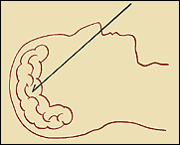
Mummification
In addition, Egyptians buried their dead with everything they would need for eternity. They used mummification to preserve dead bodies by embalming them.
The purpose of mummification was to give the soul the use of its body in the afterlife.
The Steps of mummification were:
Wash the body in good smelling soap.
2. Cut left side of body to remove internal organs and put in jars.
3. Remove the brain through the nostrils.
intestines
liver
lungs
stomach

Slide 9
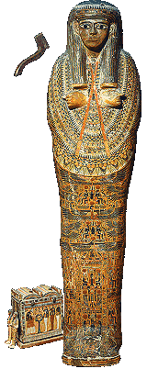
Mummification
Before the mummies were placed in their coffins, they had to be carefully wrapped.
The body is wrapped in fine linens from head to toe (even each individual finger and toe is wrapped!).
Then the arms and legs are tied together.
The mummy is then lowered into its coffin – usually there were 3 coffins for pharaohs.

Slide 10
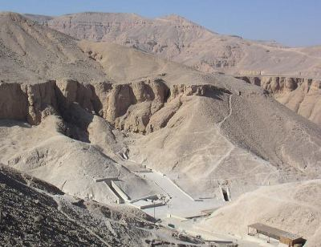
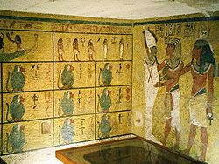
Pyramids and Valley of the Kings
Pharaohs were buried in pyramids during the Old Kingdom and the Valley of the Kings during the New Kingdom.
Inside the tombs of the pharaohs were elaborate wall paintings depicting the gods.
In addition, the pharaohs were buried with treasures to bring to the afterlife.
Tomb raiders stole most of the treasures from the pharaoh’s tombs in the Valley of the Kings.
However, one was left untouched – King Tut’s tomb.

Slide 11
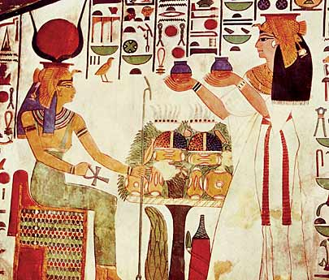
Life in Egypt
Like Mesopotamia, Egypt also used a class system.
The Pharaoh and ruling family was at the top of society.
Below the Pharaoh were the noblemen and priests. Followed by merchants, scribes, and artisans.
Most people were peasant farmers and slaves with a terrible life!
Egyptian women had a higher status and greater independence than other ancient civilizations.
They could do almost everything that men could do!
Notes:
http://dsc.discovery.com/videos/egypts-greatest-discoveries-daily-life-in-egypt.html

Slide 12
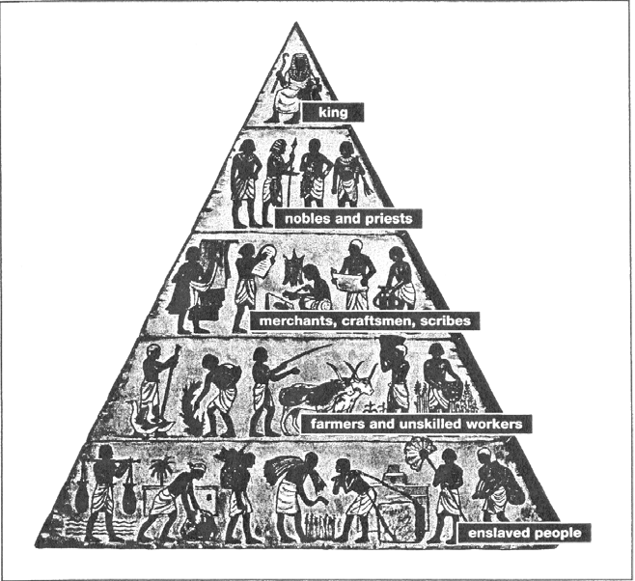

Slide 13
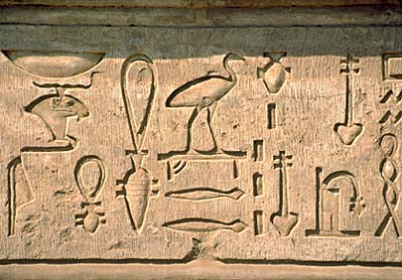
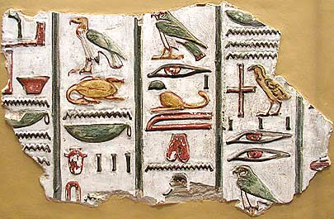
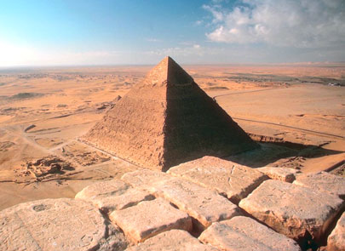
Egyptian Achievements
Ancient Egyptians developed a system of writing called hieroglyphics.
Hieroglyphics ~ used symbols or pictures to represent objects, or sounds.
In the early 1800s, Jean Champollion found the Rosetta Stone, which helped us decipher (or figure out) what each hieroglyph meant.
Egyptians also learned to make a paper-like writing material from papyrus, a plant that grows along the Nile.
Finally, Egyptians also contributed to medicine, astronomy, and mathematics.
Notes:
http://www.youtube.com/watch?v=ih3evm8XoSI&feature=related

Slide 14
Egyptian Pyramid Activity
The Ancient Egyptians took pride in their vast death and burial rituals. Being buried properly was essential to get into the afterlife. The Ancient Egyptians wanted to be buried with EVERYTHING they thought they mind need in order to help push them through to the afterlife. You will be creating your own pyramid for this activity.

Slide 15
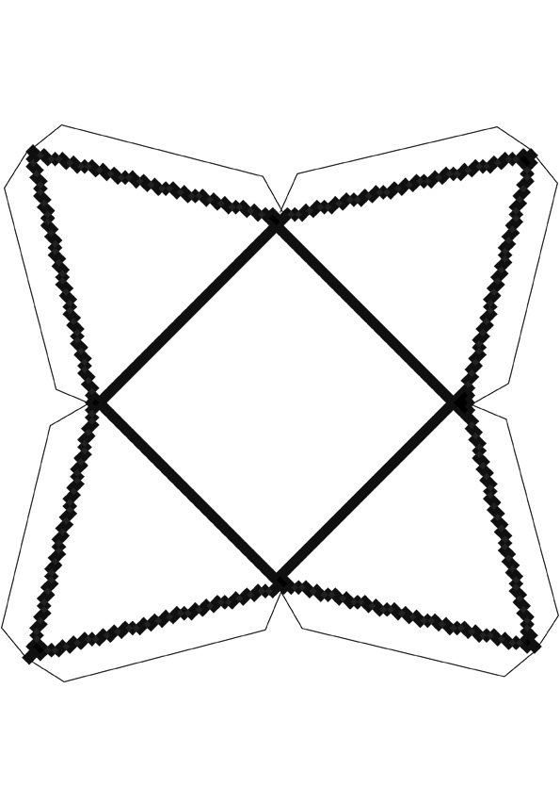
Pyramid instructions
1. Draw the things that are most valuable to you on the sides of the pyramid. (at least 4 items)
2. On a sheet of paper, write the corresponding number and tell what the object is and why it is important to you.
3. ON the Bottom of the Pyramid, write your epitaph (the quote you want on your gravestone in hieroglyphics).
Color and decorate the pyramid.

