Slide 1
TYPES OF CULTURE

Slide 2
Cultural Diversity
Cultural diversity: Wide range of cultural differences found between and within nations.
Caused By:
Natural circumstances: climate, geography
Social circumstances: Population or technology

Slide 3
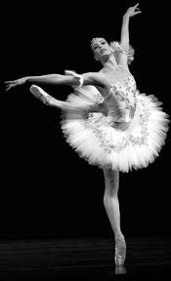
HIGH CULTURE
common meaning is the set of cultural products, mainly in the arts, held in the highest esteem by a culture
In the U.S. being “cultured” is often viewed as being international in scope.
it is the culture of an elite, wealthy, high class society
Ex-opera, ballet, theater

Slide 4
POPULAR CULTURE
“Pop” Culture: activities, products, and services that are assumed to appeal primarily to members of the middle and working classes.
“homegrown”
The media often dictates what is popular through the internet, films, music, and television
Pop culture is frequently encountered or widely accepted commonly liked or approved

Slide 5
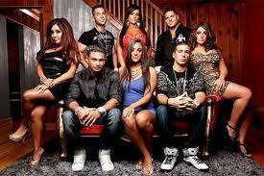
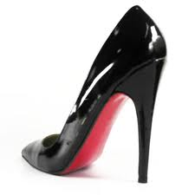
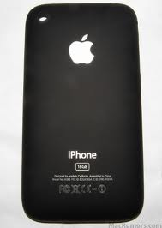
POPULAR CULTURE

Slide 6
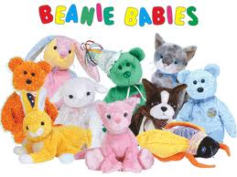
Types of Popular Culture
Fads:
Fashions:
A temporary, but widely copied activity followed enthusiastically by large numbers of people.
Ex. Object fad: Beanie babies!
Currently valued style of behavior, thinking, or appearance that is longer lasting and more widespread than a fad.
Ex. Clothing and music.

Slide 7
HOW DO WE UNDERGO CHANGE AS A CULTURE?
3 Ways:
Change in Technology
Acculturation
Diffusion

Slide 8
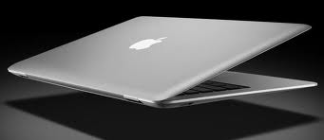
Technology
Change in Technology: the knowledge and tools people use to shape and mold our environment and practices is changed by technology.
This can happen in two ways:
Invention: inventing new technology that didn’t exist
Discovery: recognizing new phenomena and developing a new standard of things that already existed.

Slide 9
HOW DO WE UNDERGO CHANGE AS A CULTURE?
ACCULTURATION: modifying one’s own culture as result of contact with another (ex-Italians eat pasta, immigrate to the U.S. and it becomes a part of American culture)
DIFFUSION: spreading of items from group to group or society to society:
Ex: Exploration, military conquest, mission work, the mass media

Slide 10
Subcultures, Countercultures

Slide 11
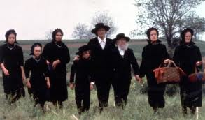
Subcultures and CounterCultures
People can give off cultural messages that make us feel like we belong or don’t belong. People who differ from the dominant culture or popular culture, often find reassurance in subcultures or counter cultures.

Slide 12
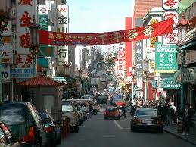
Defined
Subculture: category of people who share distinguishing attributes, beliefs, values, and or norms that set them apart in some significant manner from the dominant culture.
Counterculture: groups that strongly reject dominant societal values and norms and seek alternative lifestyles.

Slide 13
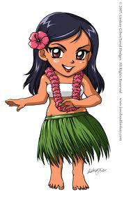
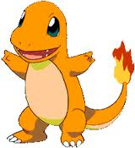
Subcultures
Distinctions can be based on anything:
Ethnicity
Religion
Region
Age
Hobby based

Slide 14
CREATE!!!
Get in Groups of 2! Only 2!
You may pick your groups, pick people with similar interests as you!
Your group is going to create a Subculture, fashion or a fad!!

