Slide 1
Triangular Trade and the Effects of Global Trade

Slide 2
Effects of Exploration
1. Read through the Effect of exploration you and your partner were assigned.
2. Decide how this effect can be visually represented.
3. Draw/Create the visual representation.
Also, explain how the effect is either positive or negative.
4. Present & Explain your visual to the class.

Slide 3
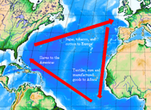
Triangular Trade across the Atlantic
What is Triangular Trade?
A three legged international trade network that links Europe, Africa, and the Americas.

Slide 4
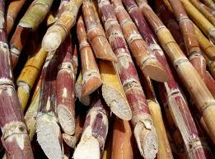
What did each Country have ?
Europe: guns, cloth, and cash
Africa: Slaves
The Americas: Sugar, molasses, cotton, furs, salt, and rum.

Slide 5
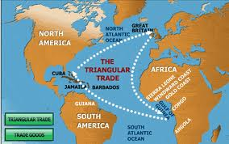
How did it work?
START: “first leg” Ships traveled from Europe with guns, cloth, and cash. They would give the resources to the leaders of African Tribes who would (in exchange) give them people.

Slide 6
Middle Passage
“Second leg” – Called the Middle passage, The people would leave Africa and travel to the Americas in poor conditions.

Slide 7
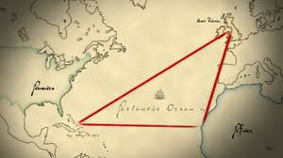
Final Leg
“final leg” The slaves were traded in the Americas for sugar, molasses, cotton, furs and rum. These resources were returned to Europe for the whole process to start over again.

Slide 8
Effects of Triangular Trade
Merchants grew extremely wealthy.
Although there were risks in investing in Triangular trade, the profit outweighed the risks.
Port cities developed

Slide 9
Effects of Triangular trade
However, For enslaved Africans, triangular trade was a horror.
Africa tribe leaders would capture them-
Men and women were bound with chains and forced to carry heavy loads.
Many captives died.
some tried to escape, but would be captured and beaten.
They were held in warehouses until the Europeans arrived.

Slide 10
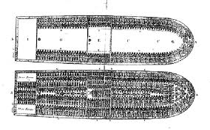
Middle Passage
Once aboard the ships, they were packed in every tightly.
Conditions were terrible and led to disease such as dysentery and smallpox.

Slide 11
Columbian Exchange
The transfer of food and resources led to many people migrating or moving to a new area.
This lead to disease spreading all over the world, and some populations significantly decreased (such as native Americans)

Slide 12
Impact of Trade
IN the 1500s, prices began to rise in Europe. However, there was much more money in circulation. A rise in the prices that is linked to a sharp increase in the amount of money available is called inflation.
This also led to European Capitalism: a system where businesses are owned privately.
The Idea of Mercantilism: you must export more than you import to be wealthy

