Slide 1
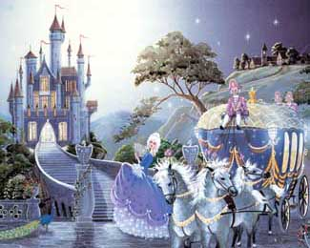
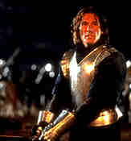
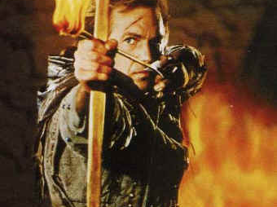
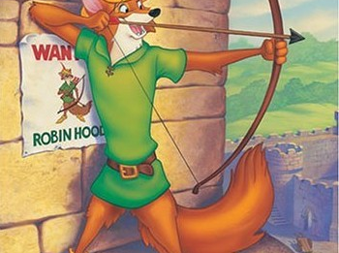
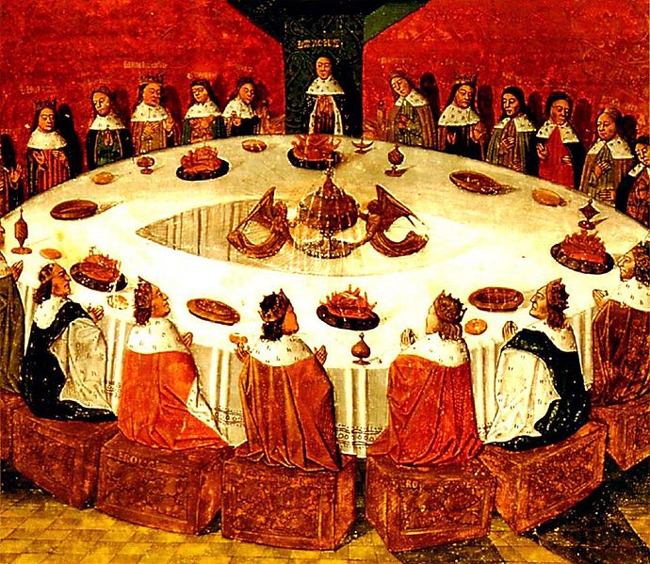
The REAL Feudal Life

Slide 2
In the Face of invasions by Vikings, Muslims, and Magyars; Kings and emperors were too weak to maintain law and order. People needed protection for themselves, their homes, and their lands. IN response to this basic need for protection, a decentralized Political structure evolved called Feudalism.
Feudalism: a loosely organizes system of rule in which powerful local lords divide their land holdings among lesser lords. In exchange these lesser lords or vassals would pledge service and loyalty to the greater lord.
TASK: Read the role you were assigned and fill in the chart for that person’s duties and responsibilities in a feudal society.

Slide 3
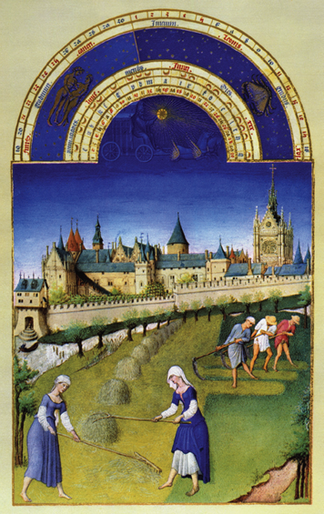
Feudalism 101
During the Middle Ages, Kings were too weak to maintain law and order. People needed protection for themselves, their homes, and their lands. This led to the development of feudalism.
Feudalism – legal and political system that governed European life during the Middle ages.
Feudalism created a highly structured society which included:
Monarchs – powerful Kings and Queens
Lords – nobles (Dukes and Counts) who owned large fiefs (lands)
Vassals - lesser lords
Knights – mounted warriors
Peasants – people bound to the land.

Slide 4
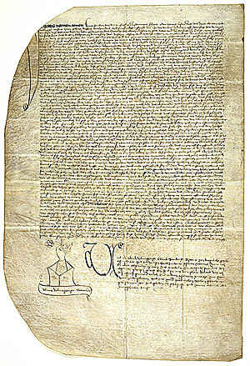
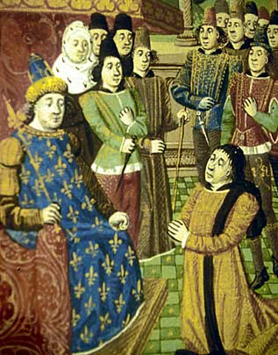
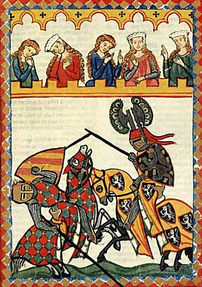
How Feudalism Worked
#1 A Feudal Contract (an agreement) was written between lords and vassals (lesser lord).
The lord would give his vassal a fief, or estate, and peasants to work the land. In return, the vassal pledged loyalty and military service to his lord.
#2 Lords would have knights to defend their lands and castle.
Knights lived by a code of conduct, called Chivalry. This required knights to be brave, loyal and true.
Knights also participated in jousting tournaments, or mock battles, for entertainment.

Slide 5
The Ten Commandments of the Code of Chivalry
From Chivalry by Leon Gautier
2. Thou shalt defend the Church...
3. Thou shalt respect all weaknesses, and shalt constitute thyself the defender of them...
4. Thou shalt love the country in the which thou was born…
5. Thou shalt not recoil (give up) before thine enemy…
8. Thou shalt never lie, and shall remain faithful to thy pledged word…
9. Thou shalt be generous, and give largess to everyone...
10. Thou shalt be everywhere and always the champion of the Right and the Good against Injustice and Evil...

Slide 6
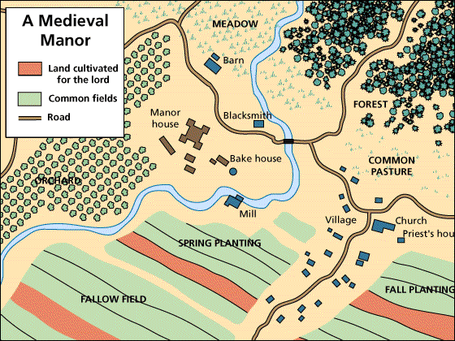
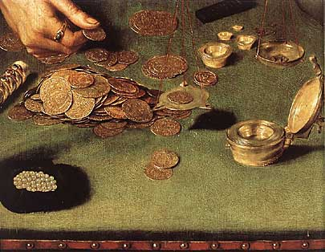
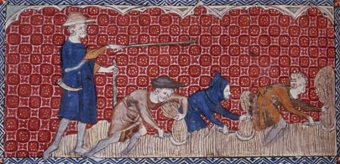
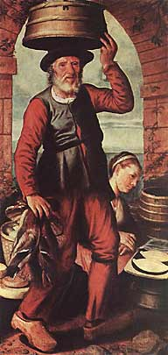
#3 Peasants lived and worked on the manor, or lord’s estate. The manor included the village and surrounding lands.
Peasants were required to work the lord’s land and pay taxes and rent to the lord, and in return the lord protected the peasants and provided food, housing and land to the peasants.
The peasants who lived on a manor produced almost everything that was needed, from food and clothing to furniture and tools.
Most peasants never ventured more than a few miles from their village during their lifetime!!
Peasants lived a very difficult life and rarely lived past the age of 35…

Slide 7
Feudalism Quick Demo!!
First, find your role on your name tag.
L = Lord V = Vassal P = Peasant Queen = Mrs. Crooks
It has been a good year, and every peasant has reaped a healthy harvest!! Good Work Peasants! You will get 5 pieces of Candy!
However, all peasants have to pay the vassal for his protection. Vassals collect 3 pieces of candy from the peasants!!
However, the vassals have to pay the lord as a demonstration of your loyalty. Vassals keep 1 piece of candy and give the lord the rest!!
Lords also have to demonstrate their loyalty and service to the King. Lords pay the Queen two pieces of candy!!
Who benefits from this feudal system? Who suffers due to this feudal system?

Slide 8
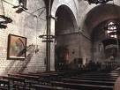
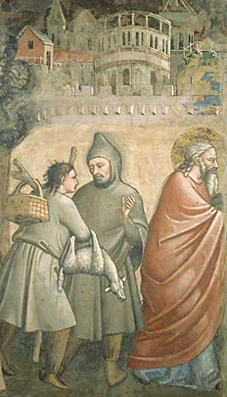
The Church
The Christian church was the center of Medieval Life!!! It provided stability and unification to Europe during the Middle Ages.
Each village had a parish priest who gave mass and provided sacraments, or the sacred rights of the church, to the people.
Christians believed the sacraments would lead them to salvation, or everlasting life with God.
The church was a social center and place of worship during the middle ages.
Villages took pride in their church and Christians were required to pay a tithe, or tax of 10% of their income to the church.
Larger cities had larger churches, called Cathedrals with flying buttresses (Gothic Style).

Slide 9
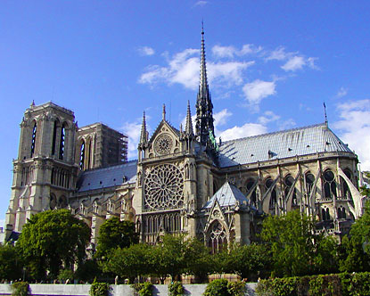

Slide 10
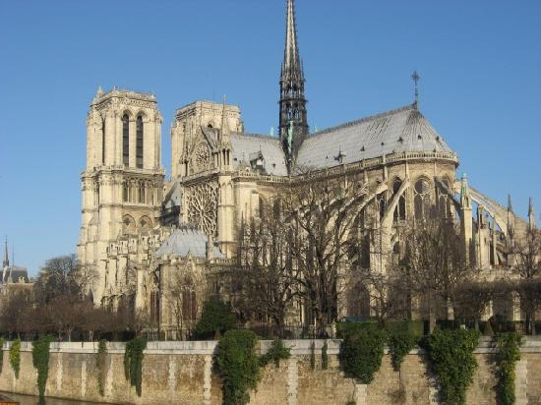

Slide 11
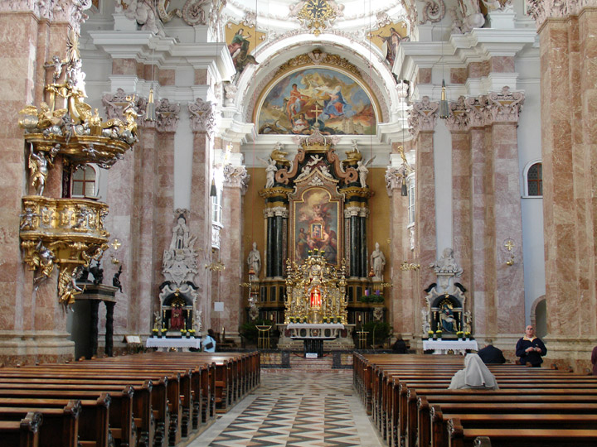

Slide 12
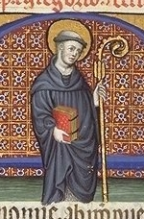
Monasteries and Convents
During the Middle Ages, men and women left everyday life to become monks and nuns. They devoted their entire lives to spiritual goals in monasteries and convents.
Monks and nuns followed Benedictine Rule and followed 3 rules:
#1 Obedience to the abbot or abbess
#2 Poverty
#3 Chastity (Purity)
The monasteries and convents provided basic services to people including care for the sick and poor, shelter to the poor, and schooling.

Slide 13
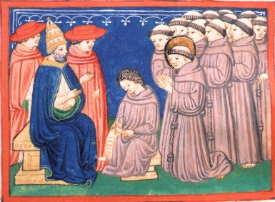
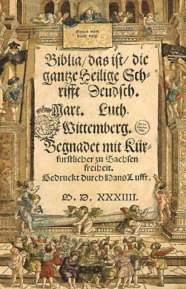
Church Power and Corruption
After the fall of Rome, the church became the most powerful secular (worldly) force in medieval Europe.
The Pope was the spiritual leader of the Western world. Medieval popes claimed Papal Supremacy or authority over all secular rulers including Kings and Emperors.
Church power was further strengthened by Cannon Law. Cannon law was based on religious teachings and governed most aspects of life.
Penalties for breaking Cannon Law included:
Excommunication – could not receive sacraments, no Christian burial, condemned to Hell for eternity.
Interdict – an order stopping sacraments for an entire town, region, or Kingdom.

