Slide 1
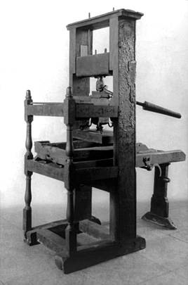
The Printing Press
By the 1400s, the Renaissance had spread from Florence to Northern Europe.
The invention of the printing press by Johann Gutenberg in 1455 helped spread the Renaissance.
Printed the first complete edition of the Bible using a printing press with moveable type.
Made printing books cheaper and easier to produce.
As printing presses were established in Italy and other parts of Europe, printed books exposed educated Europeans to new ideas and new places. Therefore, helping spread he Renaissance.

Slide 2
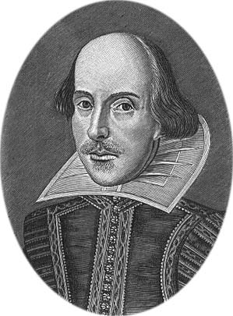
The Northern Renaissance
The Northern Renaissance began in the city of Flanders.
Like Florence, Flanders was a center of trade in northern Europe.
Famous Northern Renaissance artists:
Jan Van Eyck: painter
Albrecht Durer: painter; “Leonardo of the North”
Sir Thomas More: writer; Utopia described an ideal society
William Shakespeare: playwright; wrote 37 plays including Romeo and Juliet, Midsummer Night’s Dream, Hamlet, MacBeth, and many more!

Slide 3
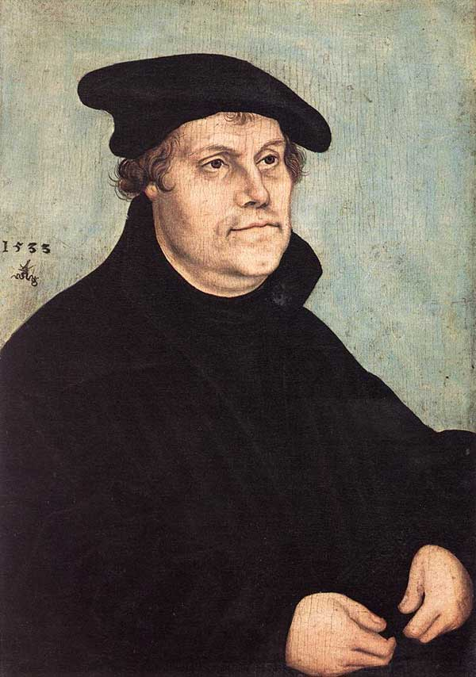
The Protestant Reformation

Slide 4
Background to the Reformation
During the 1500s, the northern renaissance sparked a religious upheaval.
Northern Europeans faced a great deal of uncertainty in their lives.
People were poor
Life was violent
Many people wanted a better life and used Humanist ideas to question the church.
These ideas spread quickly because of the printing press.

Slide 5
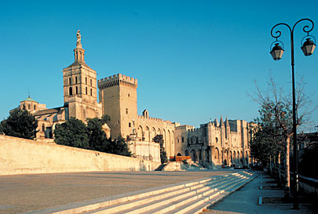
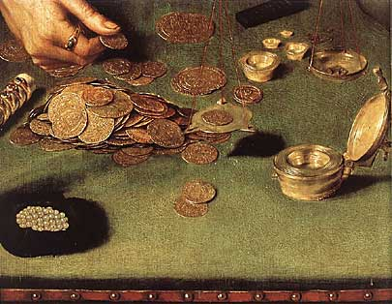
Church Abuses
Problems in the church began in the Middle Ages.
Fought with Kings and Emperors
Crusades (holy wars)
Church was selling indulgences to “pay” for its extravagant churches and lifestyle.
Indulgences = pieces of paper that people could buy to have their sins forgiven.

Slide 6
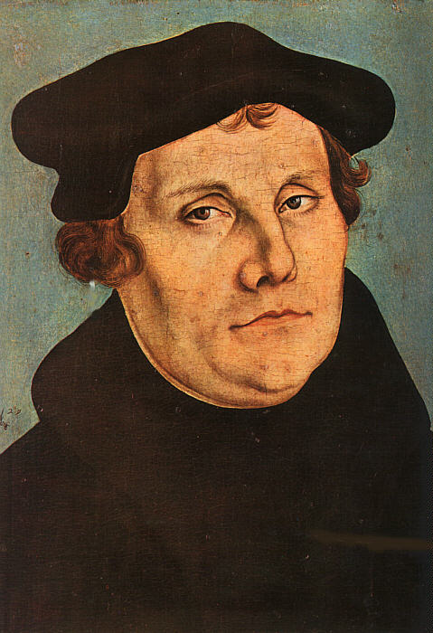
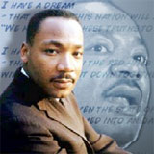
Protestant Reformation
In 1517, protests against church abuses erupted into a HUGE revolt.
The revolt was started by a German named Martin Luther.
NOT Martin Luther King Jr. (although named after the German monk).
Luther was a Catholic monk who was troubled with the Catholic Churches teachings and behavior.
Priest in Wittenberg Germany was selling indulgences to any one who contributed money for a new cathedral.
Luther was outraged!

Slide 7
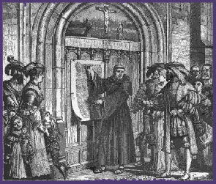
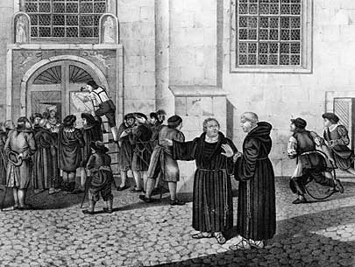
95 Theses
To express his anger with the church Luther wrote the 95 Theses (October 31, 1517).
95 Theses = list of grievances (complaints) about the Catholic church.
Called for reforms!!
Posted on the door of Wittenberg’s All Saints Church.

Slide 8
Luther’s Arguments in Theses
Luther made 3 primary arguments:
Luther disagreed that people could “purchase” forgiveness and salvation.
Luther believed that the pope had no authority to release people from purgatory.
Luther believed -salvation was achieved through “faith alone” and not through good works or through purchasing indulgences.

Slide 9
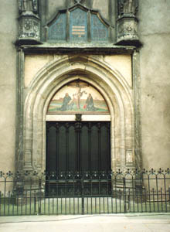
A Church Firestorm!
Luther’s ideas and copies of the 95 Theses spread quickly because of the invention of the printing press.
The Church and Emperor were furious!
In 1521, Pope Leo X excommunicated Luther.
Emperor Charles V declared Luther an outlaw making it a crime for anyone to give him food or shelter.
Still Luther continued…

Slide 10
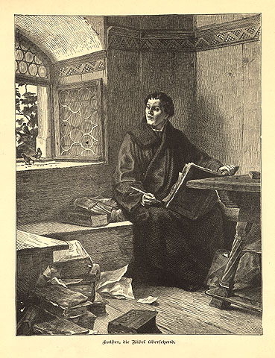
Luther’s Teachings
Four Beliefs of Lutheranism:
Achieve salvation through faith and the Bible.
Only god can provide sacraments, not priests.
Bible alone is the source of truth.
Ordinary people should read and interpret the bible.

Slide 11
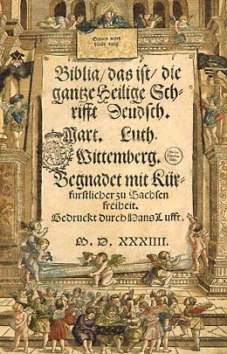
Lutheranism Spreads
New printing press spread Luther’s bible and ideas throughout northern Europe.
VERY IMPORTANT!! – Before, Bibles were only in Latin, so only clergy could read them.
Now the Bible was written in the common language of the people (German) so everyone could read the Bible.
By 1530, there was a new church called the Protestant Church.
Many peasants and kings became protestant.

Slide 12
Other Protestant Reformers
John Calvin
Believed in “predestination” – idea that God had long ago pre-determined who would gain salvation.
Followers were called “Calvinists”.

