Slide 1
The Sociological Imagination

Slide 2
Sociological Imagination
What is it?
A term to describe the desire to understand people in terms of the intersection of their own lives (their biographies) and their larger social and historical context (in history).
What is the connection between personal problems and social issues?
Remember our discussion on overspending…
Why is it important to understand the connection?

Slide 3
Get back into groups of 2-3 people… Continue this activity on the “Schools of Sociology” activity sheet… This heading will read “The Sociological Imagination”…

Slide 4
In your groups…
Each group will receive an index card with an issue written on it…
Answer the following questions regarding your issue to practice developing sociological imagination..
How can this issue be a personal problem? How is it a public issue?
How can geographic location impact how a person views this issue?
How could factors such as race, religion, gender, and/or socioeconomic status impact how an individual views this issue? How a community views the issue?
Think of a current or historical example to support your findings.

Slide 5
Picture Analysis
View each of the following pictures and answer the questions to analyze the pictures using your sociological imagination.
Give evidence and support for each answer
What era or decade was this photograph taken?
Where do you think the photograph was taken?
What event or action do you believe the photograph depicts?
What emotion(s) are being conveyed in the photograph?

Slide 6
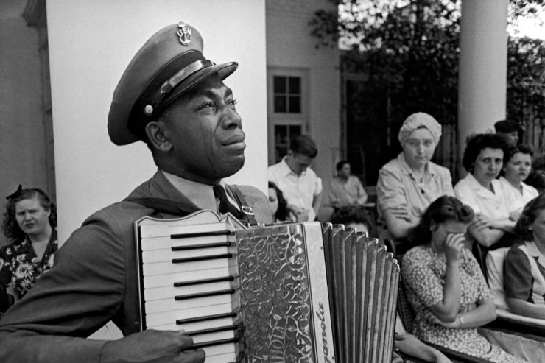

Slide 7
Weeping for FDR: In a Classic Photo, The Face of a Nation’s Loss
Tears of grief stream down the cheeks of Chief Petty Officer (USN) Graham Jackson as he plays "Goin' Home" on the accordion in Warm Springs, Georgia. President Franklin D. Roosevelt's flag-draped casket is passing, headed for the presidential train and its journey back to Washington, April 13, 1945. Read more: Weeping for FDR: In One Classic Photo, the Face of a Nation’s Loss | LIFE.com http://life.time.com/history/death-of-fdr-in-a-classic-photo-the-face-of-a-nations-loss/#ixzz2rLAgUd6U

Slide 8
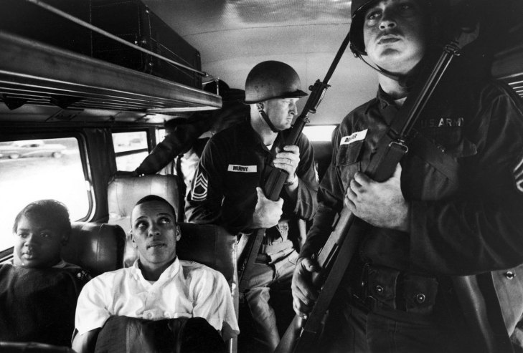

Slide 9
Martin Luther King, JR. and the Freedom Riders: Rare and Classic Photos
Not published in LIFE. Julia Aaron and David Dennis, along with 25 other freedom riders and several members of the National Guard, travel from Montgomery, Ala., to Jackson, Miss. Read more: Martin Luther King Jr. and the Freedom Riders: Rare and Classic Photos | LIFE.com http://life.time.com/history/martin-luther-king-jr-and-the-freedom-riders-rare-and-classic-photos/#ixzz2rLBrZ7rr

Slide 10
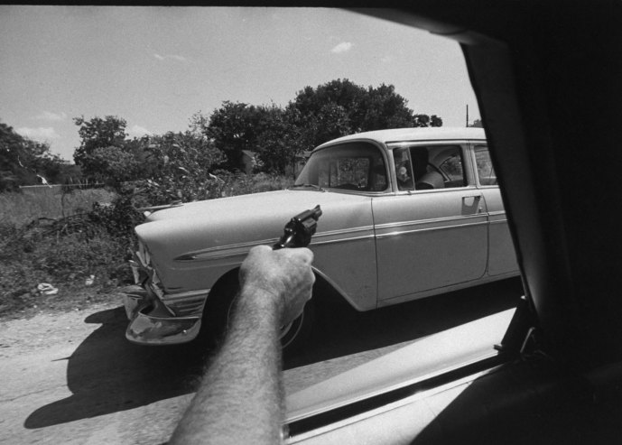

Slide 11
What America’s War on Drugs Looked Like in 1969
A U.S. Customs agent points his gun at a car suspected of transporting marijuana, 1969. Read more: Marijuana in the Pages of LIFE in 1969: To Legalize or Not to Legalize | LIFE.com http://life.time.com/culture/marijuana-in-the-pages-of-life-1969-to-legalize-or-not-to-legalize/#ixzz2rLBW8nY1

Slide 12
Discussion
How did you use your sociological imagination to analyze these photographs?
Why is sociological imagination important for sociologists to use?
How will sociological imagination help you understand the study of sociology?

