Slide 1
Bellringer: Matching 3-19-13
1. Wrote many plays including “Romeo and Juliet”
2. Wrote “Utopia”
3. Wrote “The Prince”
4. Painted The last supper
5. Painted The School of Athens.
6. Painted the Sistine Chapel ceiling.
A. Niccolo Machiavelli
B. Sir Thomas More
C. Leonardo Da Vinci
D. William Shakespeare
E. Michelangelo
F. Raphael

Slide 2
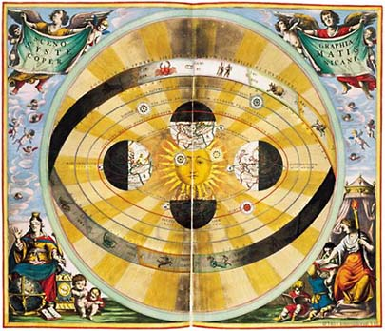
Scientific Revolution

Slide 3
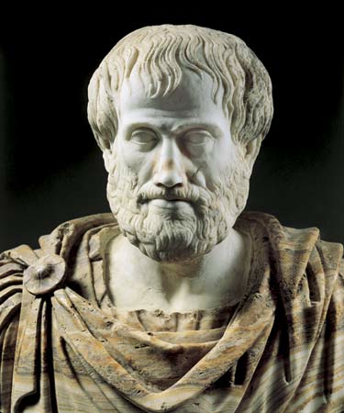
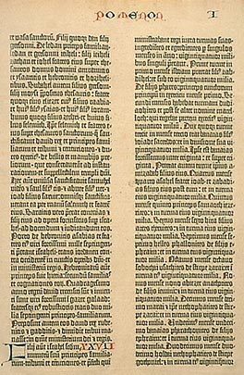
Scientific Revolution
Scholars during the 1500s, began to question classical scientific ideas and Christian beliefs. This became known as the Scientific Revolution.
Revolution = Major Change
During this time period, people in Europe began to change the way they thought about the world.
Old way of Scientific thinking was based on the Bible and Aristotle
Aristotle thought the earth was the center of the Universe.
Nobody questioned him for 2,000 years!!
- New way of Thinking used reason and logic (not just faith) to explain the world.

Slide 4
Scientific Method
During the scientific revolution, a step by step process that required scientists to collect and accurately measure data evolved called the Scientific Method.
Steps of the Scientific Method:
State the Problem
Gather information about the problem
Form a hypothesis – an educated guess
Experiment to test the hypothesis
Collect, record, and analyze data.
Draw Conclusions
Share your conclusions and answer questions.

Slide 6
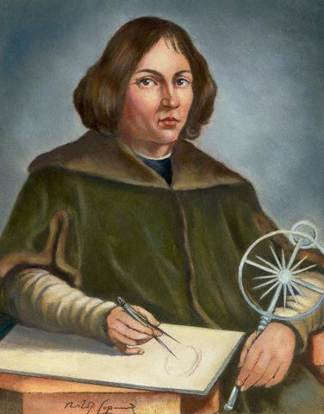
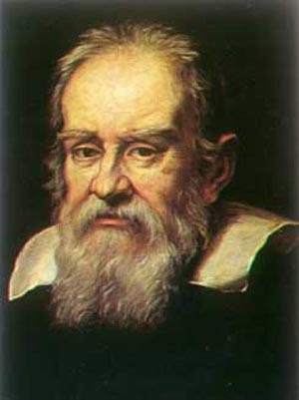
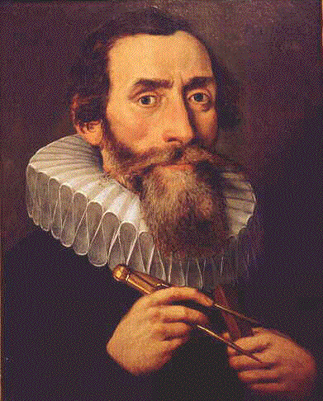
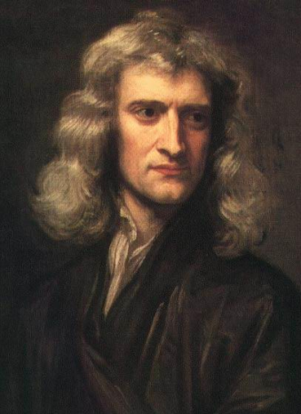
4 Scientists Made Discoveries That Changed the World
Copernicus
Galileo
Kepler
Newton

Slide 7
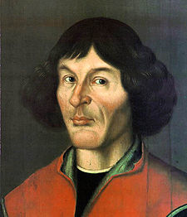
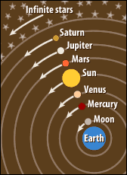
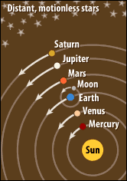
Copernicus (1543)
Main Theory:
Wrote the Revolutions of the Heavenly Spheres in 1543.
The universe is heliocentric and revolves around the sun and not the Earth.
Most people STILL did not believe him!!
Tycho Brahe = a Danish astronomer provided evidence that supported Copernicus’s theories.

Slide 8
Johannes Kepler (1550s)
Main Theory:
Planets move in orbits that are elliptical (oval) not round.

Slide 9
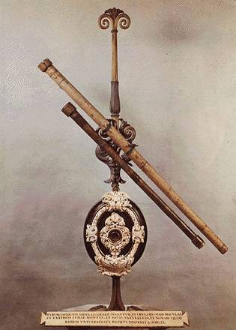
Galileo
Main Theory:
Galileo built the first telescope and studied the planets and moon.
Telescope = magnifies distant objects and is used to study the skies (astronomy)
Galileo’s Theories caused an uproar with the church!

Slide 10
Galileo’s Trial (1633)
The church condemned Galileo because his ideas challenged the Christian teaching that the heavens were fixed in position to the Earth.
In 1633, Galileo was tried before the Inquisition.
Sentenced to house arrest and silence
Threatened with death unless he said his theories were wrong (even though they were not!)

Slide 11
Isaac Newton (1687)
Main Theory:
Discovered the force of gravity.
Used math to prove that gravity keeps the planets in their orbit moving around the sun.
The greatest scientist who ever lived

Slide 12
Other Important People…
Vesalius – human anatomy
William Harvey – circulation of blood
Leeuwenhoek – microscope to see human cells and microorganisms.
Robert Boyle - chemistry

Slide 13
Consequences of Scientific Revolution
Community of scientists formed
Royal Society
Papers were read and published
Scientists subjected to critical audience
Science accepted as the preferred method of getting "truth"

Slide 14
How does this tie into humanist thinking?

