Slide 1
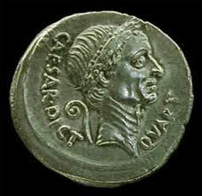
The Roman Empire

Slide 2
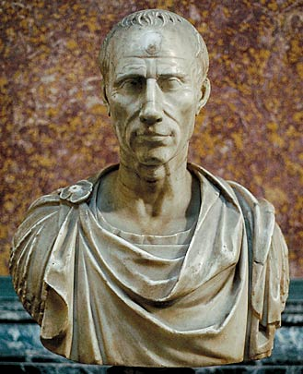
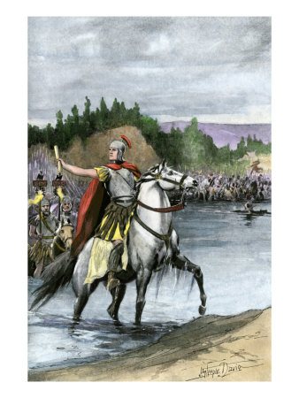
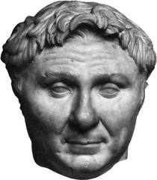
Julius Caesar
Rome plunged into a series of Civil Wars
Out of the chaos emerged Julius Caesar
Caesar was a brilliant military commander who conquered Gaul (Belgium and France)
He had many victories and added to Rome’s size and riches.
Caesar’s rival was Pompey because Pompey feared Caesars fame.
Caesar defeats Pompey and then travels around the Mediterranean suppressing (stopping) rebellions.
“Veni, Vidi, Vici” – meaning I came, I saw, I conquered

Slide 3
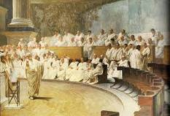
Caesar Changes Rome
Caesar returned to Rome after his successful conquests and forced the Senate to make him Dictator, or the absolute ruler of Rome.
Caesar made many reforms to Rome:
Reorganized the Government
Developed the Julian Calendar
Gave land to the poor
Public works to employ the jobless

Slide 4
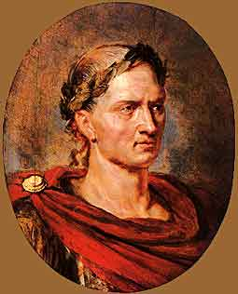
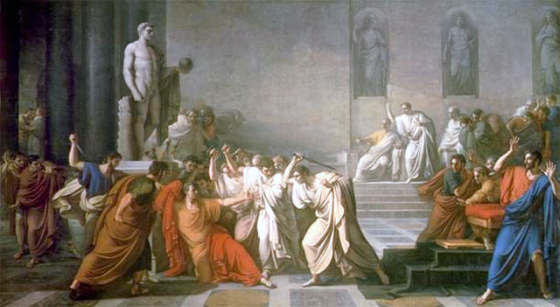
Caesar is Killed!
Caesar’s enemies worried that Caesar planned to make himself King of Rome.
So…they planned to assassinate him.
March 44 B.C., Caesar arrived in the Senate and his enemies stabbed him to death.
Becomes known as the “Ides of March”

Slide 5
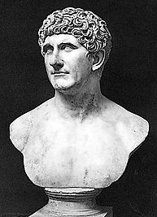
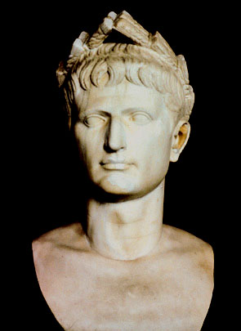
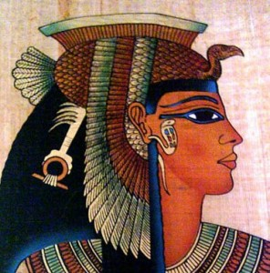
Revenge!
New civil wars erupt as a result of Caesar’s death.
Mark Antony and Octavian join to hunt down the murders and seek revenge.
Mark Antony and Octavian begin to fight (possibly over a beautiful Egyptian Queen named Cleopatra)
Begins a bitter struggle for power
In 31 B.C. Octavian defeats Mark Antony and Cleopatra.

Slide 6
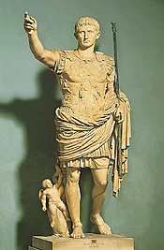
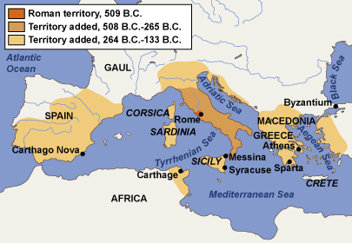
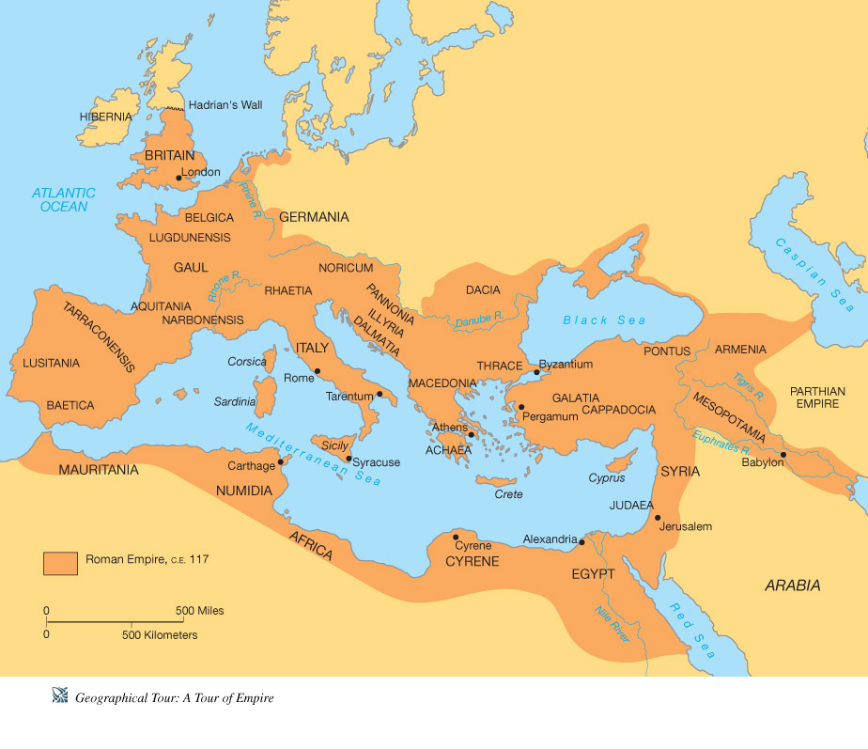
Age of Augustus
Senate gave Octavian the title of Augustus, meaning exalted one.
While Augustus was not a “King” he had absolute power and named his successors.
Under Augustus, the republic became an empire!!

Slide 7
Governing the Empire
Augustus laid the foundation for a strong and stable government.
Ruled by an Emperor who inherited power, served for life, and was worshipped as a god after death.
Senate which had 600 members and wrote laws, acted as a court, and elected magistrates.
Created a more fair tax system using the census, or population count, for the empire to know who should pay taxes.

Slide 8
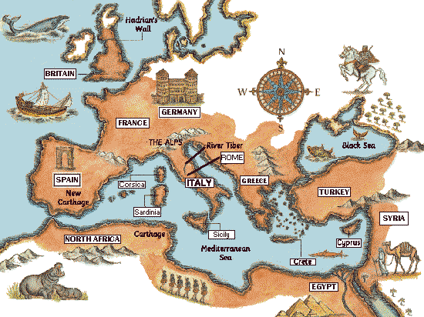
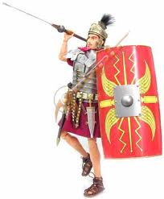
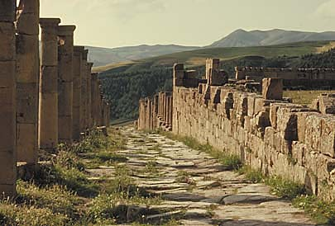
Pax Romana
The 200 year period that began with Augustus is known as the period of the Pax Romana, or “Roman Peace.”
During this period there was peace, order, unity, and prosperity across the Roman Empire.
The Empire stretched all the way to Great Britain!
Roman roads were built to increase trade
Roman legions maintained and protected the empire.
Roman Laws, called the Roman Code, were codified by Hadrian.

Slide 9
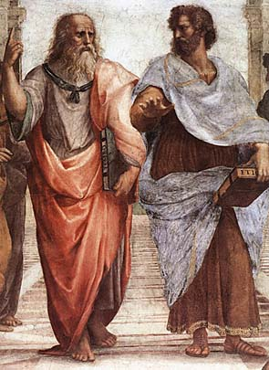
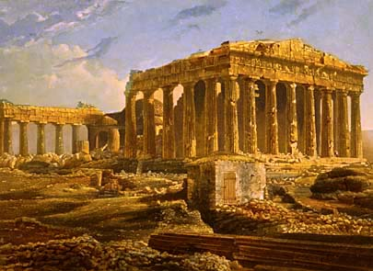
Greco-Roman Culture
Rome absorbed many ideas from the Greek colonists that lived in Southern Italy.
To the Romans, Greek art, literature, and philosophy, and scientific genius represented the height of cultural achievements.
The Romans adopted Greek and Hellenistic Achievements.
The blending of Greek, Hellenistic, and Roman traditions produced what is known as the Greco-Roman civilization
Trade and travel during the Pax Romana helped spread this new civilization.

Slide 10
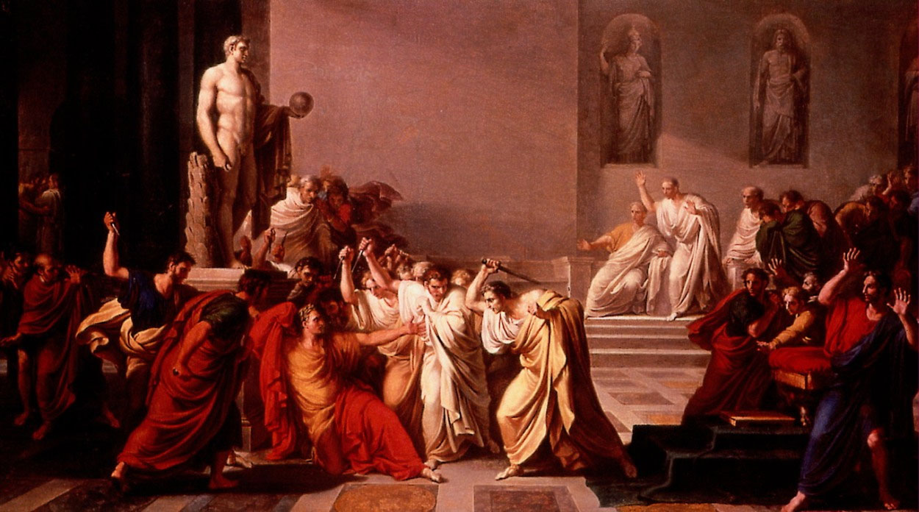
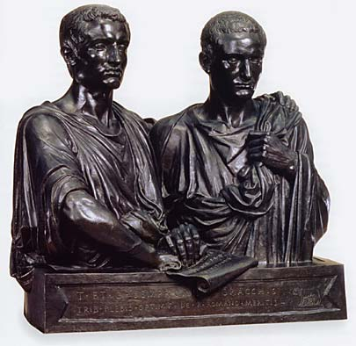
Problem of Power
However, there was one serious problem:
Who would rule after an emperor died?
Romans did not believe in passing power from father to son
This led to intrigue, violence, and some pretty terrible Emperors!

Slide 11
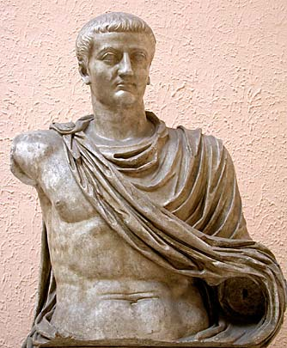
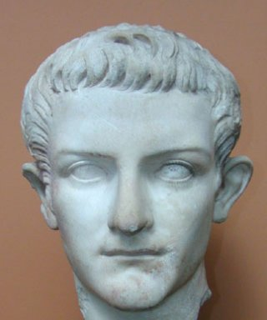
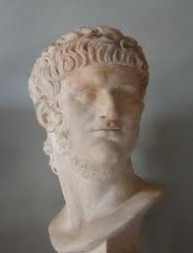
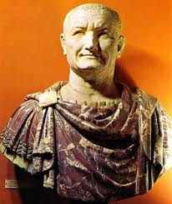
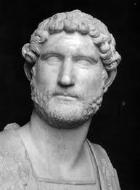
The Good, the Bad, and the Ugly…
Tiberius
Not the preferred son, very jealous
Caligula
Evil and perhaps insane
Nero
Sensitive, Handsome, Wild, and Murderer
Vespasian
Restored law, order and self-respect to Rome
Codified Roman Law
Built Hadrian’s Wall in Britain
Hadrian

