Slide 1
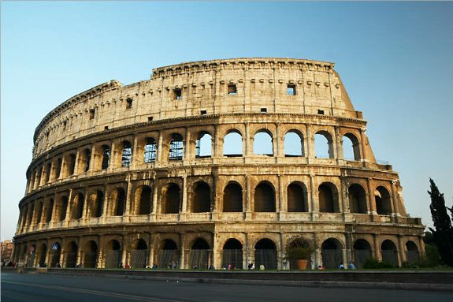
The Romans!

Slide 2
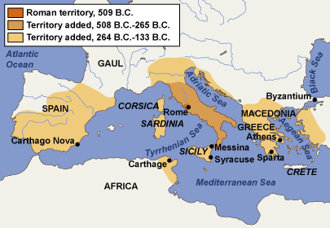
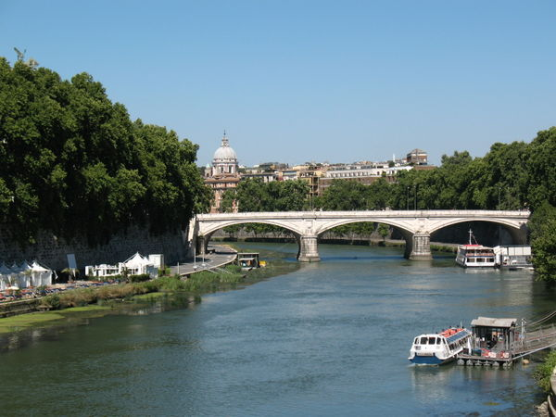
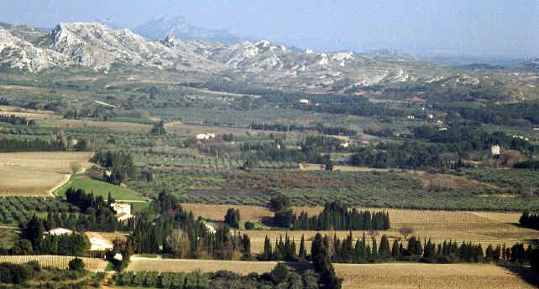
Geography of Rome
Rome is located on the Italian Peninsula in Southern Europe.
Remember a peninsula is land surrounded by water on 3 sides.
Rome is located between the Tiber River and the Mediterranean Sea. Because of it’s location on the water, Rome became an important center for trade.
Like Greece, Rome was surrounded by hills and mountains that protected it from attack.
However, it was easier to unify than Greece because the mountains are much smaller.
Rome is located on a fertile plain that was good for farming – this helped support a growing population!

Slide 3
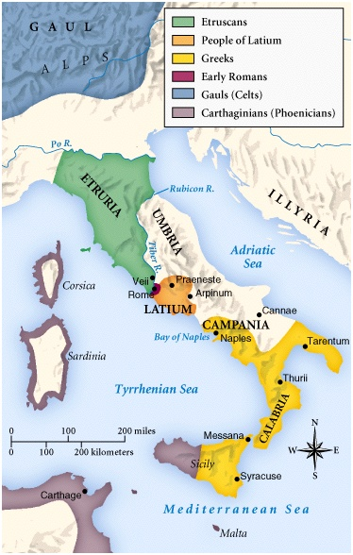
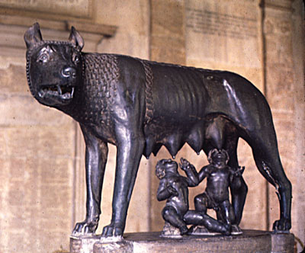
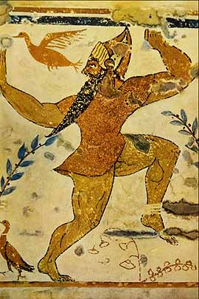
Early People of Rome
Around 800 B.C., the Latins (ancestors of Romans) migrated into Italy. They settled along the Tiber River where they herded and farmed.
The Latin villages eventually grew into Rome, the “City on Seven Hills.”
Legend says that Romulus and Remus founded the city. Romulus and Remus were said to be the sons of the God Mars – giving Rome divine origins.
Romans shared the peninsula with the Etruscans and the Greeks.
Romans learned a great deal from the Greeks – adapting their alphabet, engineering techniques, and religion.

Slide 4
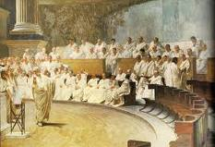
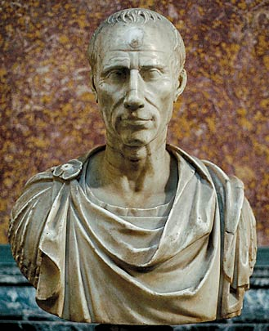
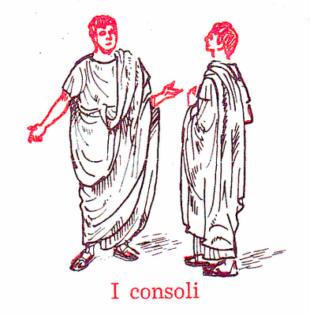
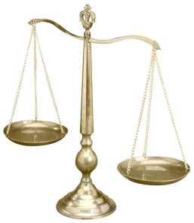
The Roman Republic
The Etruscans were driven out of Rome in 509 B.C. and the Romans founded a form of government called a Republic.
Republic ~ form of government in which people chose some of the officials in government (a form of Indirect Democracy!!).
The Republic consisted of:
1. Senate and Assembly – law-making body – ONLY allowed patricians.
Patricians – the rich landowners of Roman Society (only 10% of all Romans).
2. Consuls – 2 consuls supervised government and commanded the armies - originally only patricians could be consuls!!
3. Dictator – ruler selected by the Senate in times of war.
Julius Caesar was the most famous Roman Dictator.
4. Judges – 8 judges oversaw the courts and governed

Slide 5
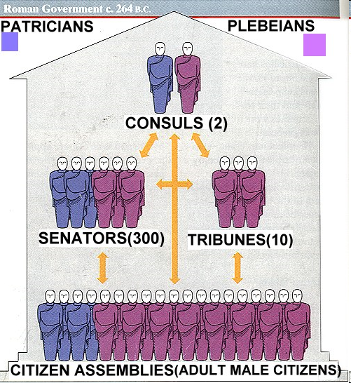

Slide 6
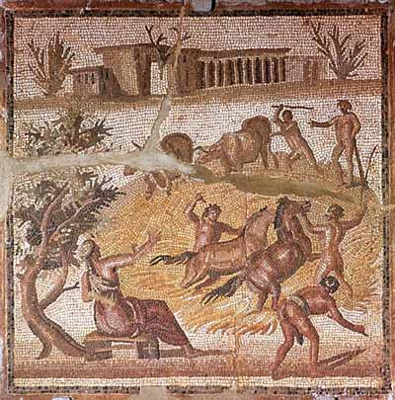
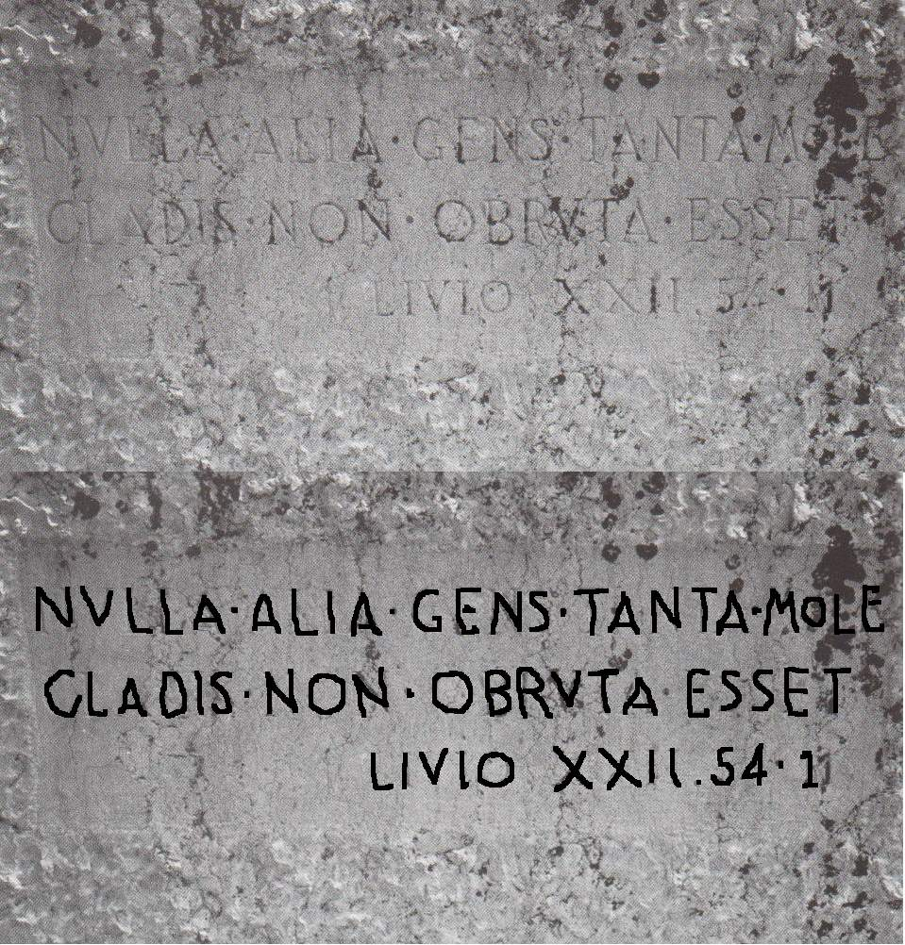
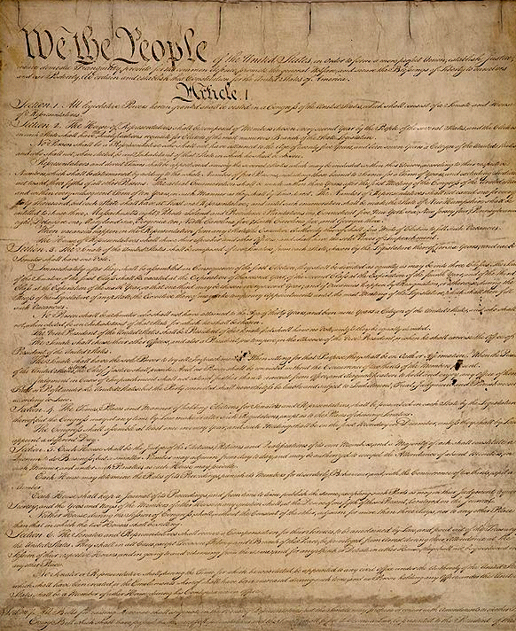
The Plebeians
Plebeians were middle class workers and farmers (90% of population).
In the beginning, Plebeians had no rights and were treated very poorly.
In time, the Plebeians gained the right to elect people to represent them in government called Tribunes.
The Tribunes had the power to veto, or block the laws that were harmful to the plebeians.
If the Greeks were known for Government, Romans were known for LAWS!
The Twelve Tables –(450 B.C.) first Roman laws written down.
Gave Plebeians more power and rights!
Later the U.S. Constitution would adopt many Roman ideas like the Senate, veto, and checks and balances (no branch has too much power).

Slide 7
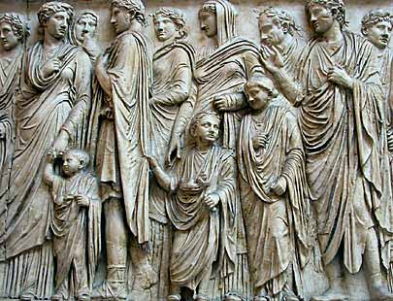
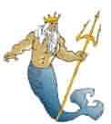
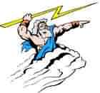
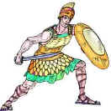
Life in the Roman Republic
The Roman Family
According to Roman Law, men had absolute power over the family. He used strict discipline and demanded total respect.
Roman women had more power than Greek women - could own property, start a business, and (eventually) influenced politics.
Unlike the Greeks, Romans educated ALL children.
Roman Religion
The Romans were polytheistic, believing in many gods. Most of their gods were adapted from Greek religion:
Jupiter ~ chief god; god of the sky
Neptune ~ god of sea.
Venus ~ goddess of love.
Mars ~ god of war.

Slide 8
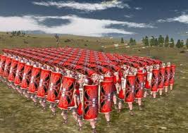
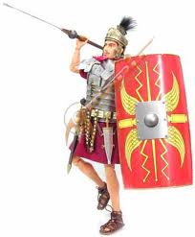
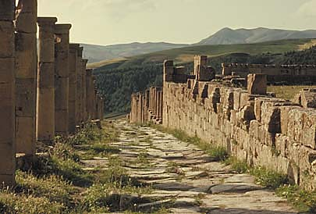
Roman Conquest
By 270 B.C., Rome drive out the Etruscans & Greeks from Italian Peninsula and started a campaign to conquer other lands.
Roman success was due to skillful diplomacy and a well trained army called a Legion.
Legion - military unit consisting of about 5,000 citizen soldiers.
To unify their growing empire, Romans treated their defeated enemies nicely. They allowed their captives to keep their own customs, money, and government.
They also gave captives full citizenship – making them loyal to Rome.
Finally, they built the (Roman) roads to keep communication between the Empire and distant lands.

Slide 9
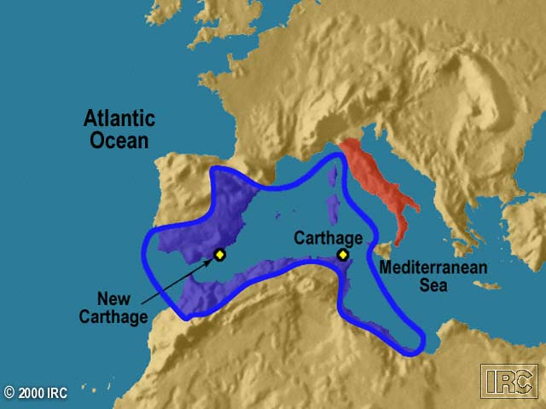
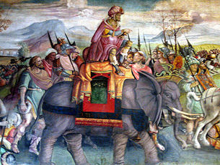
The Punic Wars
Rome’s conquest of the Italian Peninsula in 270 B.C. led to conflicts with a city-state in Northern Africa called Carthage.
Between 264 B.C. and 146 B.C., Rome fought 3 wars against Carthage called the Punic Wars.
Punic Wars
1st Punic War = Roman Wins and gains lands (Sicily, Sardinia, and Corsica)
2nd Punic War = Carthage wants revenge and appoints General Hannibal – but Rome Wins again!
3rd Punic War = Rome wins and completely destroys Carthage. Rome now controls ALL of the Mediterranean.
Rome begins a policy of imperialism – controlling foreign lands and people.

Slide 11
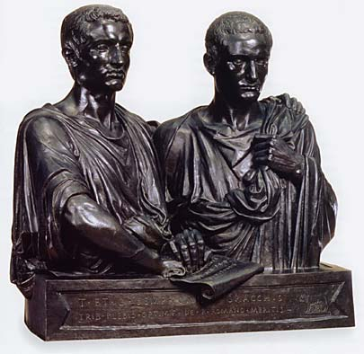
Fall of Roman Republic
As a result of the Punic Wars, many people in Rome became very rich. The rich people built huge estates, called Latifundia, and bought slaves to work their lands.
The latifundia hurt small farmers and resulted in many landless and homeless farmers – this led to conflict between Romans.
Two young patricians, Tiberius and Gaius Gracchus, tried to make reforms and give the poor farmers land, but angry riots broke out and they were killed.
Rome was unable to resolve its problems and many civil wars began.
From the chaos arose Julius Caesar, an ambitious military commander.

