Slide 1
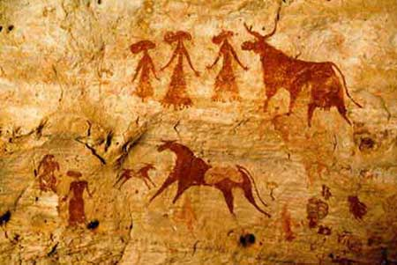
The Neolithic Revolution

Slide 2
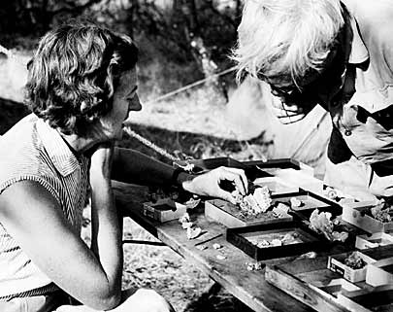
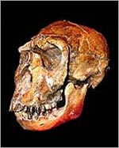
Prehistory and Hominids
Prehistory is the time period before writing.
Mary and Louis Leakey made many discoveries in Africa of hominid remains.
After the discovery of “Lucy” many other hominids were discovered including Homo Habilis, Homo Erectus, Homo Sapiens, Neanderthals and Cro-Magnon (Modern Humans).
This long period from 2 million B.C.E. to 10,000 B.C.E. is called the Old Stone Age, or Paleolithic Period.

Slide 3
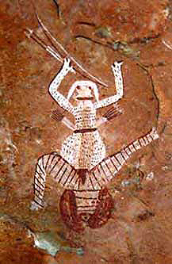
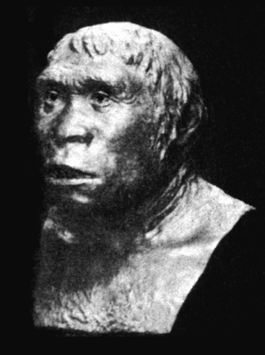
Paleolithic Period vs. Neolithic Period
Historians and scientists have divided prehistory into two eras: the Paleolithic Period and the Neolithic Period.
The Paleolithic Period, or Old Stone Age, is from at least 2 million B.C.E to about 10,000 B.C.E
The Neolithic Period, or New Stone Age, is from 10,000 B.C.E until the end of prehistory.

Slide 4
Timeline
The Paleolithic Era – 2 million BCE to 10,000 BCE
Neolithic Era – 10,00 BCE to the end of Prehistory.
Label the Paleolithic and Neolithic time period on a timeline.
Writing was developed in 3,200 BCE.
0
Common Era
B.C.E. - Remember it is descending until 0!

Slide 5
Visual Literacy Activity
Analyze the pictures with your partner.
The LEFT is the Paleolithic Era
The RIGHT is the Neolithic Era
What differences do you notice?
What changes occurred?
From these pictures, What is the Neolithic Revolution?

Slide 6
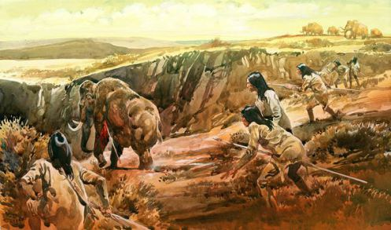
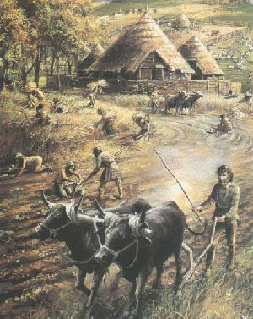
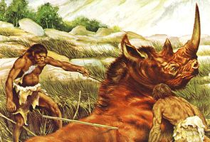

Slide 7
Paleolithic Era
Notes:
This is an illustration of life in the Paleolithic Era.
What do you see in the painting?
What do these things tell us about life in the Paleolithic Era?
How would using hunting as a primary means for obtaining food affect life in the Paleolithic period?
Paleolithic Era—hunting, foraging for food
people had to move from place to place wherever food was available
Since they couldn’t stay in one place, they couldn’t accumulate very many possessions, so no civilization.

Slide 8
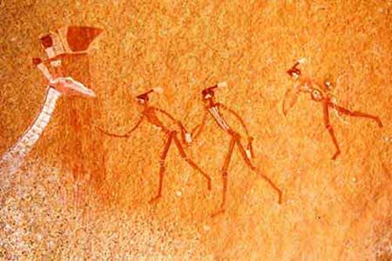
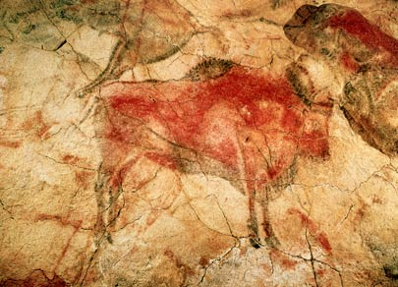
What was life like during the Old Stone Age?
Early humans lived towards the end of the Old Stone Age.
Early people were Nomads, or people who move from place to place to find food.
People of the Old Stone Age were hunters and gatherers, they survived by hunting and gathering food.
Men hunted or fished.
Women and children gathered berries, fruits, grains, and nuts.

Slide 9
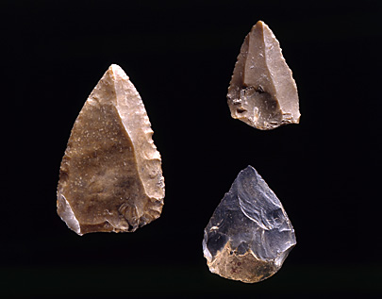
Early people depended heavily on their environment for food and shelter and had to find ways to survive in the wilderness.
They made tools and weapons from stone, bone, or wood.
They also built fires for cooking and used animal skins for clothing.

Slide 10
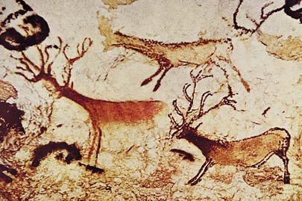
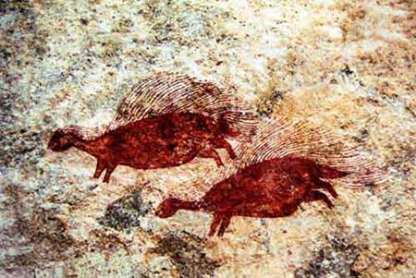
People of the Old Stone Age also developed religious beliefs that were discovered in cave paintings.
They believed the world was full of spirits and forces that lived in animals, objects, or dreams. These beliefs were called Animism.

Slide 11
Neolithic Era
Notes:
This is an illustration of life in a village in the Neolithic Era.
What do you see in the picture?
What do these things tell us about life in the Neolithic Era?
Can you tell what the differences between the Paleolithic and Neolithic Eras were?
Neolithic Revolution=invention of farming, domestication of animals→civilization b/c now people could stay in one place

Slide 12
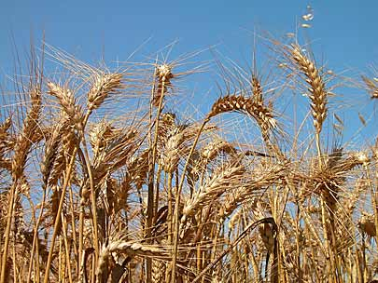
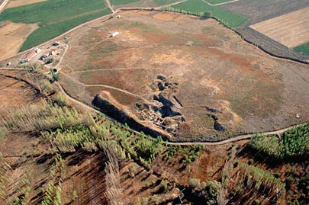
How was life different during the New Stone Age?
The New Stone Age began when people learned to farm.
Farming allowed people to produce their own food and they could settle into permanent farming villages.
The transition from nomadic life to settled farming brought about BIG changes and is called the Neolithic Revolution.

Slide 13
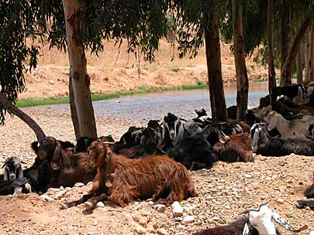
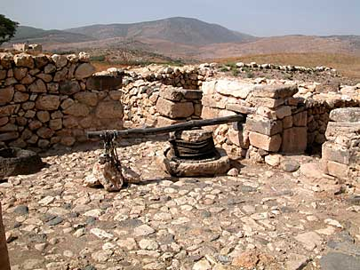
In addition to farming, people learned how to domesticate plants and animals.
Domesticate ~ raise and control plants and animals for human use. Ex. Horses
Domestication was important because it gave people an endless supply of food.
Plants were grown each year and harvested.
Animals were used for food, clothing, and shelter.

Slide 14
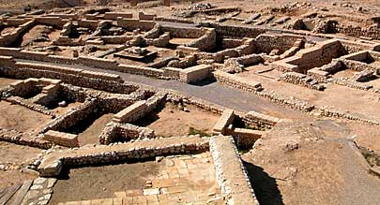
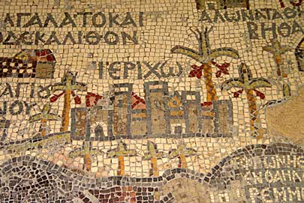
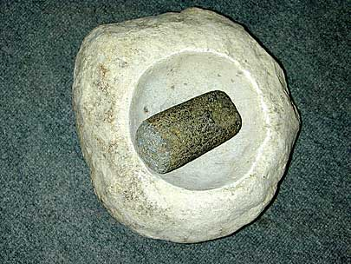
BIG Changes of the Neolithic Revolution
#1 First Villages were established at Catalhuyuk and Jericho.
#2 Men came to dominate family, economic, and political life. Only men could become warriors, chiefs, businessmen, and head of the house.
#3 New Technologies were Developed that made life easier, such as the wheel barrow and grinding bowl.

Slide 15
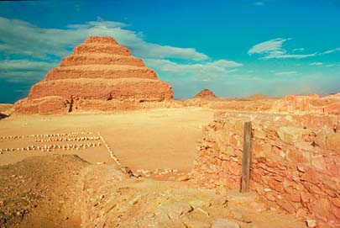
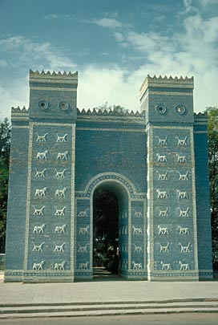
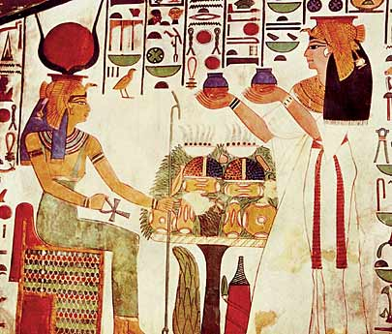
Significance of the Neolithic Revolution
The advances in technology and culture made during the Neolithic Revolution led to the emergence of cities and civilizations.
Civilizations would soon arise along the great rivers of the world!

Slide 16
Aspects of Life Reading
With your partner, Read the “aspect of life” you were assigned.
Discuss how this aspect of life changed from the Paleolithic to the Neolithic Era.
Create a visual to represent how this aspect of life changed from the Paleolithic to Neolithic Era.
Be prepared to present your creation.

Slide 17
Primary Doc Analysis
With your partner read and analyze the document you were assigned.
Is this a Primary or Secondary source?
Brief summary
Underline in…
Red- Social Changes
Blue- Intellectual Changes
Green- Economic Changes

