Slide 1
The Industrial Revolution

Slide 2
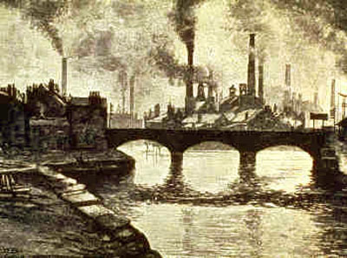
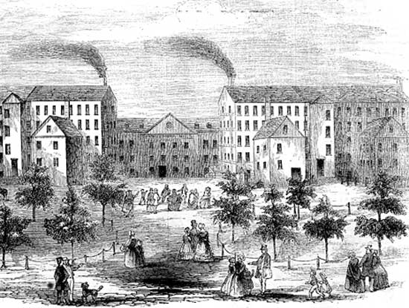
Industrialization
Industrialization - the process by which a society becomes technologically advanced, especially in terms of the means of production.
Industrialization is usually accompanied by social and economic changes.
Industrial Revolution - a long slow process that occurred in Europe (1780s and 1880s) and in the United States (1880-1910) that involved the shift from using hand tools to the use of machines in manufacturing.

Slide 3
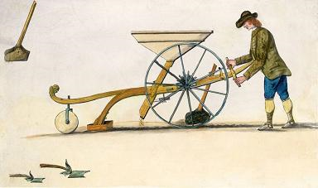
#1 The Agricultural Revolution
Agricultural Revolution:
Dutch built dams to protect their farmland from flooding. They also used fertilizer to improve their soil.
The British discovered new ways to produce more food, including the seed drill (a machine that plants seeds in rows) and new ways to breed stronger animals.
Result: More FOOD!

Slide 4
#2 Population Explosion
Population Explosion!
Since women ate better, they had healthier and stronger babies.
At the same time, medical care improved and people lived longer lives.
Result: More demand for goods!

Slide 5
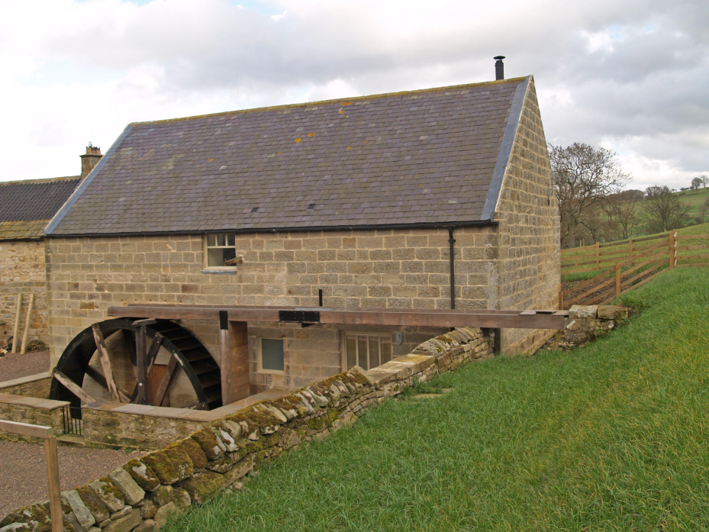
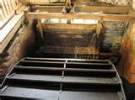
#3 Energy Revolution
Energy Revolution:
To make goods faster for the growing population, people began using giant water wheels to power new machines.
They also used coal to power steam machines.
Result: Faster Production of Goods and the Industrial Revolution!

Slide 6
Industrial Revolution Begins in Great Britain
The Industrial Revolution began in Great Britain for 4 primary reasons:
Britain had plenty of natural resources
Britain had many workers for the new mines and factories.
Britain’s colonial empire made the economy strong.
British middle class had money to invest as entrepreneurs in mines, railroads, and factories.

Slide 7
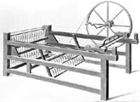
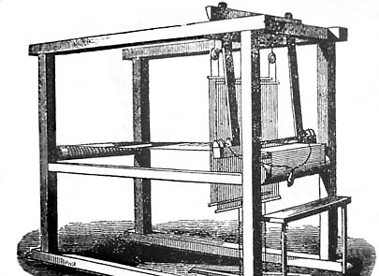
Early Industrial Revolution (1780-1880)
During the early Industrial Revolution, iron and coal were very important as they produced the energy needed to run machines.
The textile (fabric) industry was the first to use the inventions of the Industrial Revolution.
In the 1600s, women spun raw cotton into thread and then wove the thread into cloth at home.
Cottage Industry = work completed at home.
Spinsters = ladies who spun cotton.
By the 1700s, new machines allowed people to make cloth much faster.
Spinning Jenny
Flying Shuttle

Slide 8
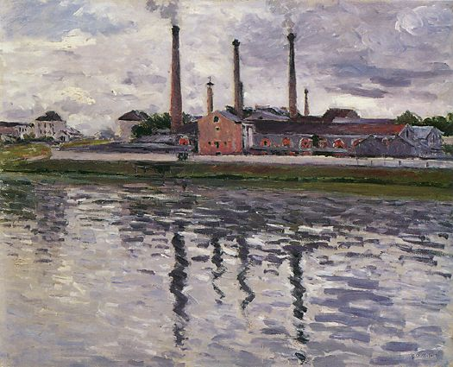
First Factories
The new machines were too large and expensive to be used at home. Instead, spinners and weavers worked in long sheds that became the first factories.

Slide 9
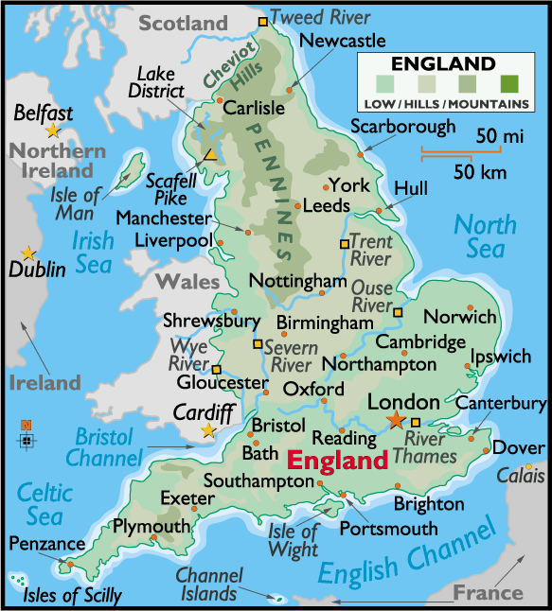
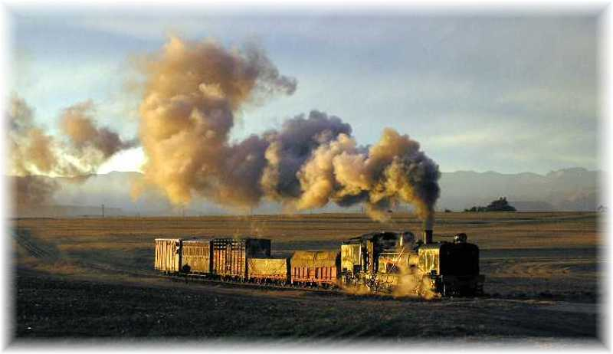
Transportation Revolution
As production increased, people needed a faster and cheaper means of transportation to move goods from place to place.
People built private roads called turnpikes and charged people who used them.
People also built canals and stronger bridges.
The most important invention was the steam locomotive by James Watt, which made the growth of railroads possible.
First railroad (1830) ran between Liverpool and Manchester, England.

Slide 10
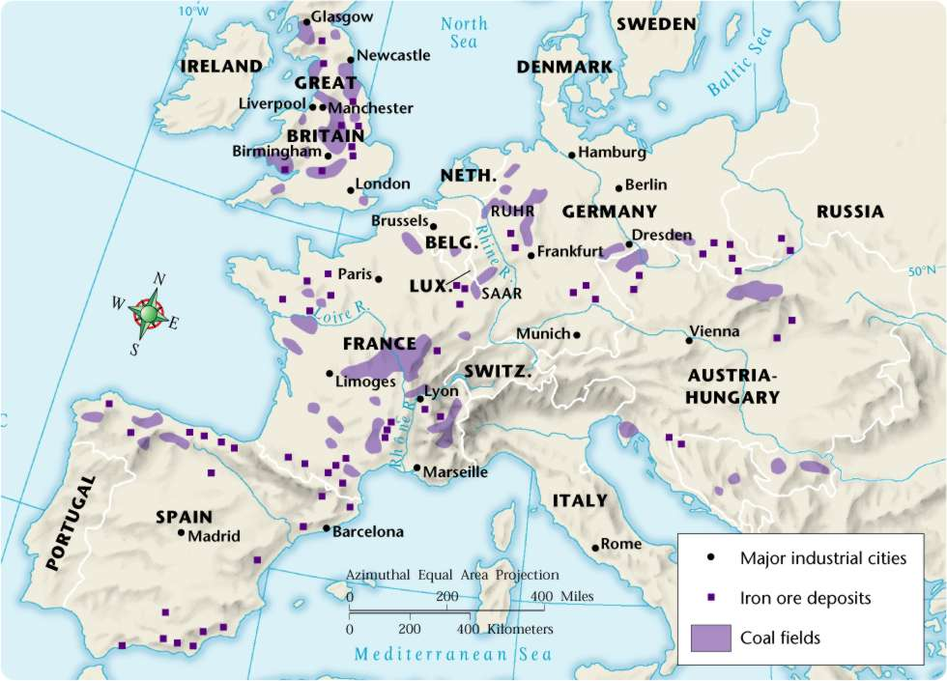
The Industrial Revolution Spreads…
European countries soon caught on to the Industrial Revolution and learned from British experts how to industrialize.
Belgium, Germany, France and the U.S. soon caught up with Great Britain.
They had more supplies of coal and iron than Britain had.
However, not all Europeans will Industrialize.
Russia will not industrialize for another 100 years!

Slide 11
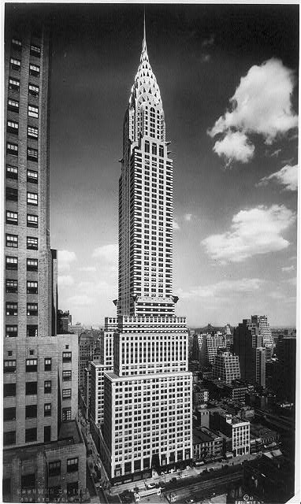
Late Industrial Revolution (1880 – 1910)
During the late Industrial Revolution, coal and oil became the major sources of fuel to run machines.
Henry Bessemer created the Bessemer Process to purify iron ore and make Steel.
Steel was lighter and more durable than Iron.
This led to the development of skyscrapers!!

Slide 12
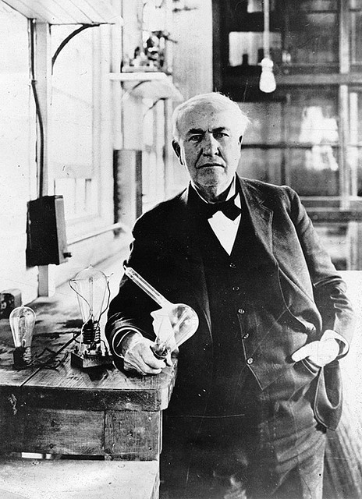
Electricity Develops
During the late Industrial Revolution, electricity developed to light homes, factories, and offices.
Thomas Edison will create the first electric light bulb.
Thomas Faraday created the first simple electric motor.
Result: People could work 24/7…
Business ☺
People ☹

Slide 13
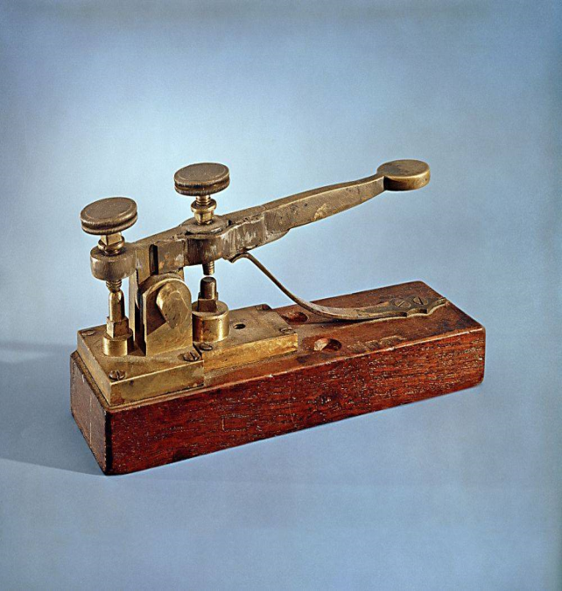
Communication Revolution
With the development of electricity came the development of new forms of rapid communication.
Samuel Morse invents the telegraph and Morse Code.
Alexander Graham Bell invents the 1st telephone.
Guglielmo Marconi invents the 1st radio.

Slide 14
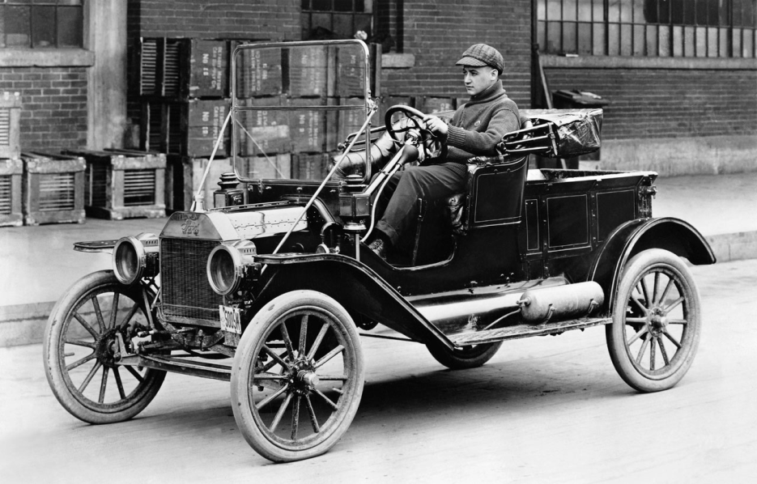
Planes and Automobiles!
During the late industrial Revolution the internal combustion engine was invented and used to create cars and planes.
Germany leads the way…
Nickolaus Otto invented the gas powered internal combustion engine, which lead to the creation of automobiles.
Karl Benz received the first patent for a three wheel auto.
Gottlieb Daimler built a four wheel auto.
And the U.S. joins…
Henry Ford = 1st U.S. car – the Model T
Wright Brothers = design and fly the 1st flimsy airplane at Kitty Hawk

Slide 15
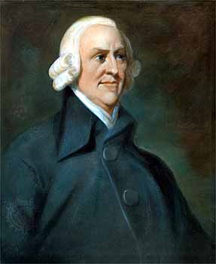
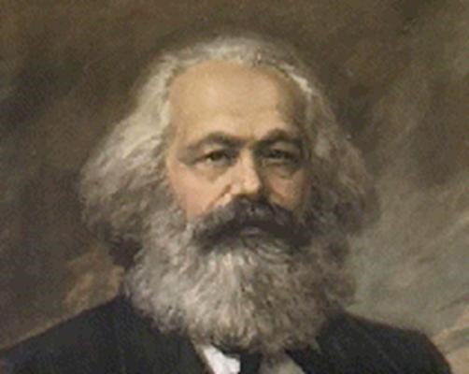
New Ways of Thinking!
However, with the changes brought about during the Industrial Revolution came new ways of thinking.
Thomas Malthus – tried to understand the staggering changes taking place during the industrial revolution. Predicted that the population increase would result in homelessness, poverty, inequality, and misery.
Capitalism, Socialism, Communism
Capitalism (Adam Smith) – advocated a free market economy with laissez-faire (“hands off”) policies, and individual rights.
Socialism - condemned the evils of capitalism and stated that society should own the means of production (not individuals)
Communism (Karl Marx) – radical form of socialism. All production is owned by the community or government.
VS

