Slide 1
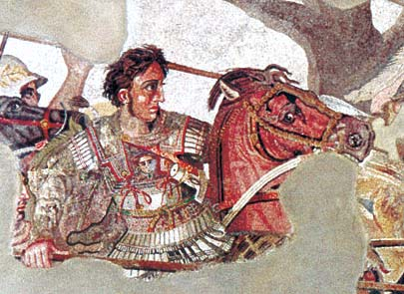
The Hellenistic Age

Slide 2
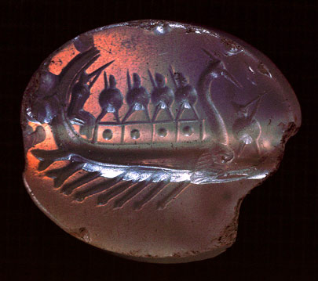
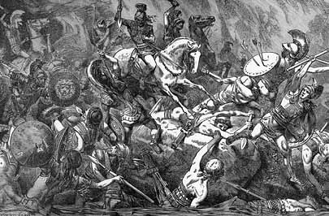
Conflict in the Greek World
The Persian Wars
In 499 B.C., the Ionian Greeks rebelled against Persian Rule. The Greek city-states declared war against Persia - the Greek city-states win!!
After the Persian Wars, Athens formed an alliance among the city-states called the Delian League.
The Delian League was meant to unify the city-states, promote peace, and defend Greece from invaders.
In 431 B.C., war broke out between Athens and Sparta because many Greeks disliked Athenian control.
Who do you think will win???
The Peloponnesian Wars
Sparta wins!!
Signals the end of Athenian control of the Greek World

Slide 3
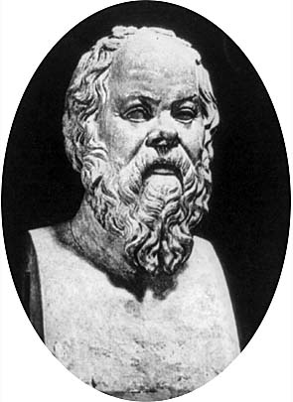
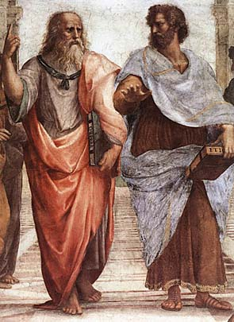
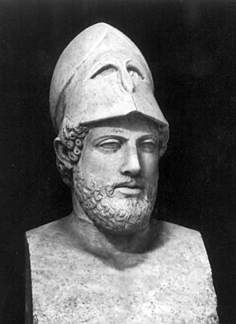
Greek Achievements
Despite political trouble and wars, Greek thinkers, writers, and artists made many important achievements.
Philosophy and Government
In Athens philosophers used rhetoric, or skillful speaking, to advance their careers. The 3 famous Greek philosophers were:
Socrates ~ developed the Socratic method to find truth and self-knowledge.
Plato ~ described an ideal government in The Republic and advocated the rule of a philosopher-King.
Aristotle ~ tried to find the best form of government and promoted the idea of the “golden mean” – a government that is not too extreme.
One of the greatest Greek rulers was Pericles, who helped poor Athenians participate in government by paying citizens for their government work.

Slide 4
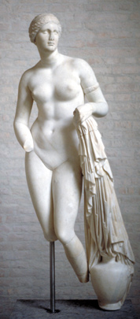
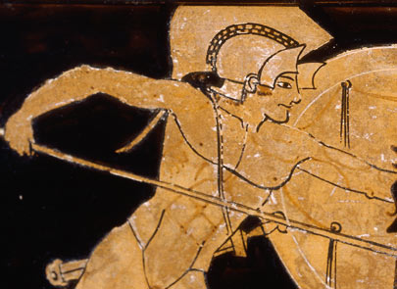
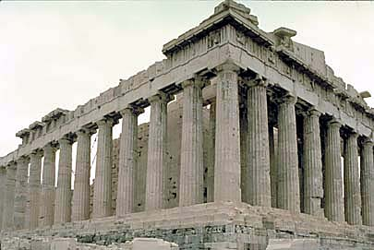
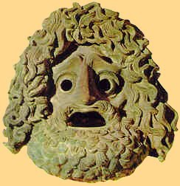
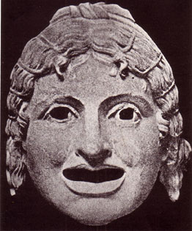
Art and Architecture
The Greeks also made advances in art and architecture – promoting balance, order, and beauty.
The greatest piece of Greek Architecture was the Parthenon, a temple for the Goddess Athena.
Literature and Drama
Greek writers composed tragedies and comedies. Actors played the roles wearing masks.
Tragedies ~ plays that told stories of human suffering and ended in disaster.
Greatest playwrights were Sophocles, and Euripides.
Comedies ~ plays that were humorous and made fun of people and customs.
The most famous comedian was Aristophanes.
Greek historian, Herodotus, was called the “father of history.”
History

Slide 5
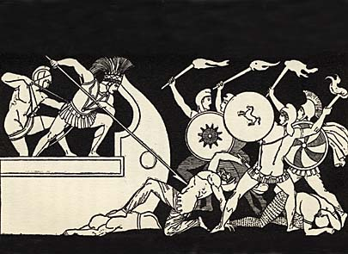
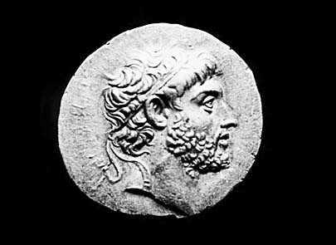
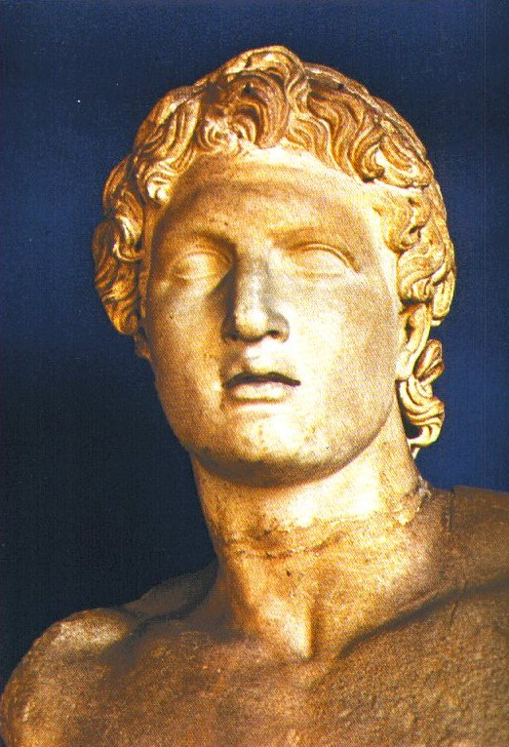
Philip II Unites Greece
The conflicts among the Greek city-states made them weak and vulnerable to invaders.
In 338 B.C., Athens fell to the Macedonian army led by King Philip II – this marked the end of Ancient Greece.
King Philip united all of the Greek city-states under his rule for the first time in history!!
King Philip dreamed of conquering the Persian Empire. However, he was assassinated before he could pursue his dream.
His son, Alexander the Great, became King at the 20 years old. He would pursue and achieve his father’s dream.
Alexander was very smart and was tutored by Aristotle in Greek literature, math and science.
He was also one of the greatest military geniuses!

Slide 6
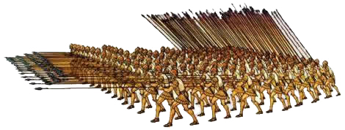
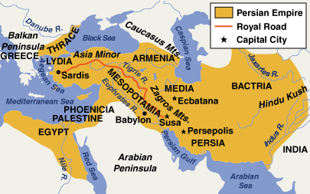
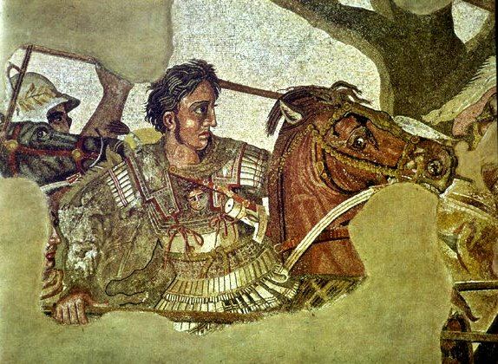
Alexander the Great
Before becoming King, Alexander was one of the best soldiers in the Macedonian military.
As King, he began to organize the forces needed to conquer Persia. To do so, he developed the phalanx.
Phalanx ~ a military strategy where soldiers carried overlapping shields and long spears.
Alexander the Great successfully defeated the Persian empire under Darius III. This was a HUGE accomplishment because the Persian empire stretched from Egypt to India.
Afterwards, Alexander moved into India. However, his troops were too tired to continue and they turned back.
On the way back to Greece, Alexander came down with a fever and died at the age of 33.

Slide 7
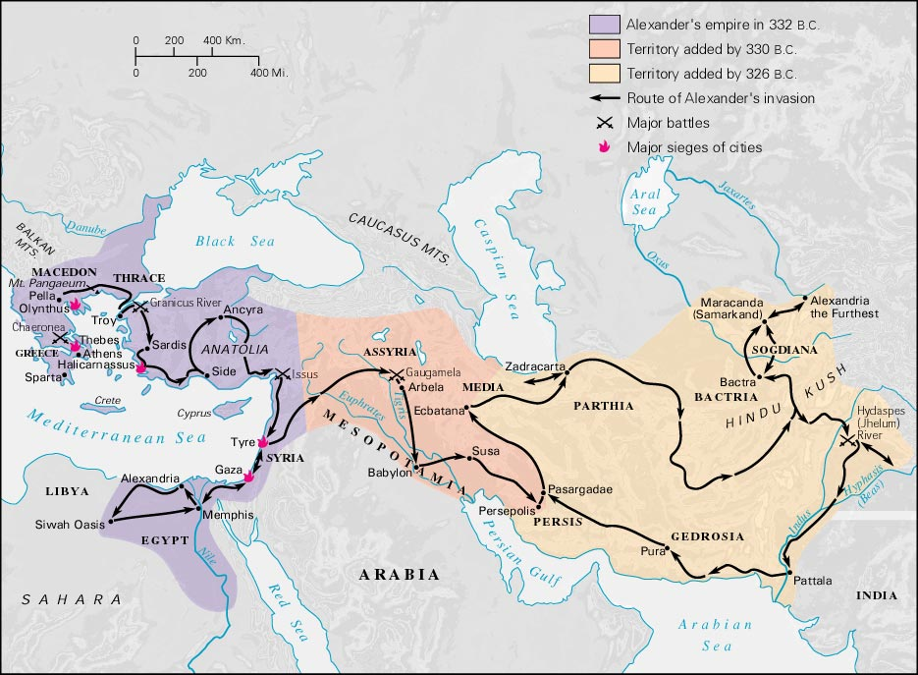
Alexander’s Empire

Slide 8
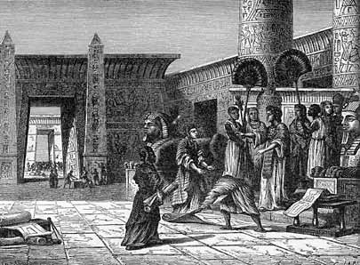
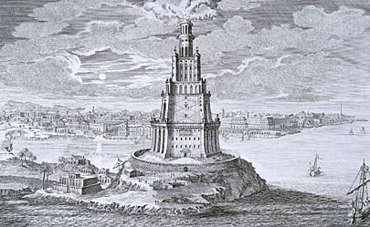
The Hellenistic Age
Although Alexander's empire soon crumbled after his death, his legacy continued for hundreds of years – known as the Hellenistic Age.
His most significant achievement was the spread of Greek culture across the Mediterranean and East.
Alexander founded many cities across the empire. The local people assimilated, or absorbed, Greek culture and ideas.
In addition, Alexander established the city of Alexandria (in Egypt) which would become a cultural capital with laboratories, libraries, lecture halls, and a zoo.
Alexander’s empire also gave women more power – they were able to leave home and learn to read and write!

Slide 9
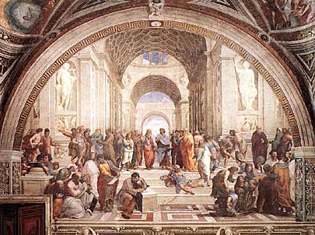
Advances of the Hellenistic Age
The cities of the Hellenistic world made great advances in the arts and sciences.
Philosophy
Zeno founded a new philosophy called Stoicism, which urged people to avoid desires and disappointments of life.
Math and Science
Pythagorean Theorem (a2+b2=c2): (Pythagoras) formula to calculate the sides of a right triangle.
Heliocentric Theory: (Aristarchus) theory that the sun was the center of the universe & the earth revolved around the sun.
Hippocratic Oath: (Hippocrates) set of ethical standards for doctors.
Drama
This was also the golden age of Greek drama.

Slide 10
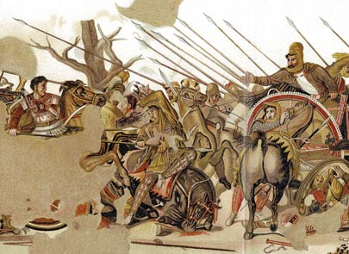

Slide 11
