Slide 1
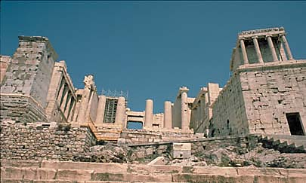
The Greek City States

Slide 2
Governing the City States
As the Greek world expanded after 750 B.C., the Greeks developed a new version of a city state called a polis and new forms of government.
Polis ~ a city and its surrounding countryside.
Each polis had an acropolis, or high city, with a large marble temple.
New Forms of Government
#1 Monarchy
The earliest form of government in Greece was monarchy. A monarch is a king or queen who has supreme power. A monarchy is a government that is ruled by a king or queen.
Most Greek city-states started out as monarchies but changed over time to other forms of government.
Sparta and other city-states developed a political system called oligarchy. Oligarchy means “rule by the few”. In an oligarchy, people rule because of wealth or land ownership.
#2 Oligarchy

Slide 3
#3 Tyranny
Poor people were not part of government in monarchies or oligarchies. Poor people came to resent this, and began rebellions.
A wealthy person who wanted to seize power made use of that anger. He would ask poor people to support him in becoming a leader. Such leaders were called tyrants. In Greece, a tyrant was someone who took power in an illegal way.
#4 Direct Democracy
Athens and some other city-states began to develop a democratic form of government, in which citizens had a more active role in the government.
Direct Democracy is a government in which the citizens work together to decide on the laws, vote in elections, and sit on juries
#5 Indirect Democracy
Indirect Democracy is a type of government in which the citizens make political decisions through elected representatives.
In an Indirect Democracy, people elect representatives to make laws. The United States is an example of an indirect democracy.

Slide 4
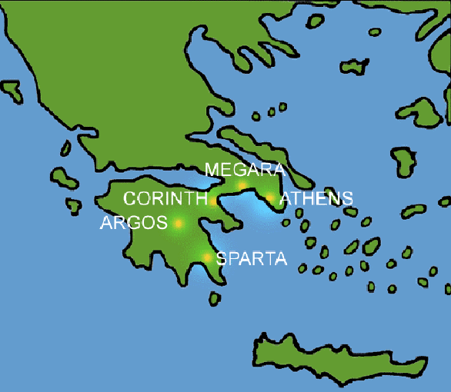
The Greek City States
The Five main City States in Ancient Greece were:
Athens
Sparta
Corinth
Megara
Argos
There was actually no central government in ancient Greece. Each city-state had its own form of government.

Slide 5
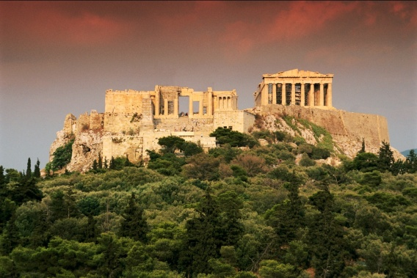
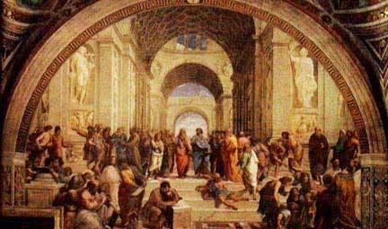
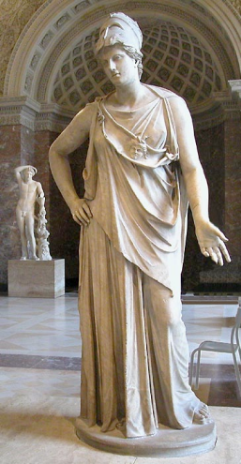
Athens and Sparta
Two very different city-states came to dominate Greece: Athens and Sparta.
Athens: Birth Place of Democracy
Athenian government began as a monarchy and evolved into an aristocracy. However, people were not happy and Athens moved towards a democracy.
The first direct democracy was developed in Athens.
While Athens’s direct democracy allowed citizens to play a role in law-making, it was considered a limited democracy because women and slaves were not considered citizens and could not vote and had no rights.
Athenians valued government, philosophy, art, and education.
In Athens, boys attended school, but girls did not.

Slide 6
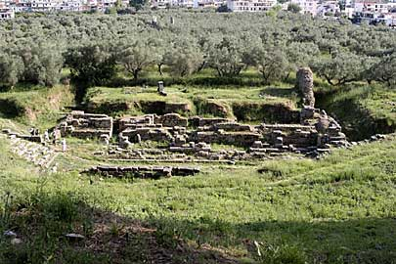
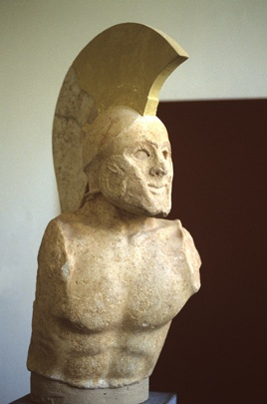
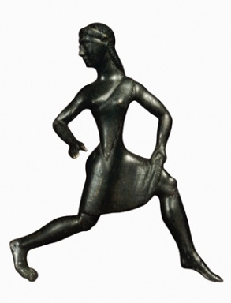
Sparta: The Military Ideal
Unlike Athens, Sparta developed a powerful military city-state ruled by two kings and a council of elders.
The government of Sparta was an oligarchy ruled by a few elite people.
Spartans had MANY slaves, called Helots, who outnumbered the rulers. Therefore, Sparta set up a brutal system of strict control over the Helots.
A Spartan’s life revolved around the military and discipline.
Every newborn was “inspected” and sickly children were abandoned to die.
At the age of 7, boys began very difficult training for the military and continued to serve in the military until they were 60 years old!
Spartan women could inherit property, but had few other rights. Their main duty was to produce strong warriors.

Slide 7
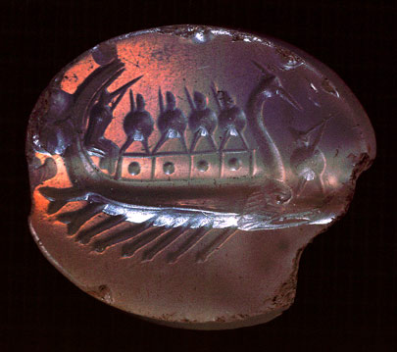
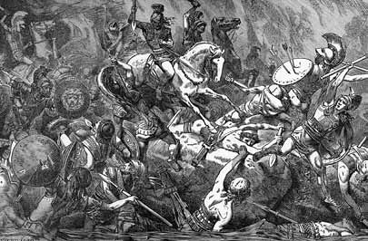
Conflict in the Greek World
The Persian Wars
In 499 B.C., the Ionian Greeks rebelled against Persian Rule. The Greek city-states declared war against Persia - the Greek city-states win!!
After the Persian Wars, Athens formed an alliance among the city-states called the Delian League.
The Delian League was meant to unify the city-states, promote peace, and defend Greece from invaders.
In 431 B.C., war broke out between Athens and Sparta because many Greeks disliked Athenian control.
Who do you think will win???
The Peloponnesian Wars
Sparta wins!!
Signals the end of Athenian control of the Greek World

