Slide 1
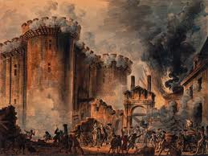
The French Revolution

Slide 2
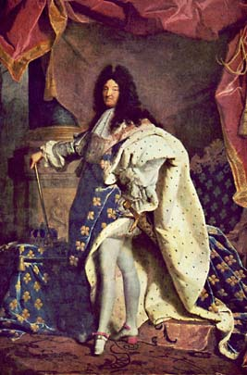
France Before the Revolution
Absolute monarch = ruler whose power not limited by having to consult with nobles, common people or their representatives
Absolute monarchs believed they ruled by divine right
Divine Right = Monarchs received power from God, must not be challenged
Remember Louis XIV – the ultimate absolute monarch???

Slide 3
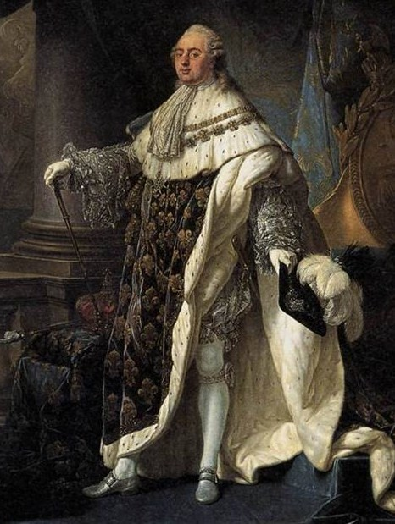
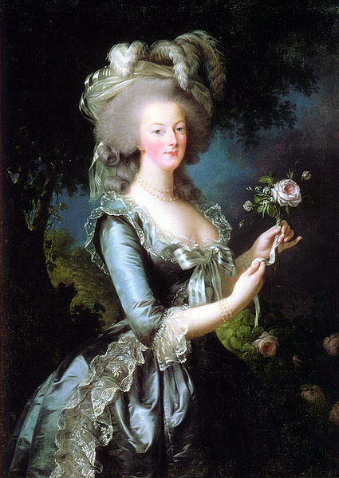
Cause #1: The French Monarchy (1775-1793)
King Louis XVI
Queen Marie Antoinette

Slide 4
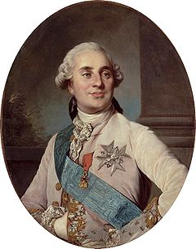
King Louis XVI
Became King of France at age 20.
Married to Marie Antoinette (of Austria).
Weak and indecisive ruler.
Easily influenced by his wife.
No leadership skills.

Slide 5
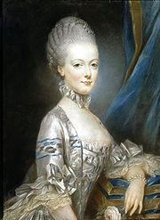
Queen Marie Antoinette
Married Louis XVI at age 14.
Daughter of Austrian Emperor Francis I and Maria Theresa.
Marriage was an alliance between France and Austria.
Big spender and spoiled brat.

Slide 6
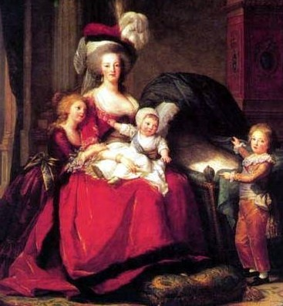
Queen Marie Antoinette
Hated to be bored.
Loved fashion (clothing and tall hair-dos).
Gambler.
Loved extravagance.
Like to play peasant in her “peasant village”.

Slide 7
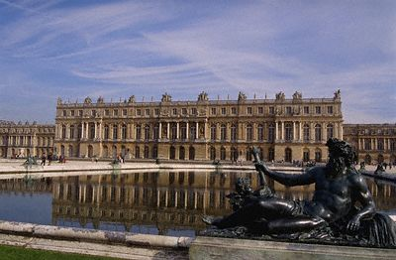
Life at the Palace of Versailles

Slide 8
Cause #2: French Society and the Three Estates
Three Estates
France’s social system, called the Old Regime, had its roots in the Middle Ages (feudalism).
France was divided up into 3 social classes called the “estates”:
The First Estate (Clergy)
The Second Estate (Nobility)
The Third Estate (Peasants, Bourgeoisie, and the Working Class)

Slide 9
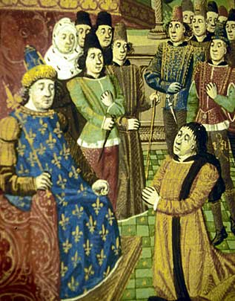
The First Estate
The first Estate was the Clergy.
Members of the Clergy and the churches:
did not pay taxes
collected tithes (taxes)
owned 10% of all lands but only .5% of the population

Slide 10
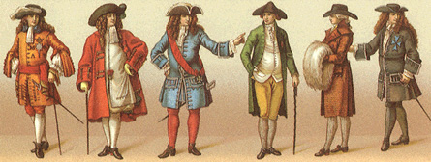
The Second Estate
The Second Estate consisted of the Nobility.
The Nobility were not a cohesive group, but they were allowed certain privileges:
Did not get taxed to full extent
given the best jobs
hunting privilege
They owned 20% of the land, but they were only 1.5% of the population.

Slide 11
The Third Estate
The third estate represented the common people, or anyone not in the first two groups.
It was the largest Estate, but it had the least amount of power.
The third estate was also the poorest, but paid heavy taxes.
Owned 70% of land, but 98% of population.

Slide 12
Cause #3: Economic Problems
The biggest problem: Debt!
The French debt was due to:
The French and Indian War
The American Revolution
The tax system
Economic decline
And poor harvests
The results were high bread prices and high unemployment.

Slide 13
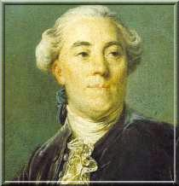
Reform?
Jacques Necker ~ He proposed cutting Royal spending, reforming the government, and abolishing tariffs.
But just as Necker was about to make changes…
YOU’RE FIRED!!!
Necker was fired when he proposed that the land held by the Church and the Nobility should be taxed.

Slide 14
What should the King do?
All classes are upset over the economic situation, but they each want very different solutions. The third estate is starting to get overtly angry, which in the future will lead to riots and a very violent future. So what should the king do???

Slide 15
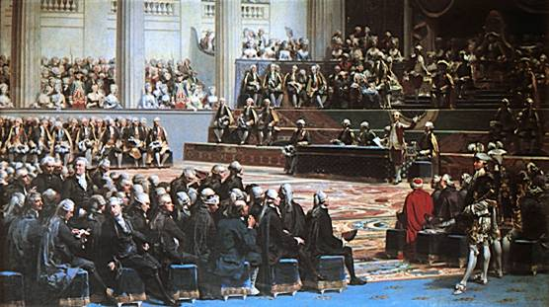
The King’s Decision
After many urges the King finally summoned the Estates General to solve the nation’s problems, the Estates General met May 1789.

Slide 16
May-July 1789
The Estates General had not been called in 175 years (not since Louis XIV!).
As an Absolute Monarch the King was the government, but Louis XVI gave in when the atmosphere was becoming more dangerous.
The third Estate wanted the votes to be counted by head, or individually, as opposed to by body.
When they voted by body the first two estates always won 2-1.

Slide 17
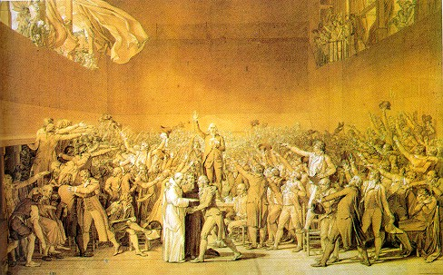
Tennis Court Oath
The King agreed to double the Third Estate, but would not change the voting system.
In response the delegates of the Third Estate walked out declaring themselves to be the National Assembly.

Slide 18
Tennis Court Oath
A few days later they found their meeting place locked and guarded.
So they went to a near-by tennis court and there they pledged to each other never to separate until they established a just constitution.
The King had to accept the Assembly when members of the first two Estates joined.
However as the Estates General could not solve the problem, uprisings in Paris were occurring and the King placed troops in Paris. As it turned into July the city was in turmoil.

Slide 19
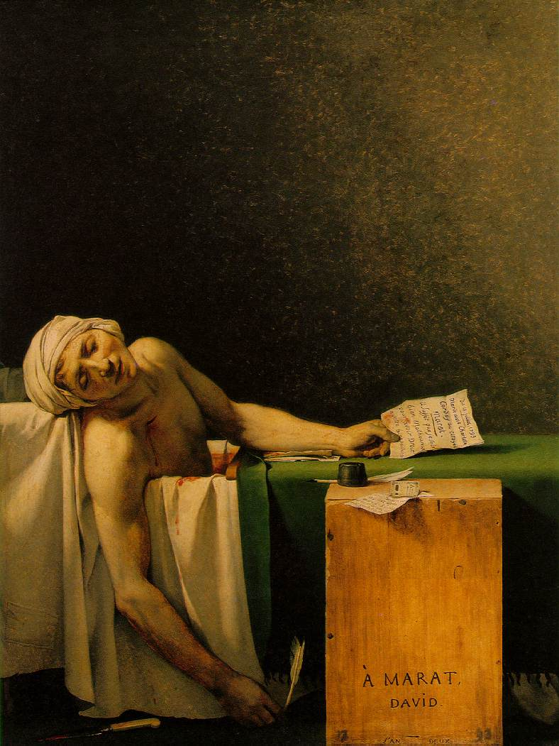
Cause #4 Enlightenment Ideas
Enlightenment ideas that influenced the American Revolution have spread to French newspapers
Jean-Paul Marat
Peasants were starving, and they remember they had paid for the American Revolution…ideas were planted

Slide 20
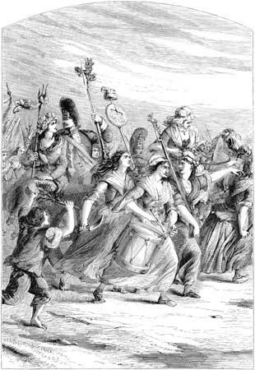
Influence from American revolution:
Peasants were starving and thought Louis XVI had thrown away money helping colonists when he should have helped them
Revolution was possible after the Americans pulled it off

Slide 21
Four Causes of the French Revolution
You will create an illustration representing the 4 causes of the French revolution. Be sure your illustrations are detailed and thoroughly explain each cause of the French Revolution!!
Cause #1 | Cause #2
Cause #3 | Cause #4

