Slide 1
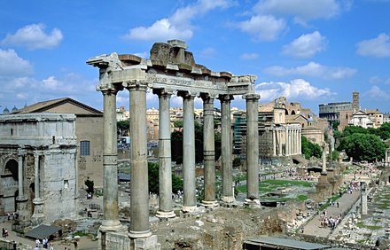
The Fall of the Roman Empire

Slide 2
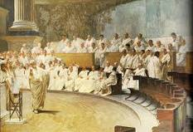
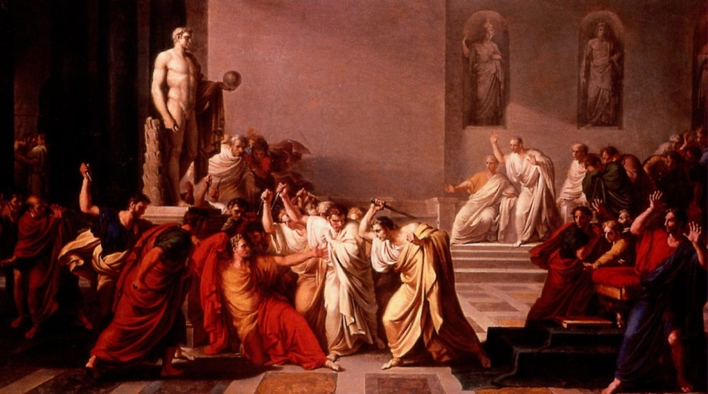
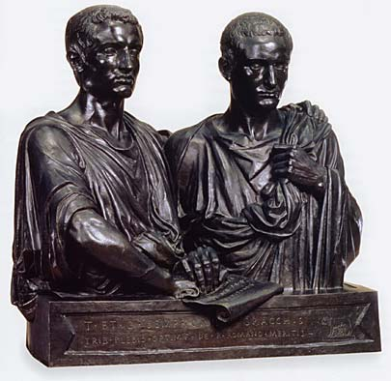
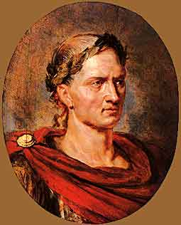
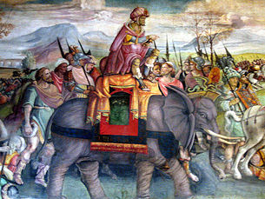
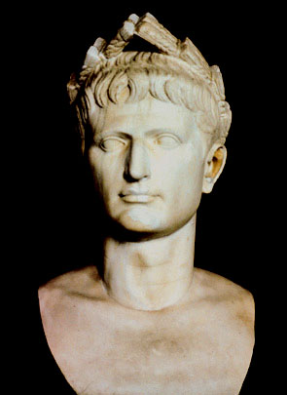
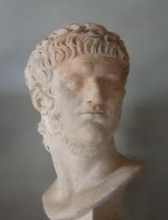
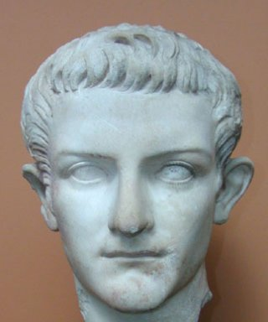
Quick Recap!
In 509 B.C., the Romans drove out the Etruscans from the Italian Peninsula and established the Roman Republic.
Under the Roman Republic, an indirect democracy was established by the patricians (rich people) and eventually the plebeians (middle class people) gained more power.
However, after the Punic Wars many people became homeless and this led to Civil Wars.
Julius Caesar arose from the Civil Wars and forced the Senate to make him Dictator of Rome, but this did not last long because he was assassinated.
The Roman Empire was established under Augustus and this began a period called the Pax Romana.
The Pax Romana also witnessed some pretty terrible emperors…

Slide 3
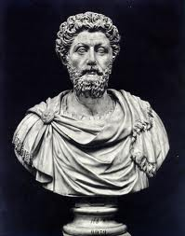
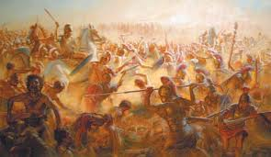
Political and Economic Problems
After the death of Emperor Marcus Aurelius in 180 AD, the golden age of the Pax Romana ended. For the next 100 years, political and economic turmoil plagued the Roman Empire.
During this time, Emperor after Emperor is overthrown by tyrants or military generals who seized power with their troops.
These tyrants usually only ruled for a few months.
In one 50 year period, at least 26 Emperors reigned. Only one died of natural causes…
Political violence and instability had become the rule!!!
At the same time, the empire was shaken by terrible social and economic troubles including high taxes, unemployment and homelessness.

Slide 4
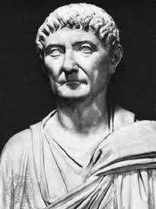
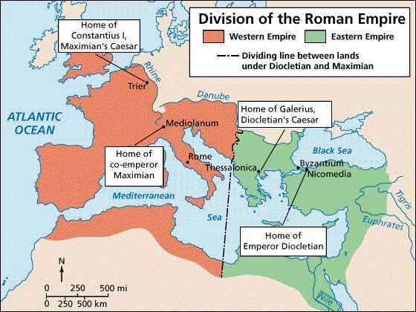
The Empire Divides
In 284 AD, Emperor Diocletian set out to restore order.
To better handle the challenges facing the huge empire, he divided it into 2 parts the Eastern Roman Empire and the Western Roman Empire!
Diocletian ruled the wealthier Eastern Roman Empire and appointed a co-emperor, Maximian, to rule the Western Roman Empire.
Diocletian also took steps to improve the Empire’s economy by fixing the prices of goods to slow inflation (the rise of prices)…but it was too late!

Slide 5
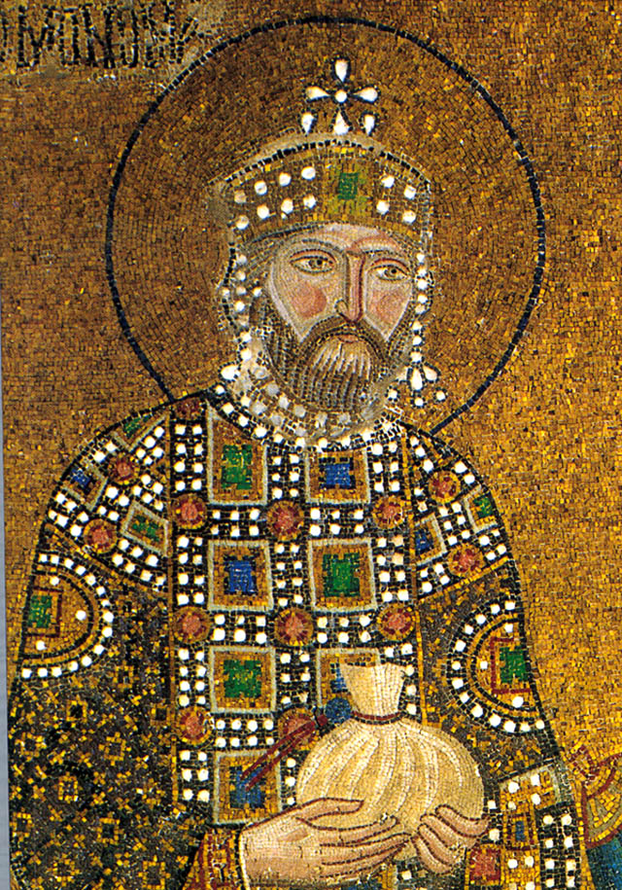
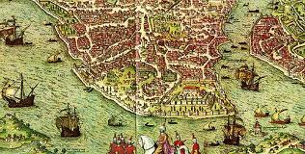
Constantine’s Reforms
In 312 AD, talented general Constantine gained the throne. As emperor, Constantine continued Diocletian’s reforms.
Constantine changed European History in 2 Important Ways:
#1 He issued the Edict of Milan in 313 to end the persecution of Christians in the Roman Empire. This allowed freedom of religion to all citizens.
#2 He established a new capital and named it Constantinople. Constantinople was called the “New Rome” and was located in the Eastern Roman Empire. It would become the new center of Roman Power!!!

Slide 6
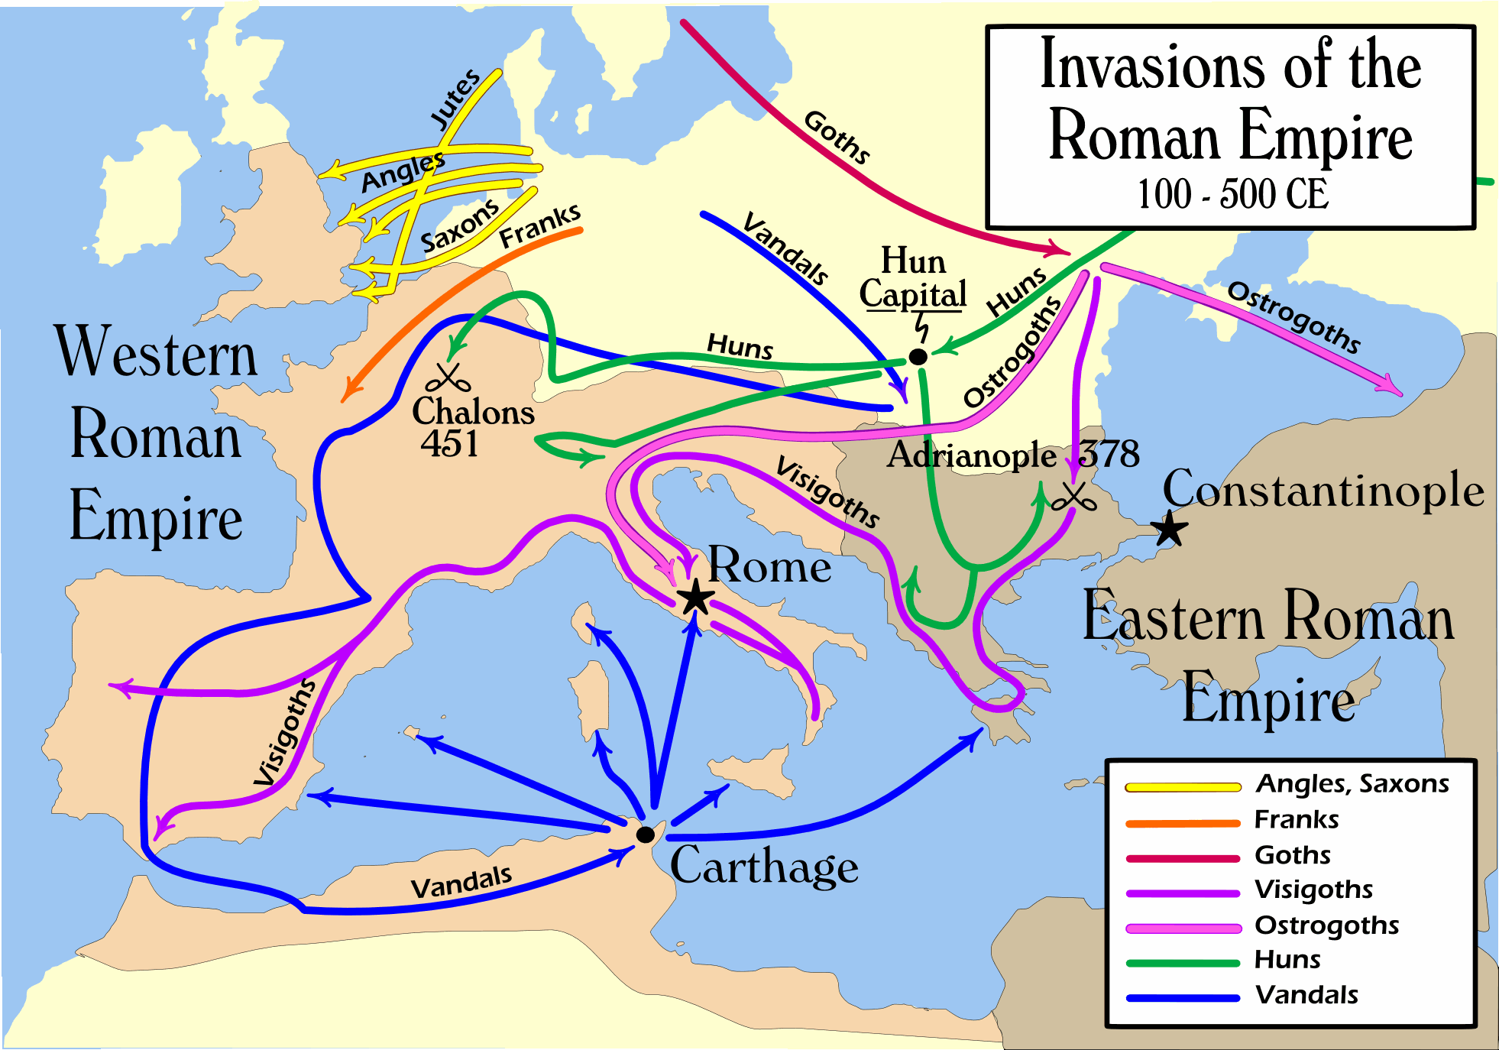
Invaders!
For centuries, Rome had faced attacks from the Germanic peoples who lived North. However, around 200 AD a chain of invaders would overwhelm Rome.
Wars in East Asia sent a nomadic people, called the Huns, migrating towards Europe. The Huns reached Europe in 370 AD and fought the Germanic tribes.
The Visigoths, Ostrogoths, Vandals, Franks, Angles, Saxons, and Goths all began to invade the Roman Empire.
The Roman legions were unable to protect Rome.

Slide 7
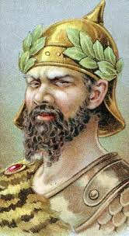
Rome is Sacked
In 378 AD, the Roman army suffered a stunning defeat when it was trying to keep the Visigoths out of Adrianople.
This illustrated that Roman power was fading!
In 410 AD, the Visigoth General Alaric overran Italy and plundered the city of Rome.
Meanwhile, the Vandals moved through Gaul and Spain into North Africa. Gradually, the Germanic tribes began to take over the western Roman empire.
In 434 AD, Attila the Hun (aka “The Scourge of God”, invaded Europe sending more Germanic tribes into the Roman Empire.
Finally, in 476 Odacer, a Germanic leader, over threw the Roman Emperor – this was the official “Fall of Rome”

Slide 8
Too Many Problems
The Fall of the Roman Empire was a MAJOR TURNING POINT in World History!!!
So why did Rome Fall?
#1 Military Attacks
Rome could not protect itself from invaders because the legions were too weak and Rome hired mercenaries (foreign soldiers) to defend its borders.
#2 Political Troubles
Government was more oppressive and authoritarian and lost support of people. Corrupt politicians undermined loyalty to Rome. Dividing Empire also weakened Rome.

Slide 9
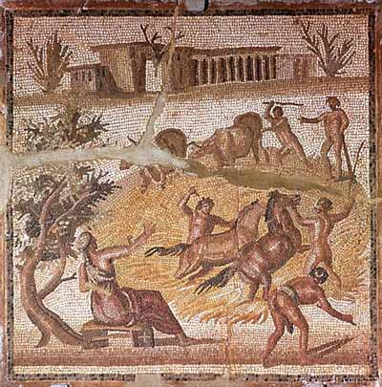
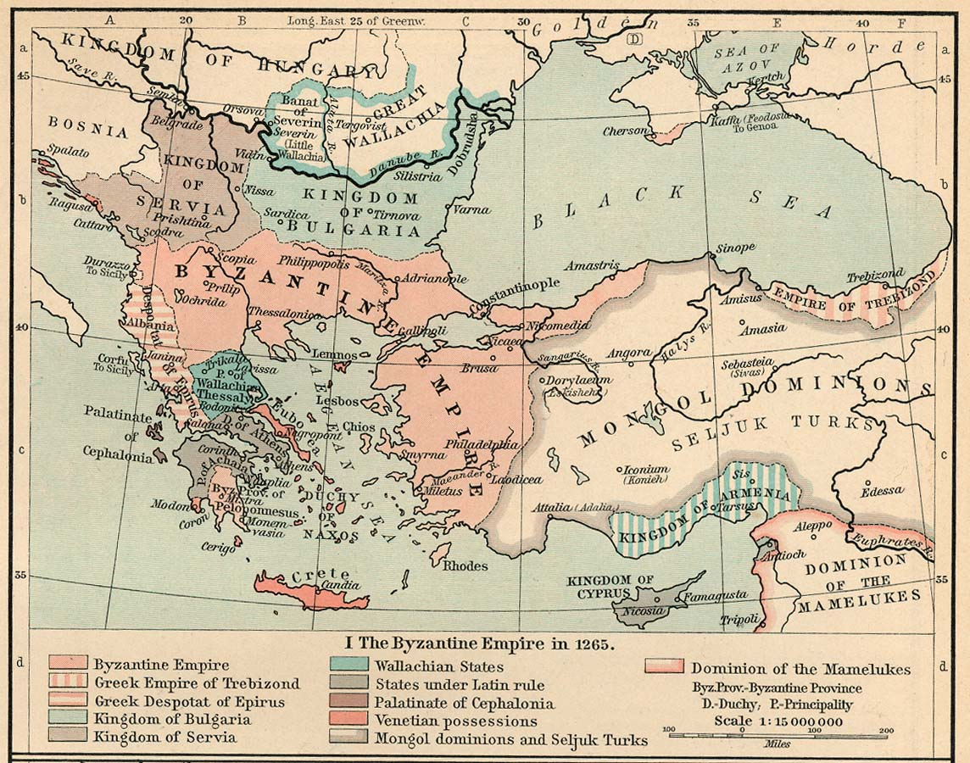
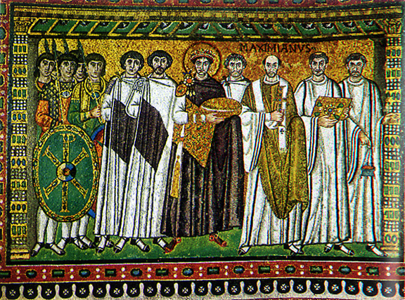
#3 Economic Weakness
Heavy taxes, reliance on slave labor, lack of new technology, and poverty led to a failing economy.
#4 Social Decay
Decline of patriotism, discipline and devotion to the Roman Empire led to the collapse. Providing “bread and circuses” may have also undermined self-reliance.
Did Rome Fall?
The Roman Empire did not disappear off the map in 476 AD.
The Eastern Roman Empire continued to exist for another 1000 years under a new name called the Byzantine Empire.

Slide 10
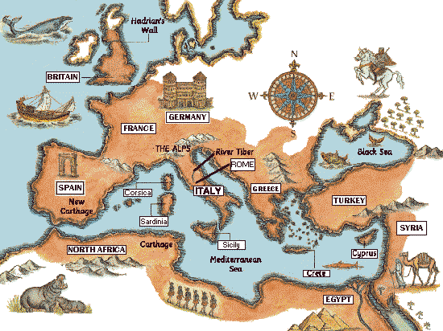
Fall of Roman Empire Timeline
Directions: Pick the 5 most important events from today’s notes and make a timeline showing the events that led to the fall of the Roman Empire. For each event, include the:
year
a name
a brief description (and a symbol for extra credit).
Finally, at the end I want you to star the top 3 events that you believe led to the collapse of the Roman Empire.
Your timeline should start at 180 AD and end at 476 AD!!

