Slide 1
The Cuban Missile Crisis
A Cold War Conflict

Slide 2
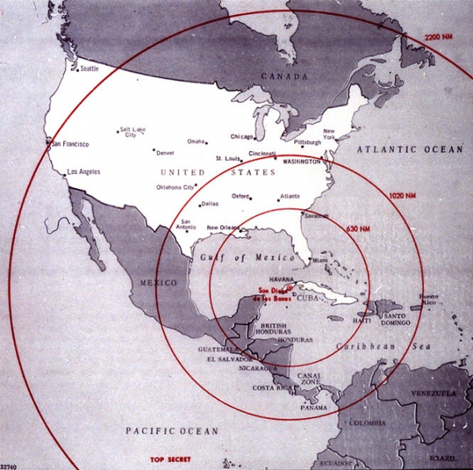
Cuba goes Communist
One of the most serious Cold war Conflicts involved the Latin American Nation of Cuba, 90 miles off the coast of Florida
Fidel Castro organized an armed rebellion against the corrupt dictator who then ruled Cuba.

Slide 3
Cuban Revolution
In 1959, Castro was victorious and set out to transform the country.
During this time period known as the Cuban revolution, Castro sought the support of the Soviet Union.
Castro worked to transform Cuba by:
Nationalizing businesses
putting most land under government control
Restricting Cubans’ political freedom
Critics were jailed or silenced
Many fled to Florida where they were granted asylum.

Slide 4
Bay of Pigs
In 1961, President John. F. Kennedy supported an invasion attempt by U.S. trained Cuban exiles.
The Bay of Pigs Invasion, known for the bay where invaders came ashore in Cuba.
However, it quickly ended in failure when Castro’s forces captured invaders.
The U.S. imposed a trade embargo on Cuba that remains in effect today.

Slide 5
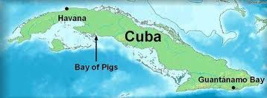
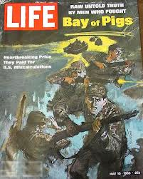

Slide 6
The Cuban missile crisis
In 1962 the Soviet Union sent Nuclear missiles to Cuba.
President Kennedy responded by imposing a naval blockade that prevented further soviet shipments. Kennedy demanded that the Soviet Union remove its nuclear missiles from Cuba.
For a few tense days, the world faced a risk of nuclear war over the issue.

Slide 7
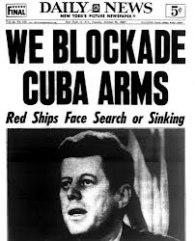

Slide 8
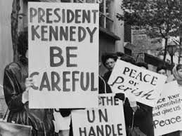
Cuban Missile Crisis
Finally, on October 28th, 1962. Soviet Premier, Nikita Khrushchev agreed to remove the Soviet Missiles, and war was averted.

