Slide 1
$YMB0LS
SYMBOLS

Slide 2
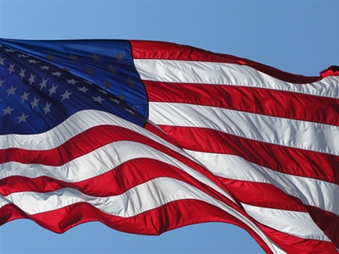
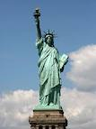
We want a shared meaning as a culture because it gives us a sense of community and unites us.
Notes:
Add the dove, peace sign, ying yang

Slide 3
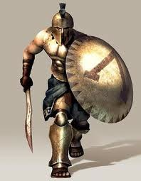
Even at a smaller level…

Slide 4
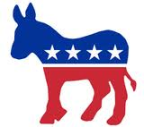
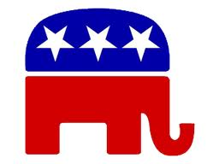
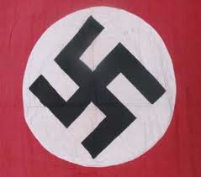
Political

Slide 6
Safety

Slide 7
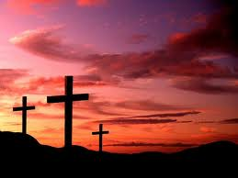
Religious

Slide 8
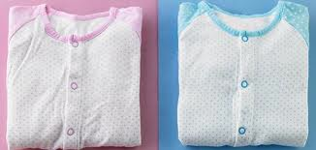
COLORS

Slide 9
Symbols
Anything that meaningfully represents something else.
Why are symbols are important??
Culture could not exist without symbols because there would be no shared meanings among people.
Express abstract idea or concept with just a simple shape.

Slide 10
Symbols are everywhere!!!

Slide 11
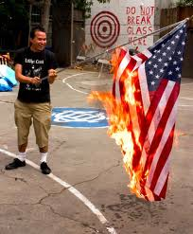
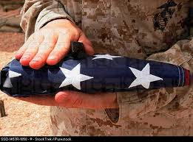
Symbols:
Mean different things to different people depending on their culture, ideas and beliefs.
Symbols stir emotion.

Slide 12
Let’s Analyze some symbols…
http://www.adl.org/hate_symbols/default.asp
Notes:
1. communism

Slide 13
Language

Slide 14
Language
Set of symbols that expresses ideas and enables people to think and communicate with one another.
Helps us describe reality.
One of our most important human attributes because it allows to share experiences, feelings, knowledge.
Not solely a human characteristic because animals use sounds, gestures, touch, smell to communicate with one another.
Ex: chimpanzees can do sign language.
Helps transmit culture from one generation to the next.

Slide 15
Sapir-Whorf Hypothesis
Language shapes the view of reality of its speakers.
Language determines or influences thought because people know the world only in terms of the vocabulary they use to familiar to their own language.
Chicken or the egg comparison?
What came first, thought or language?

Slide 16
Languages Shapes us Socially
Socially constructed ideas represented by language
We created time, hours, days, minutes. therefore “being late” “saving time” are all abstract concepts conveyed through language.
Body Language

Slide 17
Language and Gender
Does language affect gender?
Mankind, “His”story.
He or she affects gender.
Jobs expected by gender and words, nurse..etc
Nicknames: doll, babe, dude, hunk… etc.

Slide 18
Language and Ethnicity
80 % of Americans speak English at home
17 % speak something other than English.
Largest of the 17% is Spanish speaking.

Slide 19
Cultural Transmission
Language is important for cultural transmission.
Creates a group and an identity.
Some theorists say it unites us
Some say it is a source of conflict

Slide 20
Discussion
Should immigrants coming to the United States be required to learn English? Why or why not?
Should high school and or college students be required to learn a foreign language? Why or why not?

