Slide 1
Social Life
World History
Mr. Westbrook

Slide 2
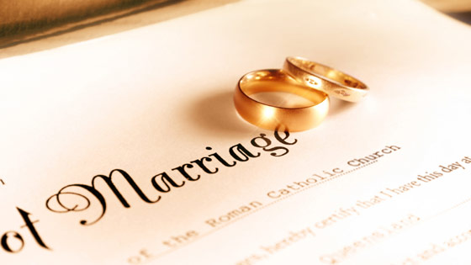
Courtship & Marriage
Notion of “falling in love” more accepted
Family still had large input in spouse
Marriage contracts drawn up to protect

Slide 3
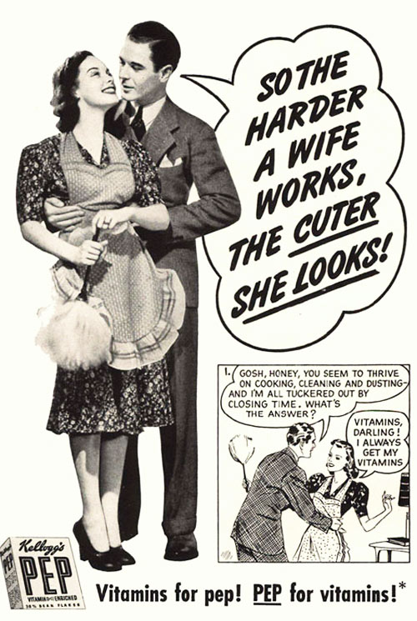
Family Life
Middle Class
Lower Class
Man made enough money to keep wife home
Ideal woman: Self – Sacrificing, caregiver who provided nest for children and refuge for husband
Everybody worked

Slide 4
Campaigns
Temperance Movement (Prohibition)
Campaign to limit or ban alcohol
Women’s Suffrage (Right to Vote)
Elizabeth Stanton & Susan B. Anthony
Seneca Falls Convention of 1849
Opposition: Women = Too emotional to vote & needed to be protected
Faster Strides being made in New Zealand, Australia, and U.S. Western Territories

Slide 5
Education System
Public Schooling
3 R’s- Reading, Writing, Rithmatic
Punctuality, Obedience, Discipline
Colleges and Universities Expanding
Social Darwinism (Survival of the fittest)
Charles Darwin
All life forms evolve over time

