Slide 1
Rise of Totalitarianism

Slide 2
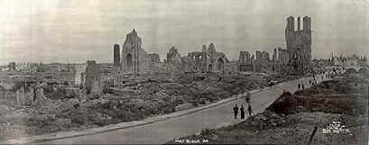
Treaty of Versailles Recap
1919 Paris Peace Conference – leaders from France, Great Britain, and the U.S. met in Paris to create a plan for peace.
Resulted in the Treaty of Versailles
France and Great Britain blamed Germany for the cost and devastation of WWI.
Wanted revenge!

Slide 3
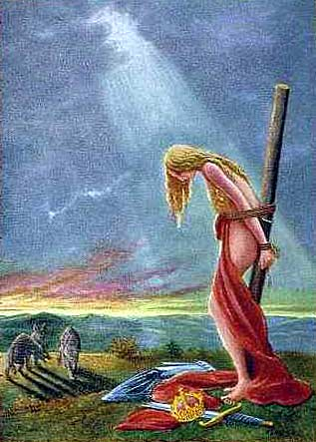
Treaty of Versailles Recap!
Treaty of Versailles severely punished Germany.
Germany had to give up land
Germany had to de-militarize (give up arms and reduce their army)
Germany had to take full blame and pay reparations ($ for their wrongdoing)
Treaty of Versailles was a flop!
Helped Hitler gain power
Led to start of WWII

Slide 4
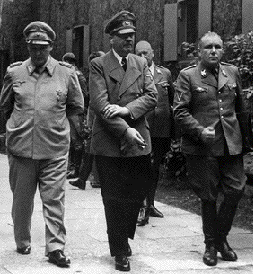
Unstable New Democracies
Between 1914 and 1918, new democracies were forming in Europe.
Very weak and did not work well
Coalition Governments – temporary alliance of several parties; usually short lived.
Voters were willing to sacrifice democratic government for strong authoritarian leadership.
Like Hitler!

Slide 5
The Weimar Republic
After WWI, Germany established a very weak democratic government called the Weimar Republic. (Vi-mar)
However, the Weimar Republic could not deal with Germany’s economic ($$) problems.
High Inflation and Unemployment
Loaf of Bread cost $200 billion marks in 1923 – Yikes!
Dawes Plan – provided for a $200 million loan from American banks to stabilize German currency and help economy.
Kellogg-Briand Pact – renounced war as an instrument of national policy.
Signed by almost every country in the world!
Notes:
It is named after its authors: United States Secretary of State Frank B. Kellogg and French foreign minister Aristide Briand.

Slide 6
Worldwide Economic Trouble
In the late 1920s, American prosperity sustained the world economy.
If the United States Economy weakened the world’s economic system might collapse. In 1929 it did…

Slide 8
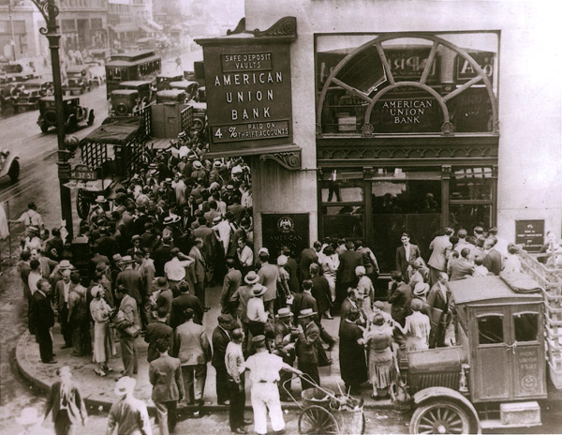
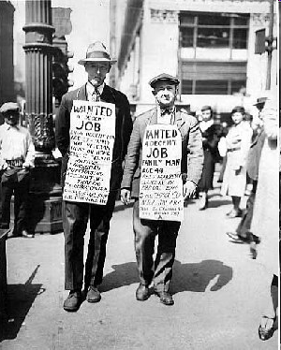
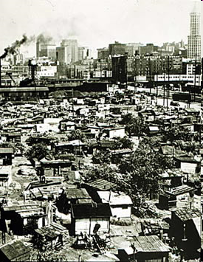
Stock Market Crash and Depression
Stock Market Crash (1929) – panic hit wall street and everyone wanted to sell their stocks (but no one wanted to buy).
Prices plunged
stock market collapsed
Great Depression – a long business slump that resulted in high unemployment, inflation, and low wages.
By 1933, 1/4th of all Americans were jobless
Collapse of American economy sent shocks around the world.
Germany and Austria were hit hardest because of war debt and dependence on American loans (Dawes Plan).

Slide 9
Rise of Authoritarian Governments
Many democracies remained strong despite the Great Depression.
However, millions of people lost faith in democratic government and turned to extreme forms of authoritarian government called Totalitarianism.

Slide 10
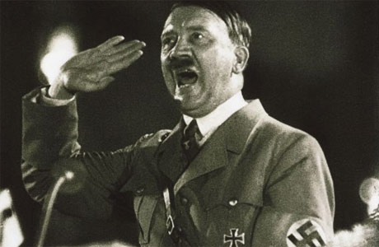
Totalitarian Governments
Totalitarianism = A government that takes complete control of almost all parts of people’s lives.
Fascism = militant form of government that emphasized extreme loyalty to the state and obedience to its leader.
Nazism = German brand of fascism.
Totalitarian governments are usually ruled by a dictator.
Dictator = sole ruler of a country
Dictators keeps control by:
Using police terror
Controls schools
Propaganda
Censorship
Persecution (a group to blame)

Slide 11
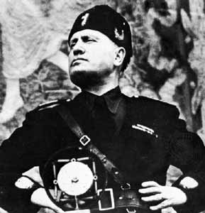
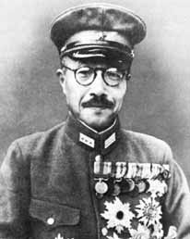
Four Authoritarian Regimes
Josef Stalin
Benito Mussolini
Tojo Hideki
Adolf Hitler

Slide 12
Dictators!
The purpose of this assignment is to study the interwar years and the rise of totalitarianism in one of the following countries – Russia, Germany, Japan, or Italy –you will teach your classmates about your totalitarian regime.
Silently read your assigned reading
Reread the assignment with your partner and answer the following questions:
Who is the leader of the Totalitarian Regime?
What is the name of the party?
What are the party’s major beliefs?
Why did citizens support these regimes?
What tactics did they use to gain power?
What tactics did they use to maintain power?

Slide 13
Life under a Dictator
Life under a Dictator
You are going to write a letter to family in America as someone living in a totalitarian regime.
You can pick any of the regimes we learned about (other than then one you “taught” today.
The requirements for the letters:
Choose one of two perspectives: someone who is an enemy of the state or someone who is a member of the party. Students should not use their real name. For example, if students choose someone living in Nazi Germany, choose a German name, etc.
Students must use at least 5 facts you learned about that regime and try to describe what they think a day in their life would be like.
Letters should be approximately one page long.
It should follow a standard friendly letter format. See attached handout for example.

