Slide 1
Research Methods
How We Find, Analyze and Interpret Sociological Information

Slide 2
Essential Questions
Why is sociological research necessary?
What is the difference between qualitative and quantitative data?
What are the strengths and weaknesses of the sociological research methods?
Why is it important to consider ethical issues in sociological research?

Slide 3
Goals to be met
The learner will develop a sociological point of view.
Objectives
1.01 Discuss the origins of sociology.
1.02 Describe similarities and differences between sociology and the other social sciences.
1.03 Identify the relationship between the study of sociology, society, and culture.
1.04 Define and apply key concepts used in sociology to understand human society and interaction.
1.05 Differentiate among the various sociological perspectives or theories on social life and formulate a personal perspective.
1.06 Differentiate among the various sociological research methods.

Slide 4
Characteristics of Social Research

Slide 5
Issues of Interest
Examine the structure and function of various features of society (like groups)
“Rates of behavior” – how often a behavior occurs under specific conditions
Knowing how groups of people with similar characteristics are likely to act under given circumstances
Stability and change – how and why some features change in society and some stay the same

Slide 6
Causation
Sociologists want to uncover the causal connections between events
All events have causes
Study cause and effect by examining relationships among variables (anything that can vary in amount or quality from case to case)
Causal relationship exists when change in one variable causes a change in another variable
Study cause and effect

Slide 7
Variables
Independent variable - causes a change in another variable
Dependent variable – Changed by (depends on) the independent variable
Ex: In a study of teen drug use
Dependent variable: level of drug use
Independent variable: School grades or attitude towards drugs
Sociologist may be interesting in determining if the level of drug use is influenced by grades in school or attitudes toward drug use
Sample question: Is drug use lower among students who are on the honor roll at school?

Slide 8
Correlation
First step in determining cause and effect is to know whether a correlation exists
Correlation exists when a change in one variable is regularly associated with a change in another variable
Correlation ≠ Causation → There may be a third variable involved
Ex: High ice cream sales may be highly correlated to crime rates, but it doesn’t mean ice cream causes crime. There is a 3rd variable that cause the other 2 variables to exist: temperature. When it is hotter outside ice cream sales increase, but so does crime. One does not cause the other though.
Sociologist determine correlation through use of controls (ways of excluding the possibility that outside variables are affecting relationship between the 2 variables being tested)

Slide 9
Types of Correlation
Positive correlation – both variables change in the same direction
Ex: Cigarette smoking and lung cancer
Negative correlation – both variables change in the opposite direction
Ex: Age and hours of sleep needed
Spurious correlation – Variables appear to be related but actually are being affected by the existence of a 3rd variable
Ex: Hospitalization and death appear to be highly correlated, but serious illness (3rd variable) is responsible for the correlation

Slide 10
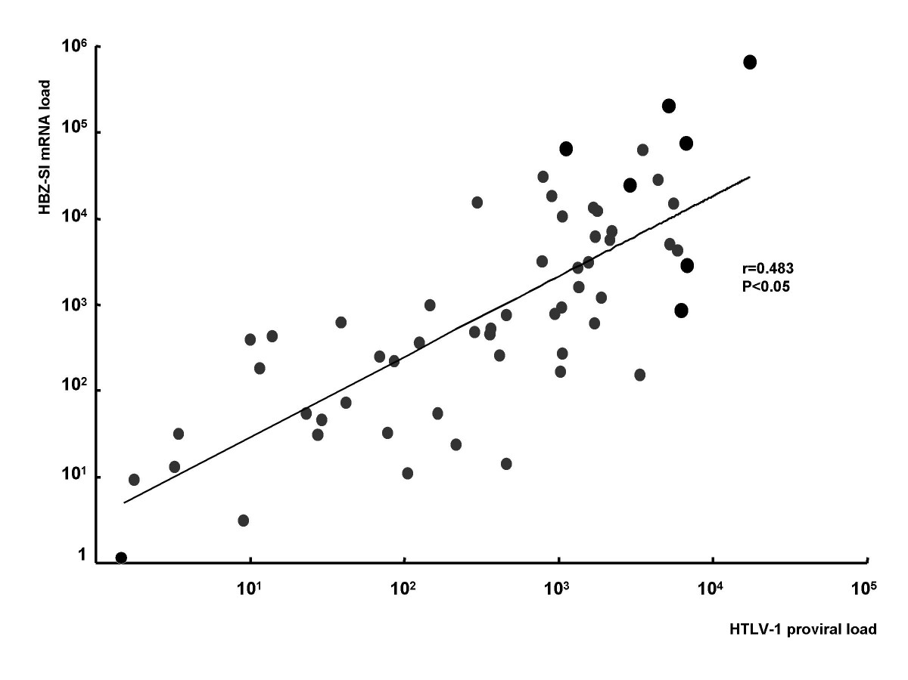
Positive Correlation
http://www.retrovirology.com/content/5/1/34/figure/F3?highres=y

Slide 11
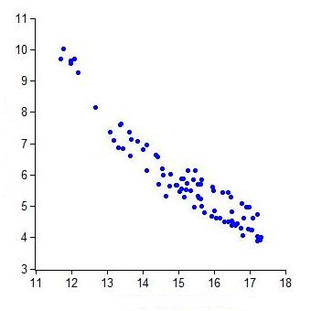
Negative Correlation
http://mrhonner.files.wordpress.com/2011/04/negative-correlation-graph.jpg

Slide 12
The Research Process
7 Steps to conducting research

Slide 13
Step 1: Defining the Problem
First step involves selecting a topic and developing an operational definition
Operational definition – Stated in terms of measurable characteristics
Ex: Durkheim wanted to study effect of social integration on suicide rates so he had to define suicide and social integration in terms that would allow him to measure both concepts.

Slide 14
Step 2: Reviewing the Literature
Good research is conducted within the context of an existing body of knowledge
Sociologists review published reports of studies that have information on their research interests
Provides researchers with valuable insights and prevents unnecessary duplication

Slide 15
Step 3: Form a Hypothesis
After reviewing the literature sociologists must develop a testable hypothesis
Hypothesis – Statement that predicts the relationship between two or more variables.
Ex: Durkheim hypothesized that suicide rates within groups vary inversely with the degree to which group members are integrated into society . The more social bonds a person has, the less likely they are to commit suicide.

Slide 16
Step 4: Choosing a Research Design
Research design – Plan for collecting, analyzing, and evaluating data
Most data collection methods fall into 4 categories:
Surveys
Experiments
Observational studies
Analysis of existing sources
Once the data is collected, sociologists need some form of statistical analysis to evaluate the findings

Slide 17
Step 5: Collecting the Data
Different research designs require taking different factors into consideration
Ex: Surveys cost money
Information must be carefully record to make sure it is accurate

Slide 18
Step 6: Analyzing the Data
Researchers must maintain objectivity and not read more into the data than there is
Purpose is to determine whether the data support the hypotheses

Slide 19
Step 7: Presenting Conclusions
Sociologists must draw conclusions from the data and present the findings to others
By reporting their findings, sociologists add to the body of sociological knowledge and make it possible for other sociologists to evaluate the data and the research process

Slide 20
Basic Research Methods
Research Designs Revisited

Slide 21
Historical Method
Used to analyze existing sources
Involves examining any materials from the past that contain information of interest
Materials can include things such as toys, clothes, pictures, and tools; but mostly consist of written documents
A way to study trends
Personal material can allow researchers to view private and unguarded feelings of an individual who lived at another point in time

Slide 22
Content Analysis
Analyze existing sources
Process involves counting the number of times an element (word, symbol, event, etc.) appears in a given context
Used to analyze any form of recorded communication (television, radio, movies, etc.)
Easy to use and inexpensive, researchers just have to count

Slide 23
Survey Method
Used to collect data on attitudes and opinions from large numbers of people
Techniques
Questionnaires
Respond in writing in person or by mail
Advantage – Collect information from a large amount of people in a short period of time
Disadvantage – do not enable to sociologists to know if participants interpreted the questions correctly and rely solely on the answers
Interviews
Respond orally in person or over the telephone
Advantage – easier for researcher to ask for clarifications and note context clues (facial expression)
Disadvantage – Time consuming and expensive
Choose respondents using a sample of a population – mostly random samples
Samples must be representative of the entire population

Slide 24
Observation
Detached Observation
Observe the situation from a distance
Advantage- Individuals do not realize they are being observed and will be less likely to change natural behaviors
Disadvantage – Researchers sometimes miss important details because they are removed from the situation
Participant Observation
Directly involved in the situation
Some researchers remain anonymous, some do not

Slide 25
Case Study
Intensive analysis of a person, group, event, or problem
Case studies will use some other research methods, but it is the intense focus that sets this method apart from the rest
Useful in analyzing infrequent or temporary events (riots or natural disasters)
Advantage – In-depth picture of a real-life situation
Disadvantage – Researchers may generalize on the basis of one case

Slide 26
Statistical Analysis
Involves:
Use of mathematical data
Analyzing data that have already been collected to determine the strength of the relationship that may exist between 2 or more variables
Most important concepts are the three measure of central tendency: mean, median, and mode
Same data will produce different averages depending on which of the measures you use
Has become a preferred method
Large amounts of information in a short amount of time
End Note:
Many sociologists use more than one research method in the process.

Slide 27
Get with a Partner!
Identify a social issue or problem at your high school. Imagine that you are a sociologist and explain how you would use the process to research this problem.
Be sure to:
Identify problem/issue- should relate to human (social) behavior
Develop hypothesis- take an “educated guess” regarding the relationship between the variables
Choose research design
explain your chosen method (i.e. survey, observation, experiment, etc.) for collecting and analyzing data
explain why you chose this method over the others
Refer to your text and notes for possible research methods
This assignment should be prepared in outline form! It helps if you choose a topic that you are actually interested in!

