Slide 1
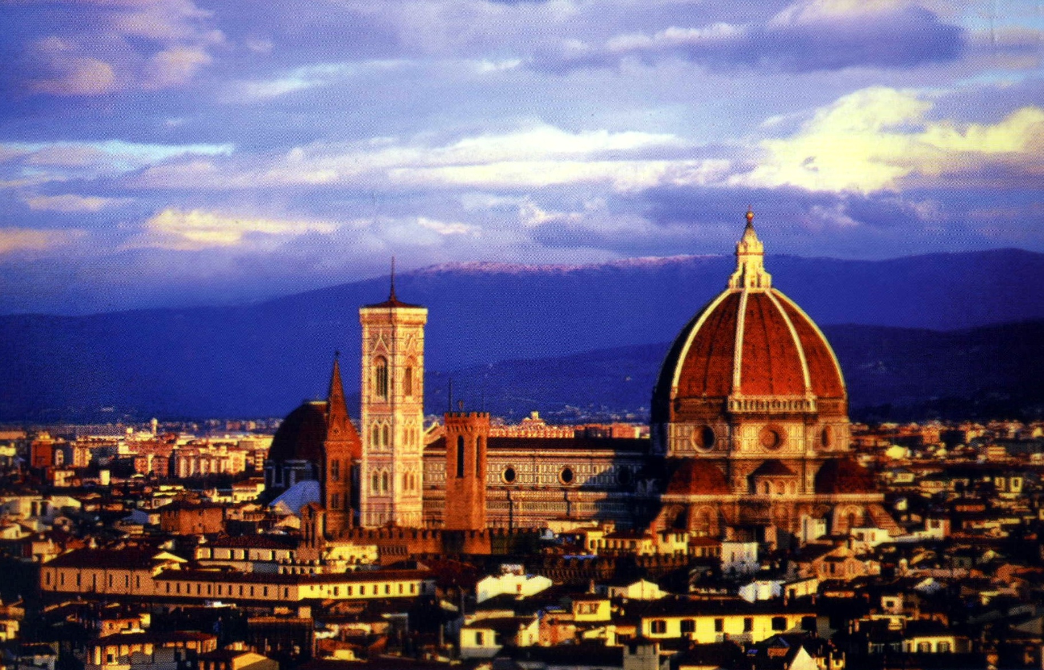
Renaissance Italy

Slide 2
The Renaissance
The Renaissance is the time period following the Middle Ages in Europe from 1350 -1600.
Renaissance = French for “rebirth”
The Renaissance renewed interest in Greek and Roman literature and life.
It placed emphasis on the power of human reason and advances in the arts and sciences.

Slide 3
Italy was the Birthplace of the Renaissance.
It began in the 1300s in the Italian city-states of:
Florence
Milan
Naples
Rome
Venice

Slide 4
Causes of the Italian Renaissance
There are 4 significant causes of the Italian Renaissance:
Reminders of the glory of Ancient Rome through the ruins of old buildings.
Italy had largely avoided economic crisis of the late Middle Ages which had affected other parts of Europe.
Italian city states were important centers of trade (an effect of the Crusades). They had contact with other cultures – the Byzantine and Islamic world – through trade routes and the Crusades.
Many Byzantine scholars came to Italy after the fall of Constantinople to the Ottoman Turks in 1453. Helping spread knowledge and ideas.

Slide 6
Humanism
Scholars grew interested in Greek and Roman grammar, history, poetry, and rhetoric – for their own sake rather than for the relevance to the Christian church.
Humanists believed in:
The pursuit of full, active, meaningful life on Earth.
That each individual has dignity and worth
People are rational beings who possess within themselves the capacity for truth and goodness.

Slide 8
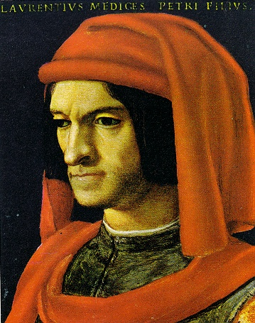
Florence: The Birthplace of the Renaissance
In the 1434, Florence came under the rule of a powerful family – the Medici Family.
The Medici's were strong patrons (financial supporters) of the arts.
The Medici’s funded many artists in Florence – including Michelangelo.
For this reason, Florence became known as the Birthplace of the Renaissance.

Slide 9
Art of the Renaissance
To make artistic creations more realistic, Renaissance artists experimented with new techniques.
This led to the development of Perspective – giving a work a better sense of depth.
New oil paints, which could take weeks to dry, allowed artists to work on a single painting for long periods of time.

Slide 11
Under humanist influence art moved from symbolic representation of the person to a life like appearance.

Slide 12
Although much of the art was still based on Christian biblical themes, artists also portrayed scenes from classical mythology.
Botticelli, The Birth of Venus, 1480

Slide 13
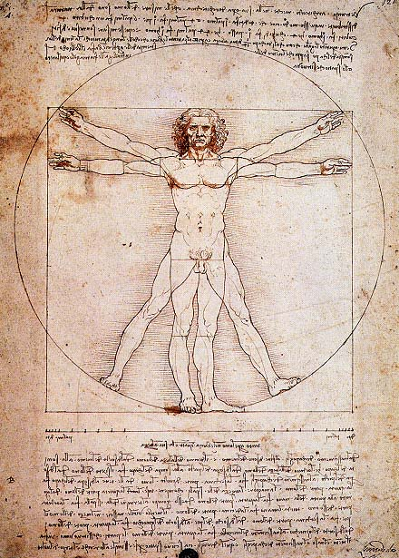
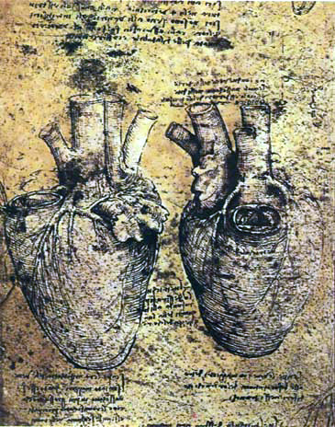
Anatomy was studied to portray human figures more accurately and naturally.
Studies of Human Anatomy – Da Vinci

Slide 14
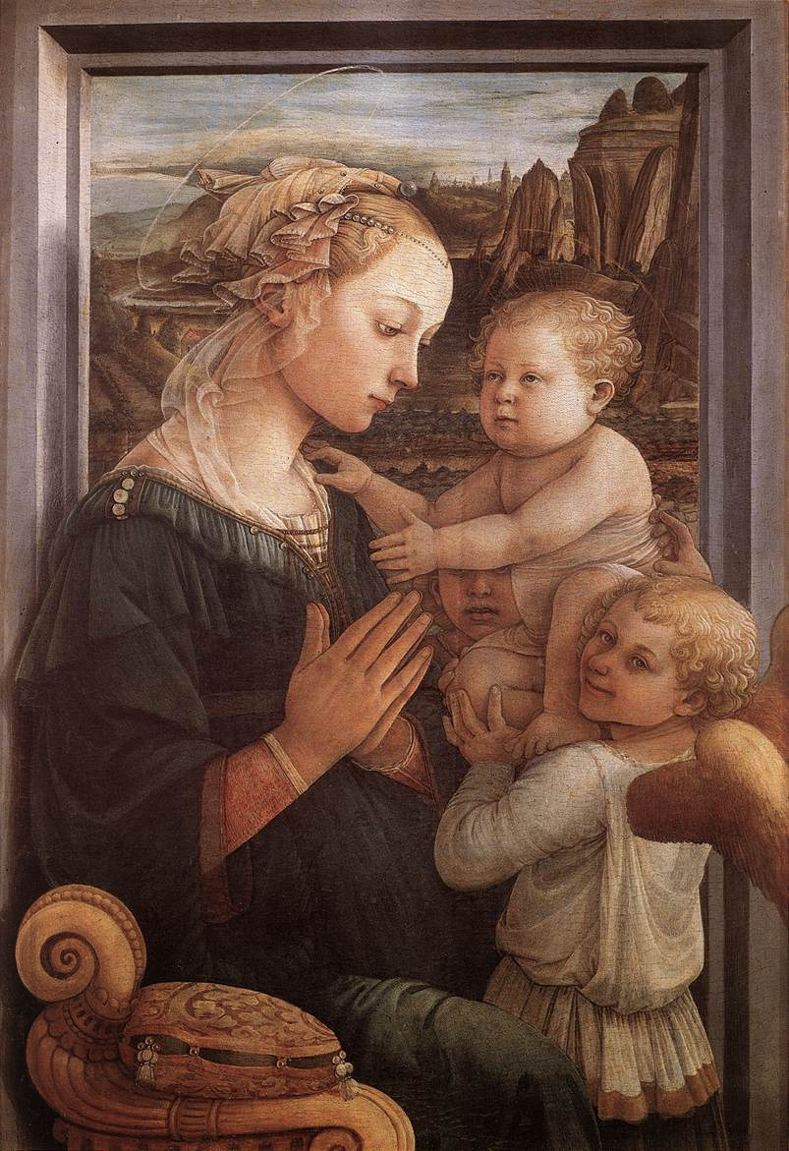
The subtleties of gesture and expression were used to convey human emotions.

Slide 15
Famous Artists of Florence
Famous artists of the Italian Renaissance included:
Michelangelo
Raphael
Donatello
Leonardo Da Vinci

Slide 16
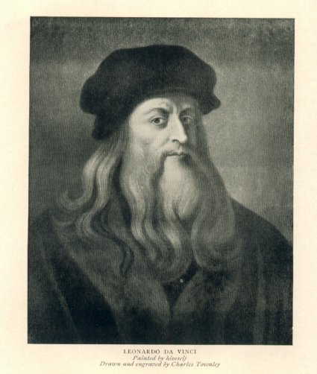
Leonardo da Vinci (1452- 1519)
Master of the High Renaissance
“Renaissance Man” = Celebrated painter, sculptor, architect, engineer, and scientist.
Very innovative and influential
Greatest works:
Mona Lisa
The Last Supper

Slide 17
da Vinci: Mona Lisa

Slide 18
da Vinci: The Last Supper

Slide 19
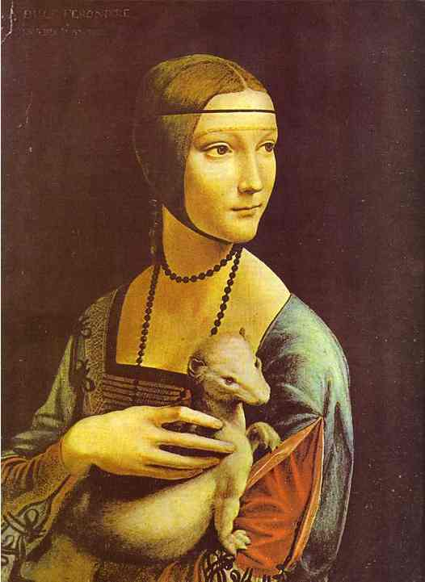
da Vinci: Portrait of Cecelia Gallerani

Slide 20
Da Vinci: Armored Car and Flying Machine

Slide 21
da Vinci: Anatomy Studies Homo Universalis

Slide 22
Michelangelo Buonarroti (1475 – 1564)
Highly influential painter, sculptor, architect, and poet.
Explored movement and expression of the male nude form.
Continually sought challenge – physical, artistic and mental.
Greatest works:
Ceiling of Sistine Chapel in Rome.
Statue of David (from the Bible)
Dome of St. Peter’s Cathedral in Rome.

Slide 23
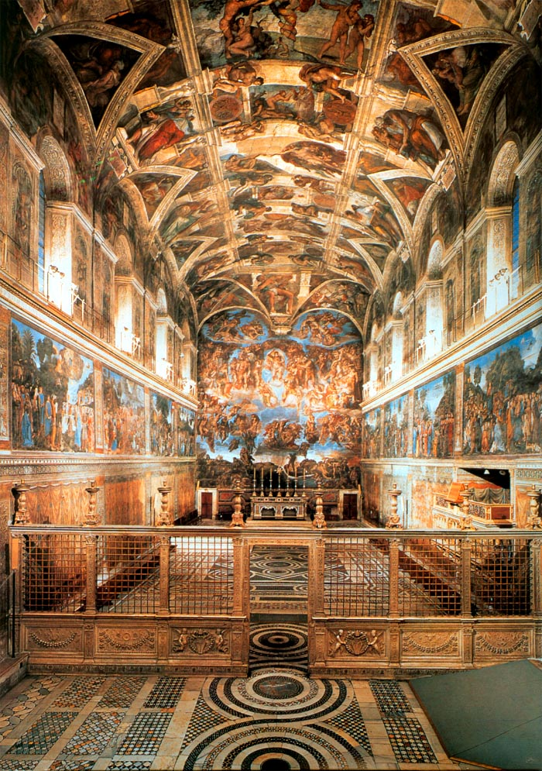
Michelangelo: Sistine Chapel (Rome)

Slide 24
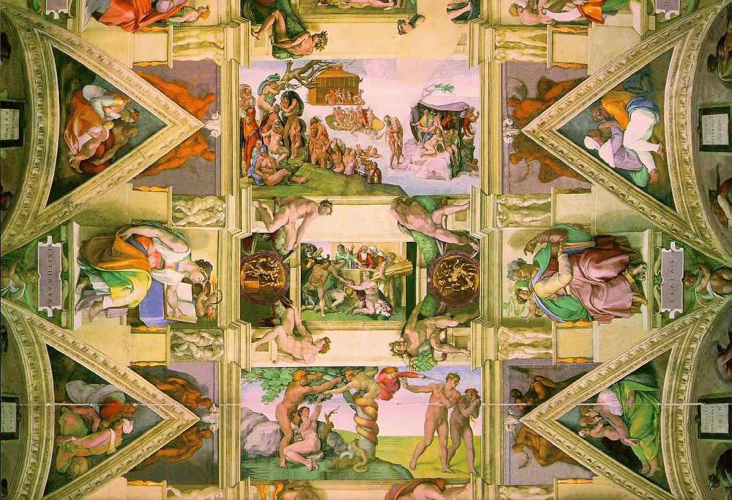
Michelangelo: Sistine Chapel (Rome)

Slide 25
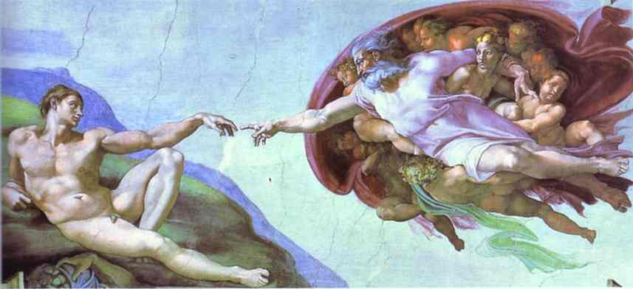
Michelangelo: Creation of Adam (Sistine Chapel)

Slide 26
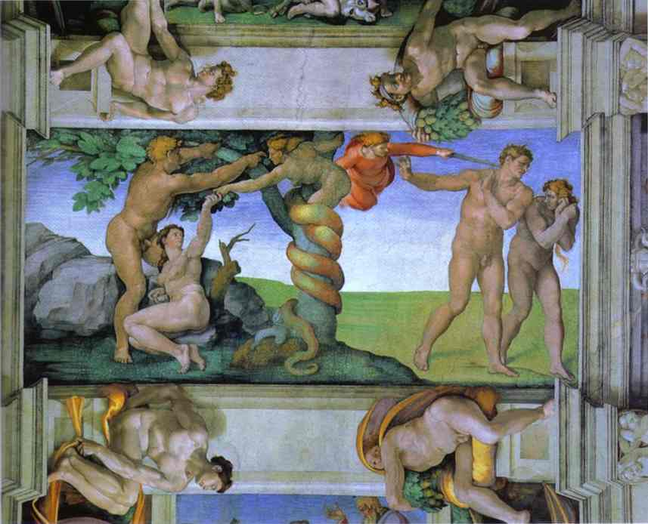
Michelangelo: The Expulsion of Adam and Eve (Sistine Chapel)

Slide 27
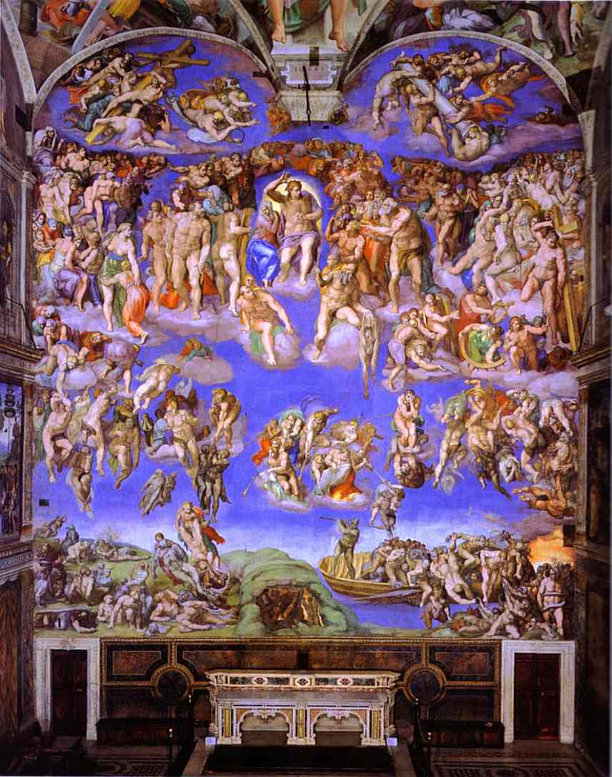
Michelangelo: The Last Judgment (Sistine Chapel)

Slide 28
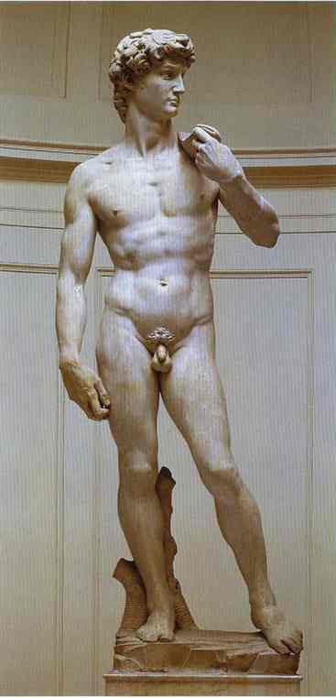
Michelangelo: David

Slide 29
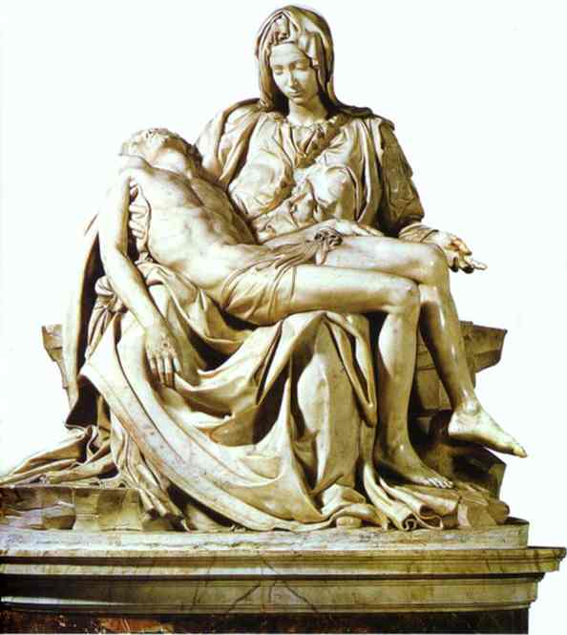
Michelangelo: Pieta

Slide 30
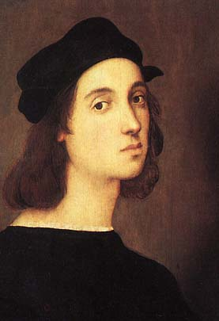
Raphael (1483-1520)
Greatest works:
Portrayals of the Madonna (mother of Jesus).
The School of Athens

Slide 31
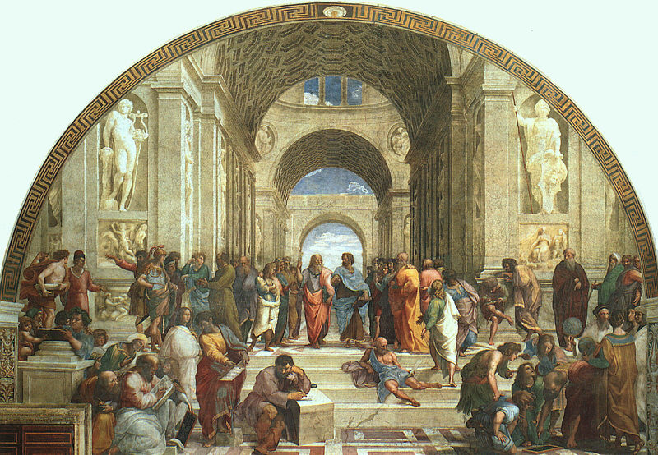
Raphael: School of Athens

Slide 32
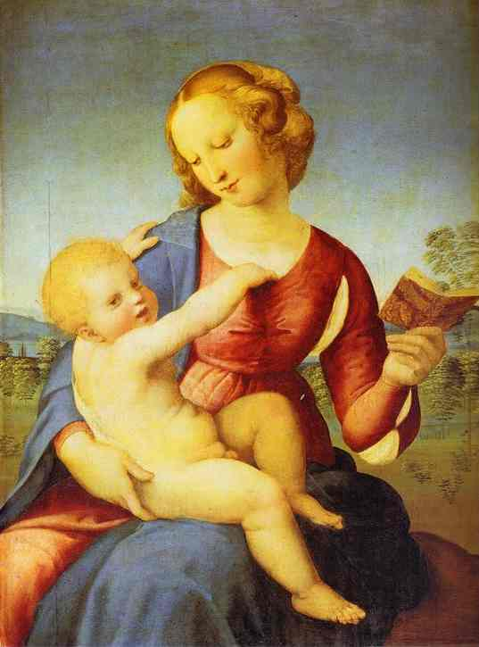
Raphael: Calonna Madonna

Slide 33
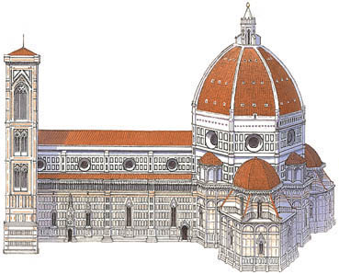
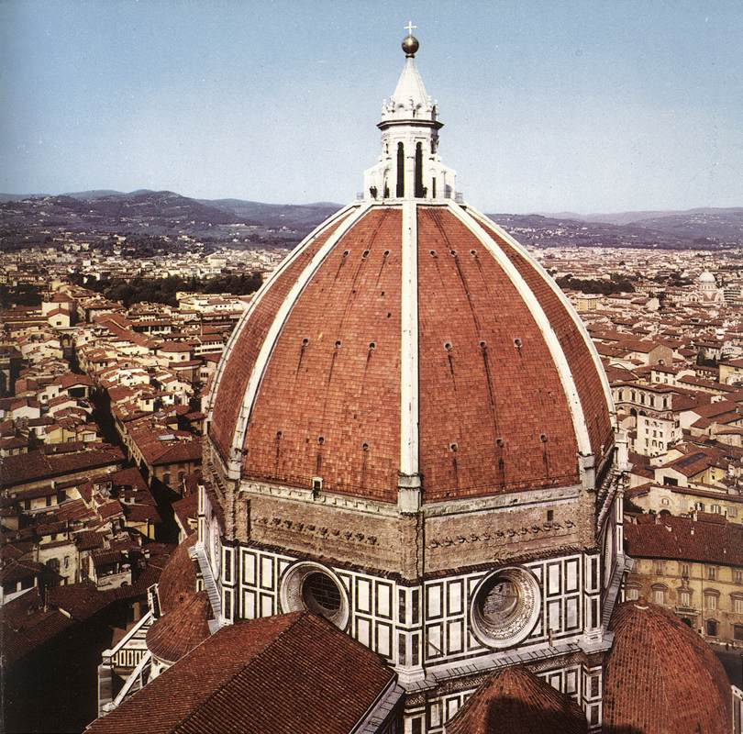
Italian Renaissance Architecture
In architecture, there was a return to the domes and columns of the Greek and Roman days.
Brunelleschi was the most famous architect who built the Cathedral of Florence.

Slide 34
Brunelleschi’s Dome

Slide 35
St. Peter’s Basilica Rome

Slide 36
Grand Canal, Venice

Slide 37
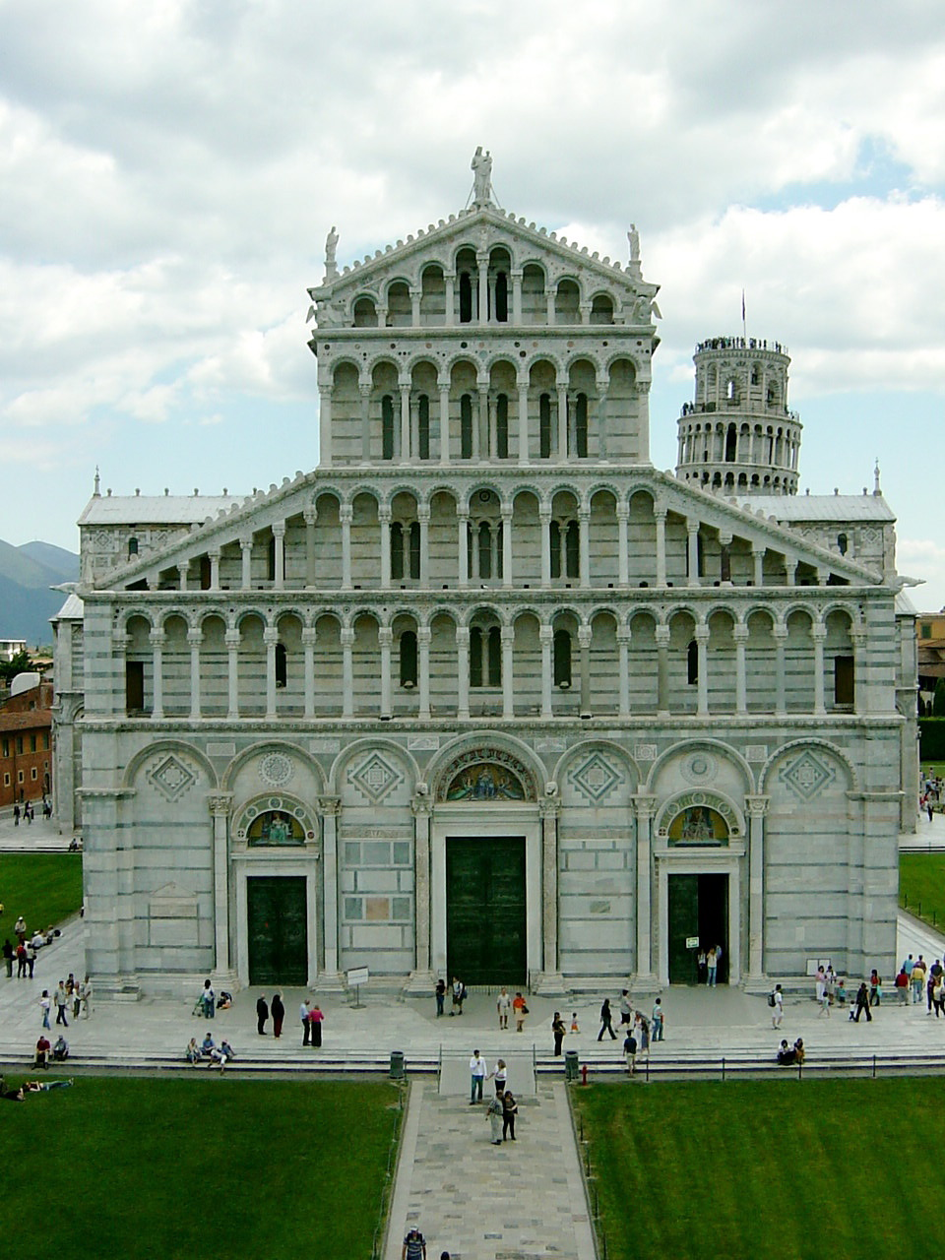
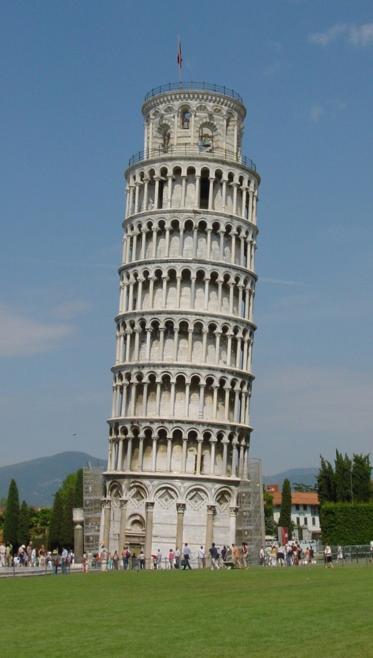
Cathedral and Leaning Town of Pisa

Slide 38
Italian Renaissance Writers
Nicolo Machiavelli (1469-1527) was an Italian statesman, historian, and political philosopher.
His influential writings on government have made his name synonymous with cunning and duplicity.
He became prominent in the government of Florence around 1500.
During his government service he met many Italian rulers and studied their political tactics.

Slide 39
Machiavelli: The Prince (1513)
His most famous work, The Prince, describes how a prince can acquire and maintain political power.
Machiavelli believes a ruler is not bound by traditional ethical norms.
A prince should be concerned only with power.

Slide 40
A Good Politician (according to Machiavelli)
Lie: "it's good to be true to your word, but you should lie whenever it advances your power or security - not only that, it's necessary."
Do Wrong: "Hence it is necessary for a prince wishing to hold his own to know how to do wrong, and to make use of it or not according to necessity."
Use Force: “… when they believe no longer, it may be possible to make them believe by force. "

Slide 42
Machiavelli’s Impact
Machiavelli’s work gave birth to modern political theory in the Western World. It has been studied by influential people including:
Bismarck JFK Hitler Stalin

Slide 43
Guide to the Italian Renaissance
You are going to a “Guide to the Italian Renaissance.” Your guide should inform readers of the following:
What is the Renaissance?
Why did it start in Italy?
What were the ideas of the Renaissance?
And two of the following details:
Poetry of the Renaissance
Science and Engineering of the Renaissance
Art and Architecture of the Renaissance
Politics of the Renaissance

Slide 44
Machiavelli’s The Prince
On your own sheet of paper, answer the questions about the Prince! You may highlight the paper if you need to.

Slide 45
Upon this a question arises: whether it be better to be loved than feared or feared than loved? It may be answered that one should wish to be both, but, because it is difficult to unite them in one person, it is much safer to be feared than loved…

Slide 46
Because this is to be asserted in general of men, that they are ungrateful, fickle, false, cowardly, covetous, and

Slide 47
as long as you succeed they are yours entirely; they will offer you their blood, property, life, and children, as is said above, when the need is far distant; but when it approaches they turn against you

Slide 48
but fear preserves you by a dread of punishment which never fails.

Slide 49
Nevertheless a prince ought to inspire fear in such a way that, if he does not win love, he avoids hatred; because he can endure very well being feared whilst he is not hated,
which will always be as long as he abstains from the property of his citizens and subjects and from their women.

Slide 50
But when it is necessary for him to proceed against the life of someone, he must do it on proper justification and for manifest cause, but above all things he must keep his hands off the property of others, because men more quickly forget the death of their father than the loss of their patrimony.

