Slide 1
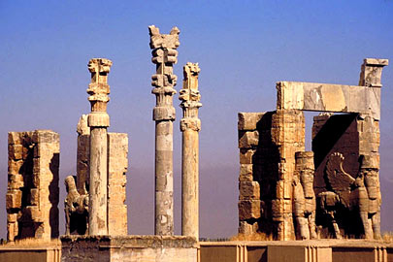
The World’s First Civilization: Mesopotamia

Slide 2
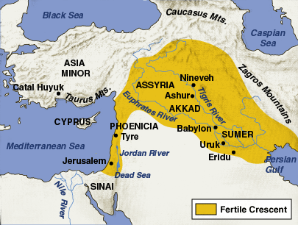
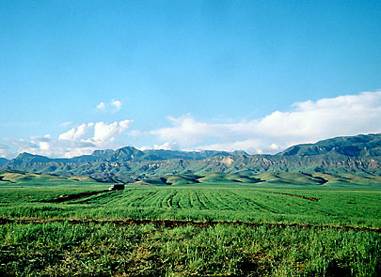
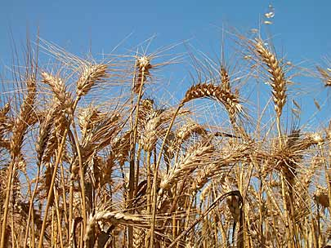
Fertile Crescent Civilization
Mesopotamia, arose in the Fertile Crescent around 3300 B.C.
Fertile Crescent ~ a region in the Middle East known for rich soils and good farming.
Mesopotamia means “between two rivers” because it was located between the Tigris and Euphrates rivers.
The world’s first civilization developed in Southeastern Mesopotamia called Sumer.

Slide 3
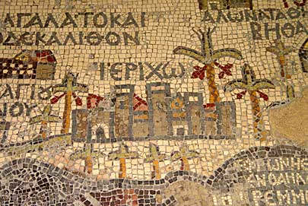
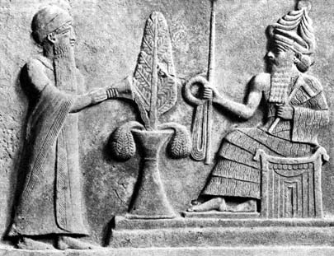
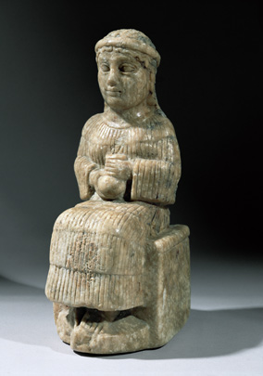
Life in Sumer
Sumerians built 12 city-states , which are cities that control the surrounding lands.
The two biggest city-states were Ur and Uruk.
These city-states were governed by the same families, called dynasties.
Sumerians established a social hierarchy where some people were given a higher rank than others – the highest people were the ruling family and priests.
Most people were poor peasant farmers who grew wheat and barley.
Women were given a few legal rights, could own property, and start a career.

Slide 4
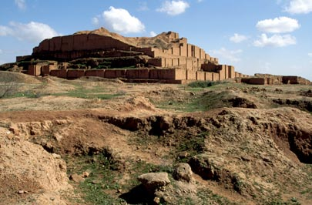
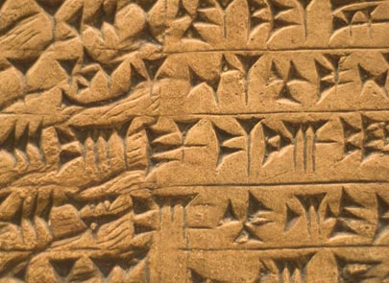
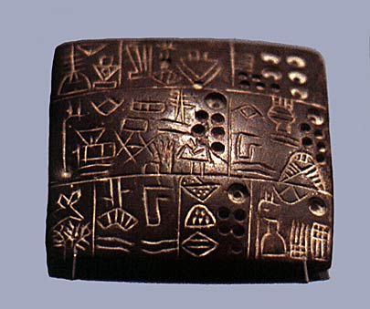
Sumerians were polytheistic – believing in many gods.
They worshipped their gods at large, stepped temples called Ziggurats.
Sumerians believed that in the afterlife everyone lived a miserable life in the underworld – gloomy.
Sumerians invented the first system of writing called cuneiform.
Cuneiform ~ writing using triangular (wedge-shaped) marks.
Sumerians created a narrative poem called the Epic of Gilgamesh about a flood that destroys the world.

Slide 5
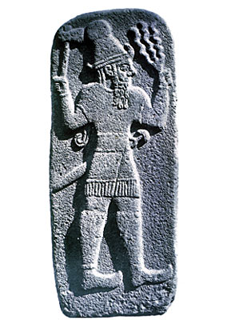
The End of Sumer
Fighting between the 12 city-states made Sumer weak.
In 2350 B.C., the Sumerians were conquered by Sargon, the ruler of Akkad.
However the legacy of Sumer continued throughout history. Sumer was known for:
Being the world’s first civilization
And The Epic of Gilgamesh
Inventing cuneiform, astronomy and mathematics

Slide 6
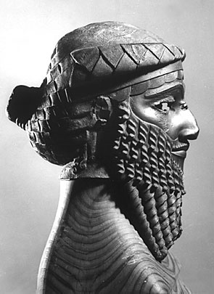
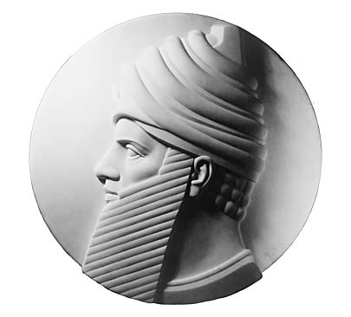
Invaders, Traders, and Empire Builders
Akkadians
In 2300 B.C., Sargon ,the ruler of Akkad, invaded and conquered Sumer.
He expanded his territory and built the first empire known in history!
Babylonians
In 1790 B.C., Hammurabi, king of Babylon, captured Mesopotamia
Hammurabi established a set of laws called Hammurabi’s Code. It was the first important attempt by a ruler to codify, or establish and put in writing, all the laws to govern a state.
Hammurabi’s code included Civil (crimes against property) and criminal (crimes against people) law!!
Punishments were VERY harsh – an eye for an eye!

Slide 7
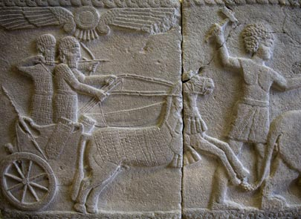
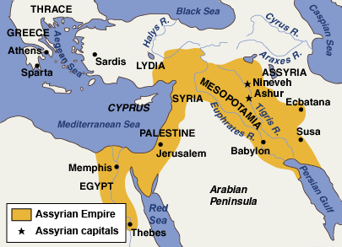
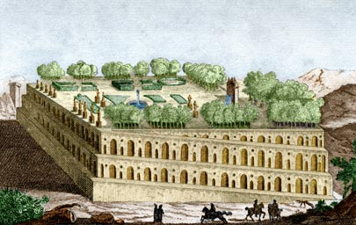
Hittites
In 1400 B.C, the Hittites conquered Mesopotamia.
They brought with them a major achievement – how to make weapons with iron.
Assyrians
Around 1100 B.C., the Assyrians, who were the most feared warriors in history, conquered Mesopotamia.
Used brutal tactics in war...
Assyrians expanded their empire, established a well-ordered society, built beautiful cities, and built the first library.
Babylonians again…
In 612 B.C., Babylonians crushed the Assyrians and reestablished their power. King Nebuchadnezzar greatly expanded the kingdom across Mediterranean.
And build 1 of the 7 wonders of the world…Hanging Gardens of Babylon!

Slide 8
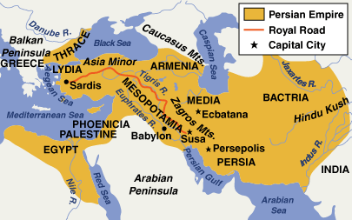
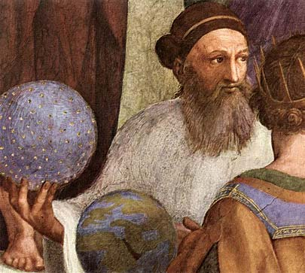
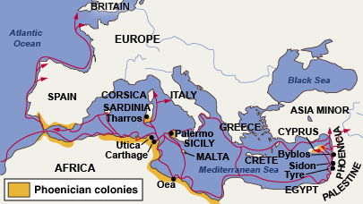
Persians
In 539 B.C. Babylon fell to the Persian army of Cyrus the Great.
King Darius I, greatly expanded the empire creating a government organized into provinces with governors and establishing a money economy (based on coins, not goods).
Persians also established a new religion called Zoroastrianism which believed in one god, Ahura Mazda
Phoenicians
Never conquered Mesopotamia, but established colonies along the Mediterranean.
Called the “Carriers of Civilization” because they spread Middle Eastern Civilization around the Mediterranean.
Also invented the world’s first Alphabet, where each symbol represents a sound. The Greeks later used the Phoenician’s alphabet!

