Slide 1
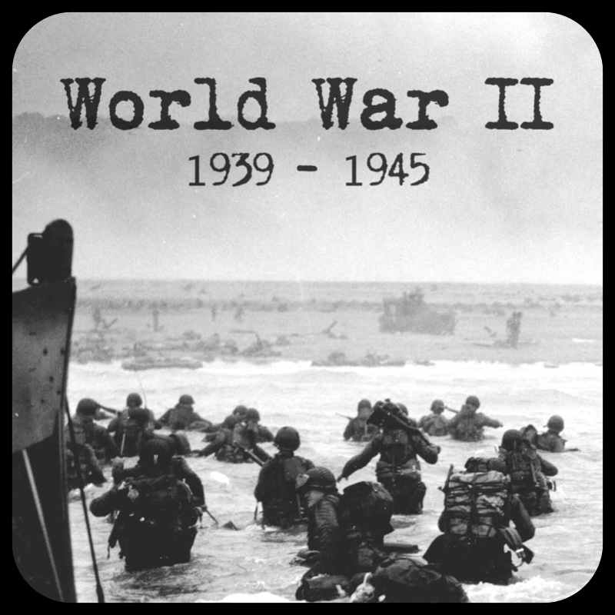
Life around WWII
World History
Mr. Westbrook
Created by: Matthew Washington

Slide 2
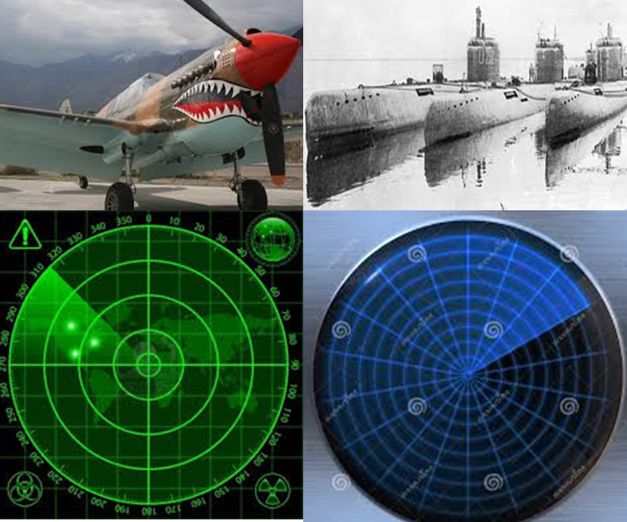
Warfare
Air Power Improved
Design & effectiveness of plane improved
Bombs to drop
Fast Moving Armored tanks
More reliable
Paratroopers
Improved design & effectiveness of subs
Radar: detect planes
Sonar: detect subs

Slide 3
Genocide
*Deliberate murder of a group of people*
Holocaust
6 million Jews killed
5 million non-Jews killed
Death Camps
Heads shaved, separated men and women. Children from adults
Young, old, and sick immediately killed

Slide 4
Total War
Ended Great Depression in U.S.
Citizens rights limited
Japanese Americans forced into internment camps

Slide 5
Women in the War
Worked in industry
Worked in military (drove trucks & ambulances delivered airplanes, decoded messages)
Some European women fought on front lines

