Slide 1
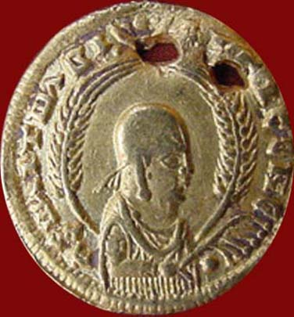
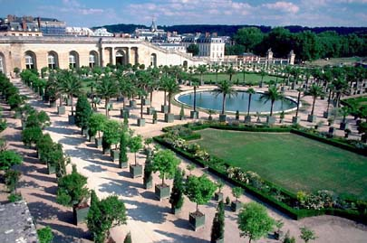
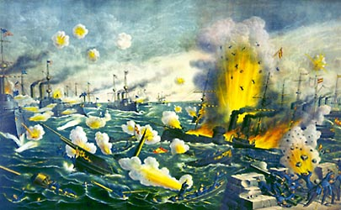
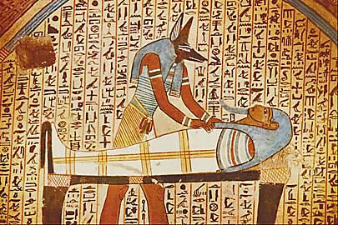
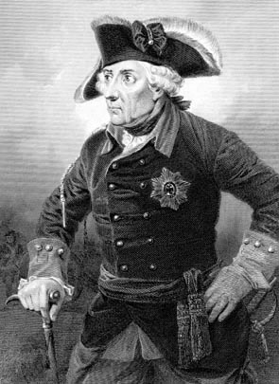
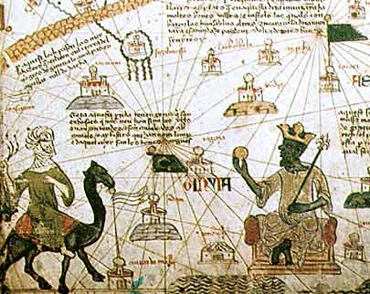
Introduction to History

Slide 2
Why is it important to study history? OR Is it not important?? Explain your opinion.

Slide 3
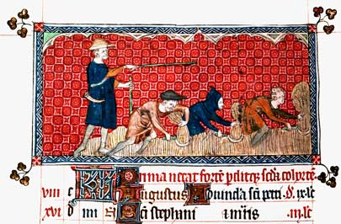
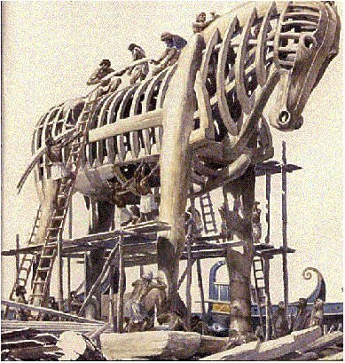
What is History?
Everything that happened in the past (including yesterday).
History can be written or oral:
Written History ~ History that has been written down and preserved throughout time.
Oral History ~ history which has been passed on by word of mouth such as through stories or songs.

Slide 4
Prehistory
The invention and use of writing marked the beginning of recorded history.
However, humans and their ancestors had lived on Earth for thousands upon thousands of years before the recording of history began.
We call the long period of time before people invented writing: Prehistory

Slide 5
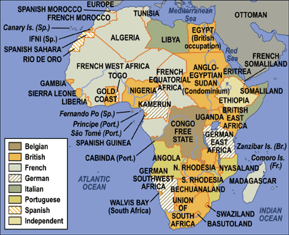
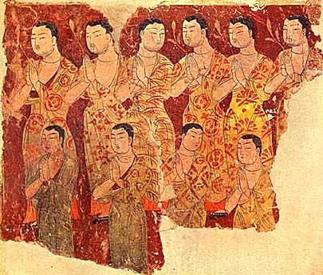
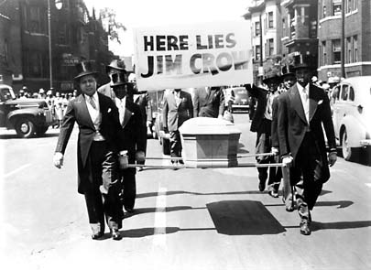
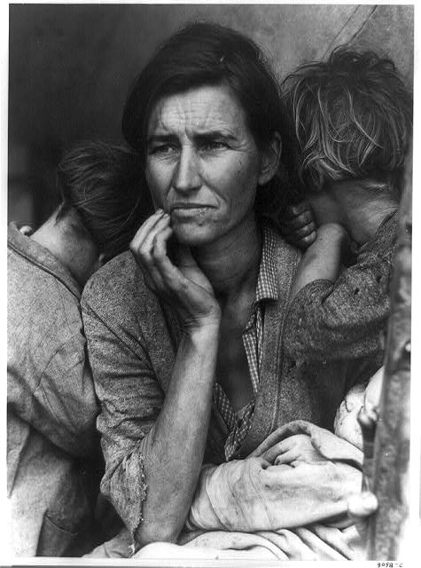
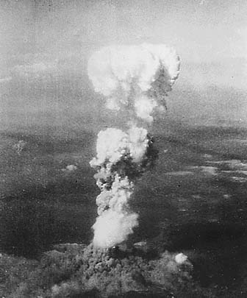
Why Study History?
#1
To understand the importance of current events, most of which have roots in the past.
For ex. Genocide in Africa, Religious Wars, and Civil Rights
#2
Understanding the past, can help us understand what happens today and what may happen in the future.
For Ex. Great Depression and Atomic Bomb
“The past causes the present, and the present causes the future.”

Slide 6
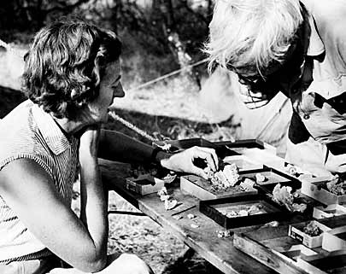
People who Study the Past
Anthropologists
Archaeologists
Historians
Political Scientists
Sociologists
Economists
Geographers

Slide 7
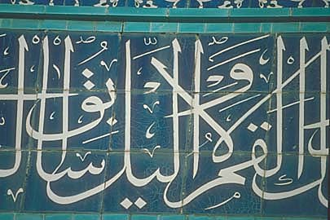
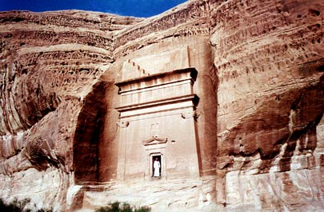
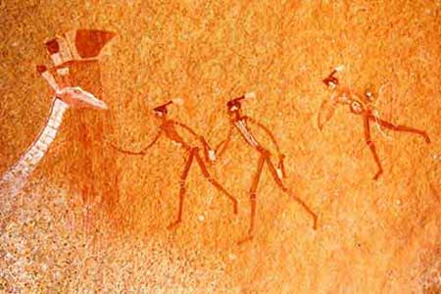
Historians
Historians are like detectives who use clues to discover what occurred in the past.
Historians study, record, write about, and interpret human experiences of the past.
Evaluate evidence to determine if it is reliable.

Slide 8
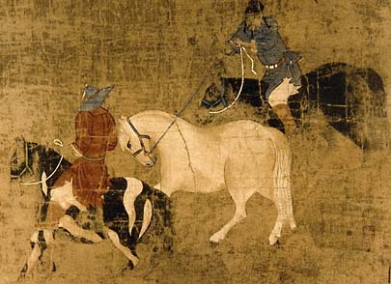
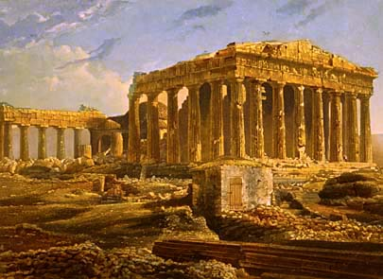
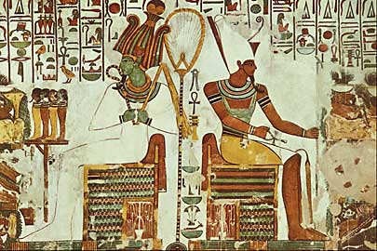
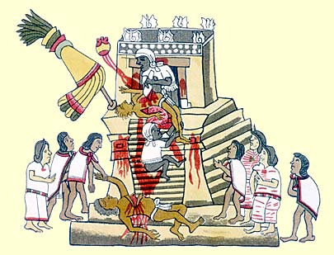
Anthropologists
Anthropologists study human cultures (both past and present).
Culture ~ the way of life of a society which is handed down from one generation to the next through learning and experience.
Culture includes the beliefs, values, and practices of a people.

Slide 9
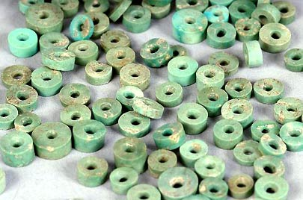
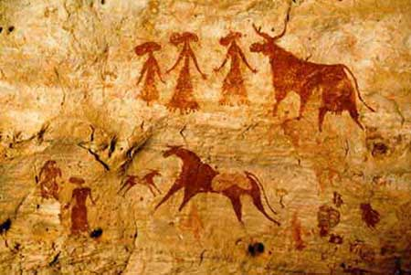
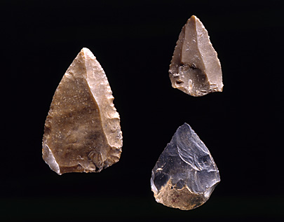
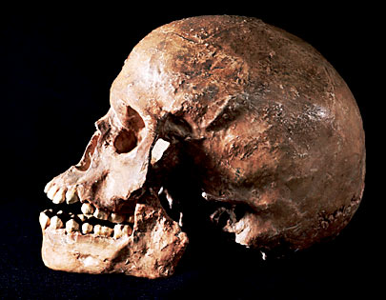
Archaeologists
Study past people and cultures through finding and analyzing material remains of human cultures.
Dig through dirt at sites in search of clues.
“Artifacts” = anything made by humans such as tools, coins, buildings, weapons, pottery, clothes, and artwork.
“Fossils” = the remains of living things (plants, animals, people), not things that were made.

Slide 10
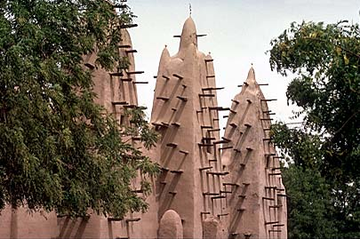
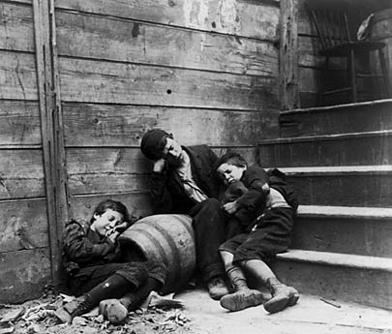
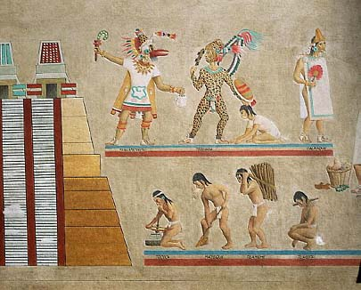
Sociologists
Sociologists study the relationships between individuals and groups.
Examples of groups sociologists study:
Social Institutions (such as families, school and churches)
Social Problems (crime, race relations, poverty)
Social Classes

Slide 11
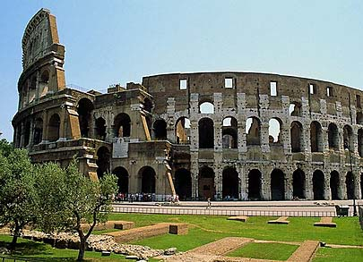
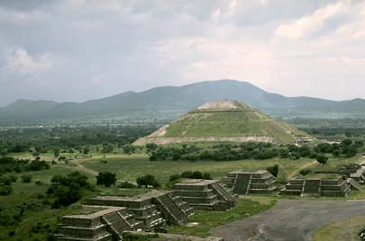
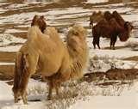
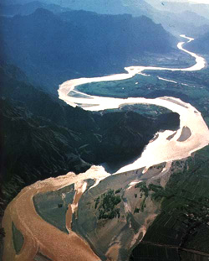
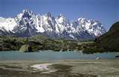
Geographers
Geographers study the Earth and how people interact with it.
“Human characteristics” ~ such as buildings, roads, bridges, and man-made lakes.
“Physical characteristics” ~ such as mountains, oceans, lakes, beaches, rivers, wildlife, soil, and hills.

Slide 12
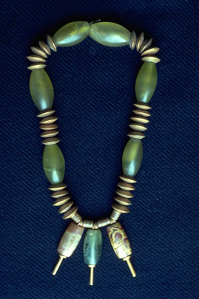
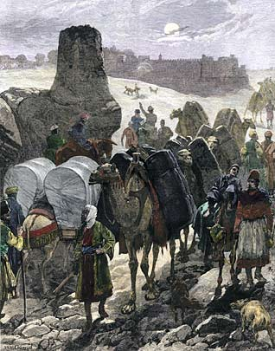
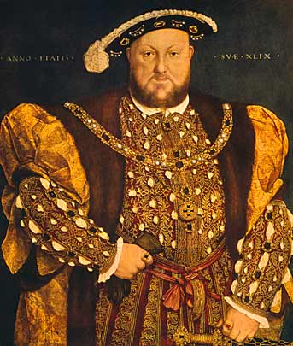
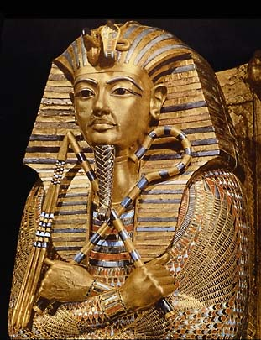
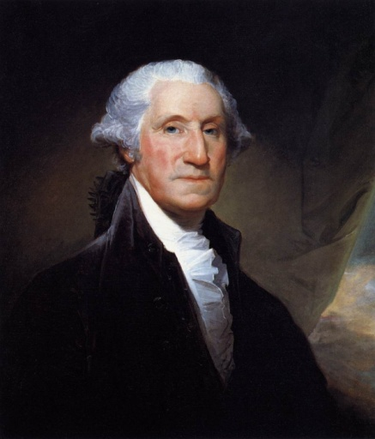
Other People Who Study History
Economists - Study the production and distribution of scarce resources, goods, and services.
Political Scientists – Study government and politics.

Slide 13
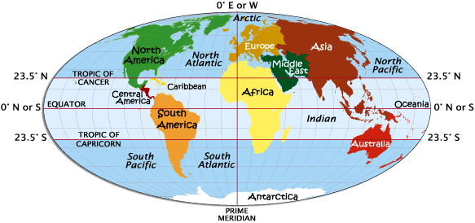
Historical Tools
Historians (like detectives) use all sorts of tools to put together a historical story.
#2 Artifacts
#1 Maps!
#3 Fossils
#4 Oral History
#5 Written History

Slide 14
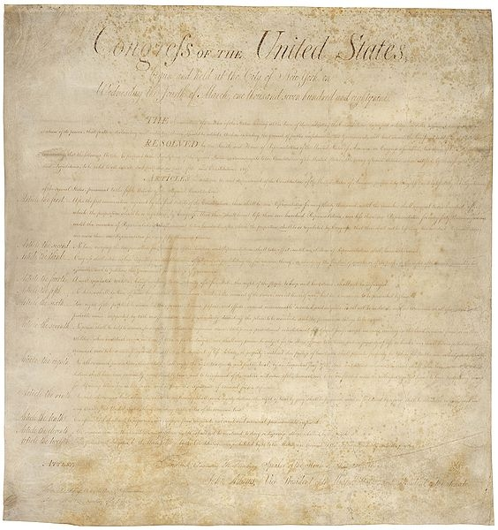
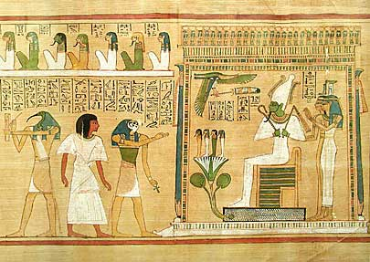
Written History Sources
Primary Sources
first hand or eyewitness accounts of an event
experienced the event
subject to different interpretations
Secondary Sources
second-hand records of what happened
did not experience the event

Slide 15
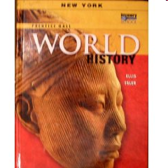
Primary or Secondary Historical Source?
Textbook
Secondary!

Slide 16
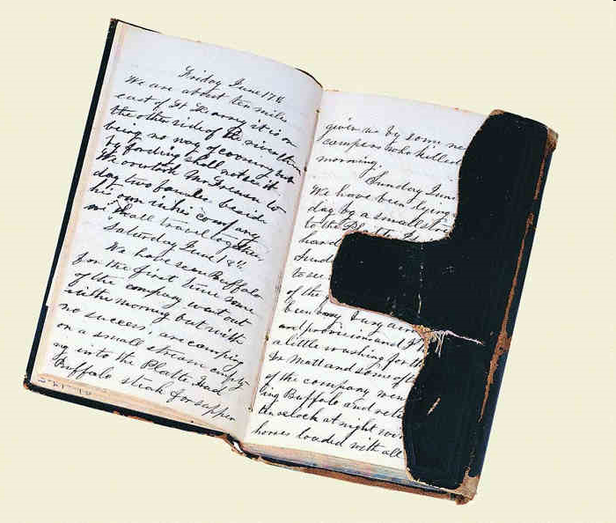
Primary or Secondary Historical Source?
Diary
Primary!

Slide 17
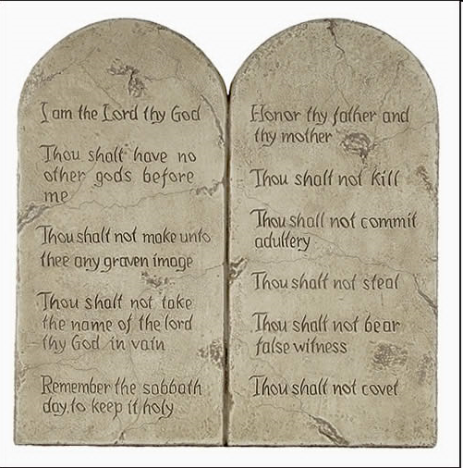
Primary or Secondary Historical Source?
The Ten Commandments
Primary!

Slide 18
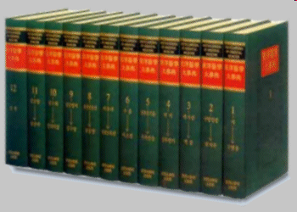
Primary or Secondary Historical Source?
Encyclopedias
Secondary!

Slide 19
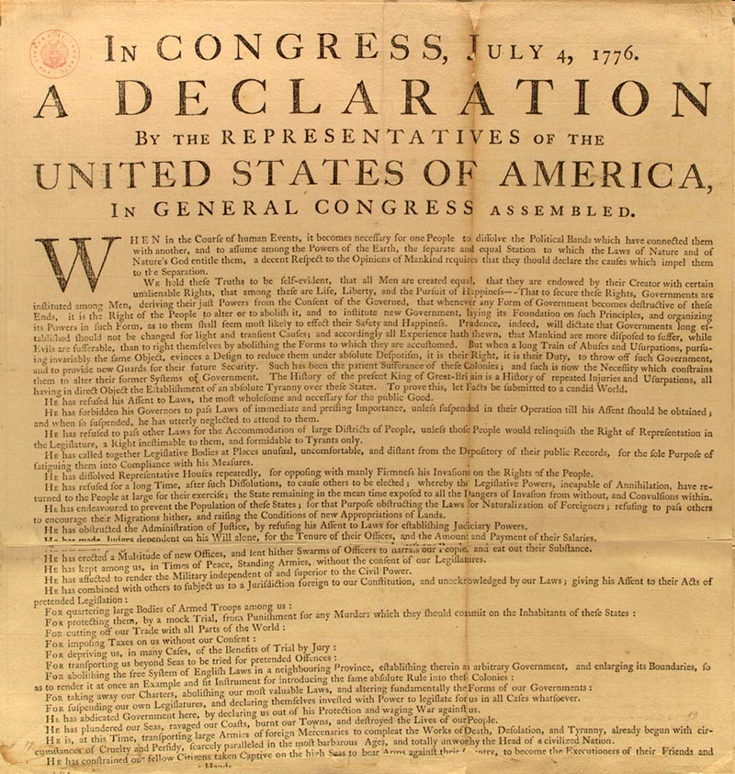
Primary or Secondary Historical Source?
Declaration of Independence
Primary!

Slide 20
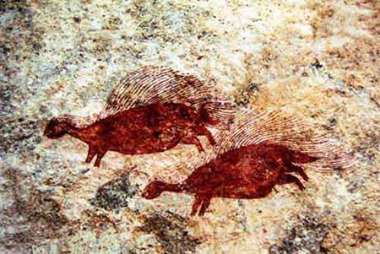
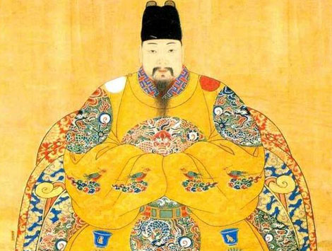
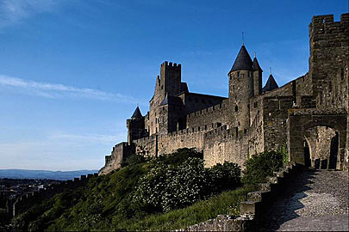
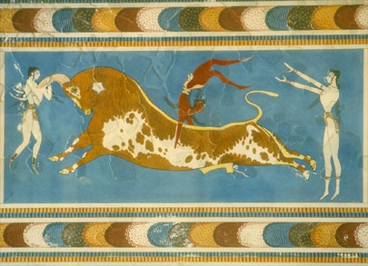
BC and AD
Historians have split our calendar into two time periods:
A.D./C.E. –(After death) “Anno Domini ” (Latin for “in the year of our Lord”), or “Common Era”
B.C. / B.C.E. = “Before Christ”, or “Before Common Era”
We currently live in the year 2018 C.E.

Slide 21
Descending
Ascending
BCE
A.D or CE
0

Slide 22
1756 CE
Seven Years' War (French and Indian Wars in America)
1999 CE
U.S. and China reach landmark trade agreement
1800 CE
Napoleon conquers Italy
1861 CE
U.S. Civil War begins
2014 CE
TODAY!
1 CE
Birth of Jesus Christ, Buddhism introduced to China
800 CE
Charlemagne crowned first Holy Roman Emperor in Rome
400 CE
Western Roman empire disintegrates under weak emperors
1368 CE
Ming Dynasty begins in China.
1535 CE
Reformation begins
4.5 Billion B.C E
Planet Earth formed.
600 million B.C.E
Earliest date to which fossils
can be traced.
100,000 B.C.E
First modern Homo sapiens in South Africa.
15,000 B.C.E
Migrations across Bering Straits into the Americas.

Slide 23
Archeology of Coin
Pretend it is the year 3014:
You and your partner have just discovered an Artifact from an ancient civilization. It is your job to analyze this artifact and put together a historical past.

Slide 24
After Examining the Coin: What conclusions can you draw about this Ancient civilization?
DO you think they had…
a religion?
a leader?
Laws?
a Culture?
What was the culture of these ancient people (Americans) like?

