Slide 1
Important American Documents
World History
Westbrook

Slide 2
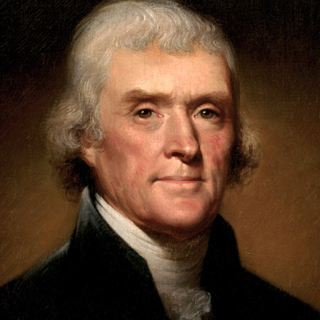
Declaration of Independence
Written by Thomas Jefferson
Signed July 4, 1776
Involved principle of Popular Sovereignty : All government power comes from the people
Detailed colonists' grievances against England

Slide 3
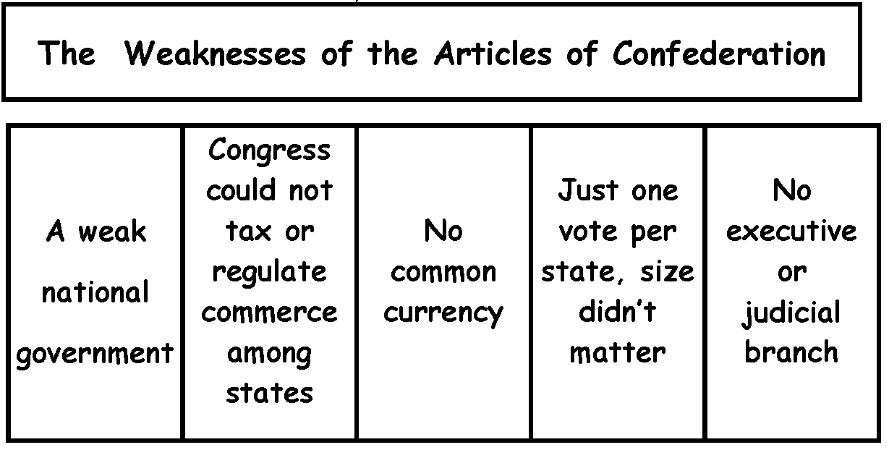
Articles of Confederation & Constitution
Nation’s 1st Constitution
Too weak to run the United States effectively

Slide 4
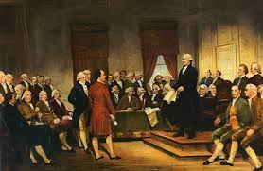
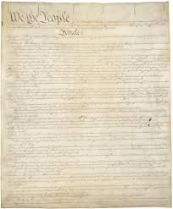
Constitution
Created a Federal Republic : Power divided between federal/national government & state government
Requires elected President & Legislature (Congress)
Separation of Powers (3 branch)
Executive (President & Cabinet)
Legislature (Congress)
Judicial (Supreme Court)
First 10 Amendments = Bill of Rights
1789, Constitution Ratified and becomes “Law of the Land”

