Slide 1
Imperialism

Slide 2
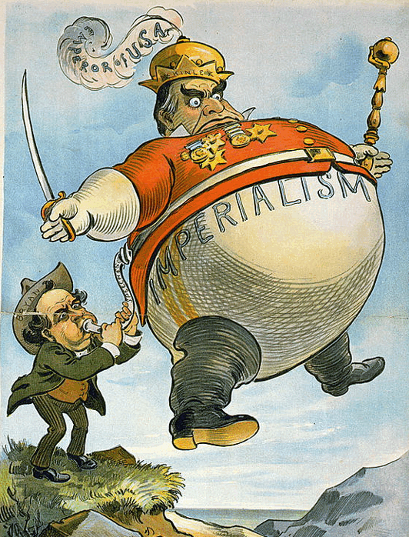
Imperialism
After the Industrial Revolution, Europeans began looking for new lands to explore and colonize this led to imperialism.
IMPERIALISM: domination by one country over the political and economic life of another country.

Slide 3
Motives of Imperialism
ECONOMIC
POLITICAL
RELIGIOUS
EXPLORATORY
IDEOLOGICAL

Slide 4
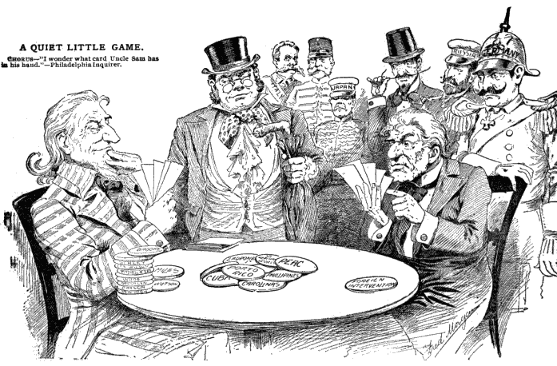
Economic Motives of Imperialism
ECONOMIC:
Make $$
Control foreign trade
New markets
Raw materials and cheap labor
Investments
Export technology.

Slide 5
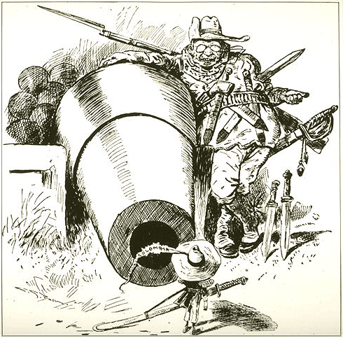
Political Motives of Imperialism
POLITICAL:
Gain power
Compete with other countries
Expand territory
Exercise military force
Gain prestige
Boost national pride &
security

Slide 6
Religious Motives of Imperialism
RELIGIOUS:
Spread Christianity
Spread American values and moral beliefs
Educate people of other cultures

Slide 7
Exploratory Motives of Imperialism
EXPLORATORY:
Explore the “unknown”
Conduct scientific research
Medical searches
Adventure
Investigate “unknown” cultures.

Slide 8
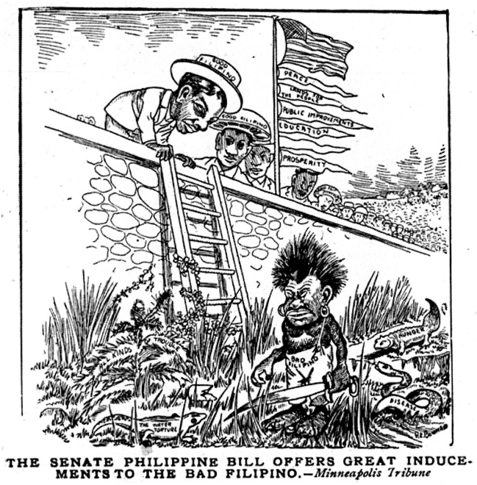
Ideological Motives of Imperialism
IDEOLOGICAL:
Cultural values
Belief in Race superiority (racism)
Belief in duty to “civilize” people in other parts of the world
Belief that all great nations should
have empires
“Survival of the Fittest”-
only the strongest nations will
survive.

Slide 9
Analyzing Motives of Imperialism
STEPS:
With your partner, examine the picture to determine which motive it reveals.
Describe what you see and write an explanation of why you chose that motive.

Slide 10
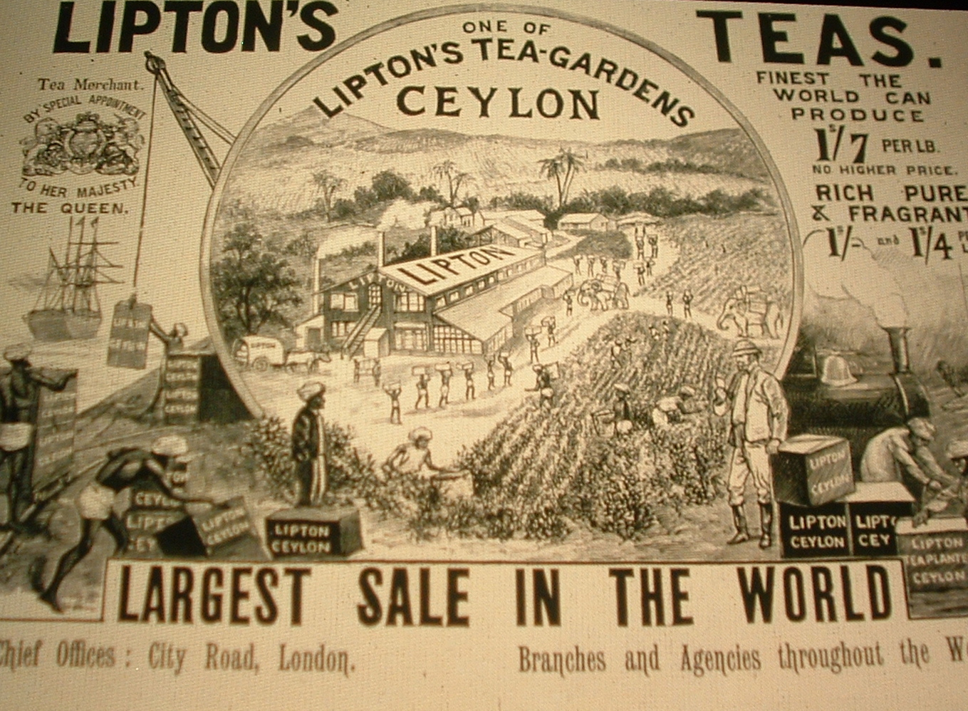
British Lipton Tea advertisement in the 1890s
Imperial motives: ECONOMIC (goods from Ceylon transported to London, use of indigenous labor and resources, exportation of industrial technology) or POLLITICAL (gaining national prestige through international trade)

Slide 11
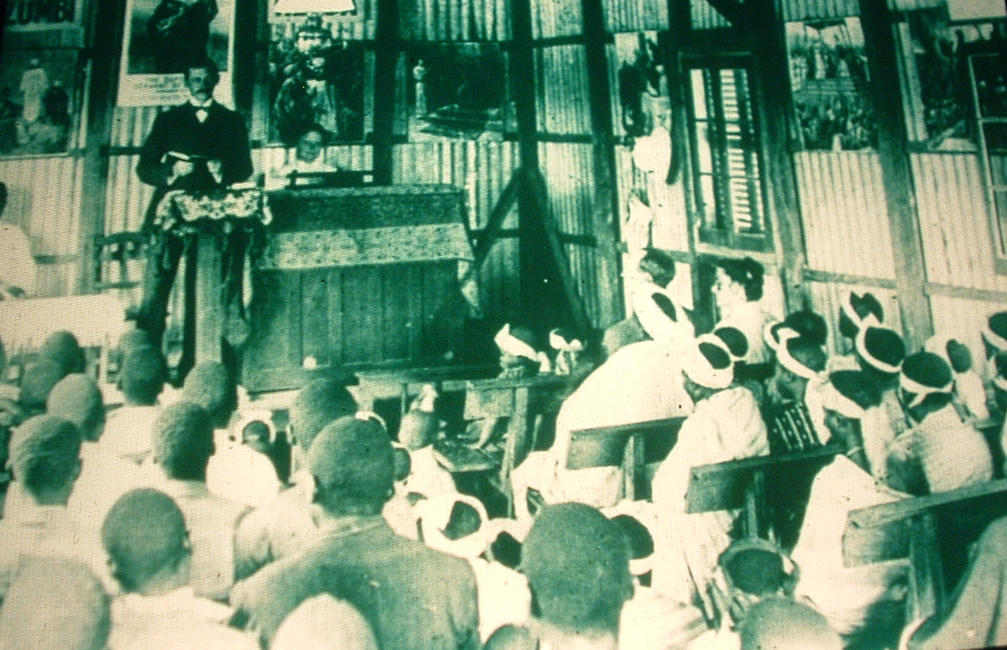
A Methodist Sunday School at Guiongua, Angola, 1925
Imperial motives: RELIGIOUS (Europeans spreading Christian values & education) or IDEOLOGICAL (teaching European customs & beliefs)

Slide 12
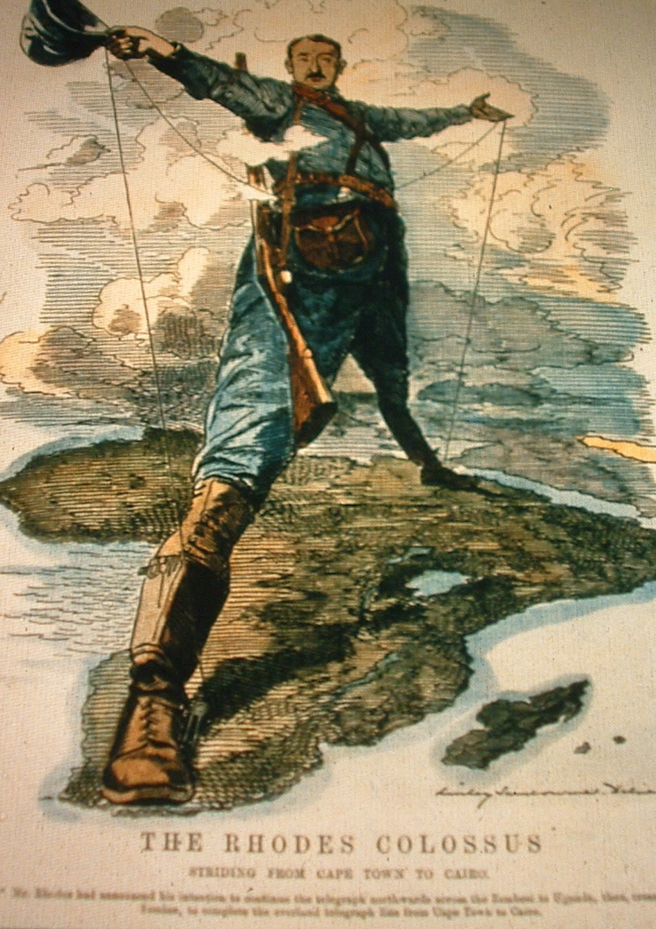
British cartoon “The Rhodes Colossus” showing Cecil Rhodes’ vision of making Africa “all British from Cape to Cairo” 1892
Imperial motives:
POLITICAL (desire to control African territory, desire to boost national pride and gain power by winning colonies, desire to have military presence) or
EXPLORATORY (exploring or venturing into unknown territory)

Slide 13
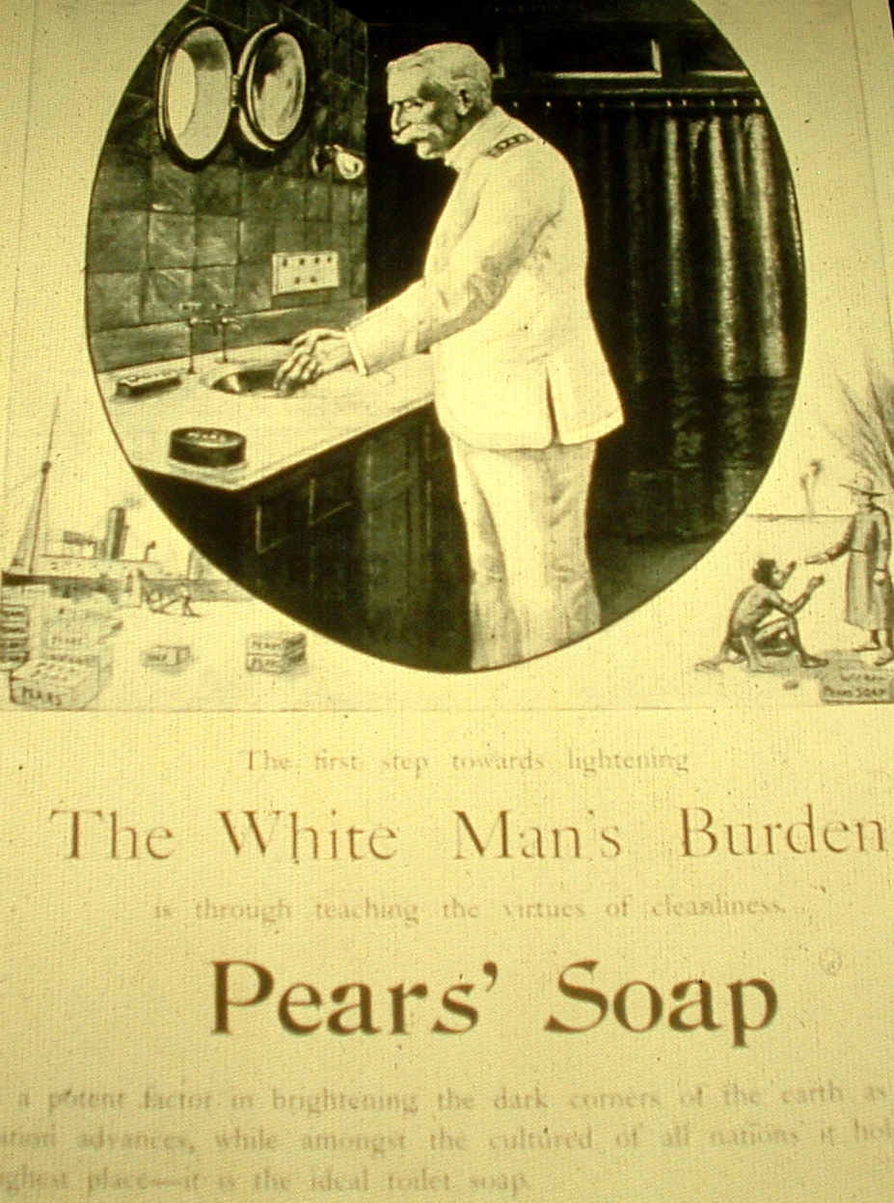
An advertisement for Pears’ Soap from the 1890s, and one stanza of the British poet Rudyard Kipling’s poem, The White Man’s Burden, written in 1899
Imperial motives:
IDEOLOGICAL (belief in European superiority, need to “civilize” captive peoples, need to cleanse “dark corners of the earth”) or
ECONOMIC (boats transporting goods to colonies, advertisement to sell product)

Slide 14
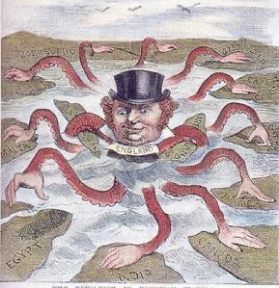
Spread of Imperialism
From 1870 to 1914, imperialist nations gained control over most of the world.
The European powers gained lands in Africa, Asia, and the Middle East with very little trouble. The United States gained lands in the Americas.

Slide 15
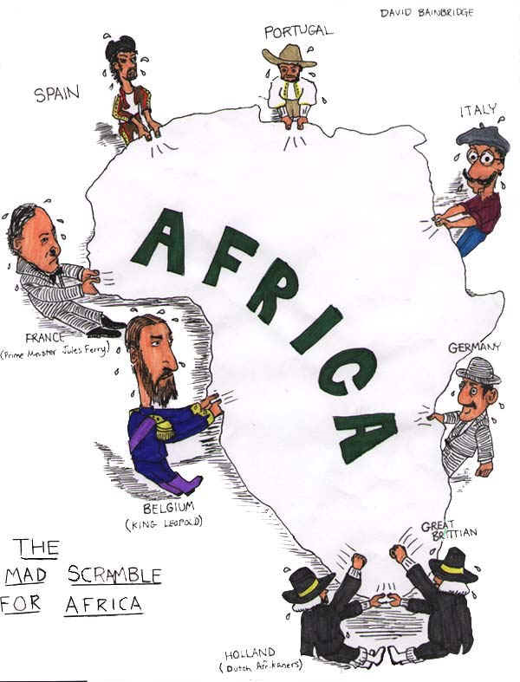
The European Scramble for Africa
Belgium was the first European country to try to explore and colonize Africa.
Before long, Britain, France and Germany were all claiming regions of Africa
To avoid fighting with each other the Europeans met at the Berlin Conference.
BERLIN CONFERENCE (1884): a meeting of European nations to decide how to colonize Africa. The Africans were not represented at the meeting.
By 1914, there were only two countries that were NOT controlled by Europeans.

Slide 16
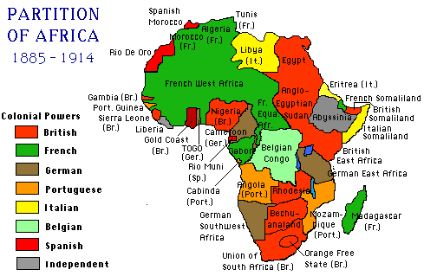
Which colonial power had the most land?

Slide 17
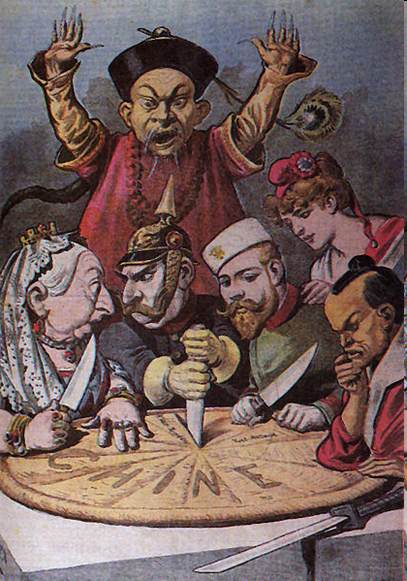
“Spheres of Influence” in Asia
Like Africa, European countries also wanted to gain lands in Asia – specifically China.
European powers created a sphere of influence by controlling the Chinese economy.
Open Door Policy – developed by European imperial powers to keep Chinese trade open to everyone.
And of course, they did not consult the Chinese

Slide 18
Spheres of Influence

Slide 19
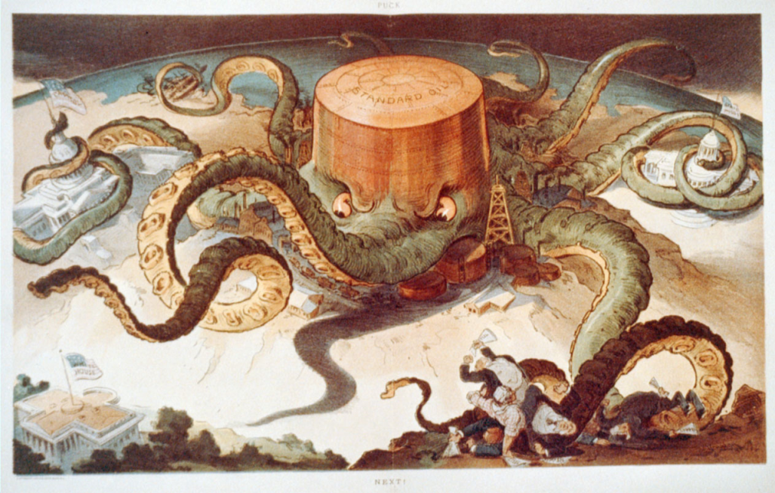
Oil in the Middle East
The discovery of oil changed everything in the Middle East!
As the Ottoman Empire fell to nationalist movements, Europeans began to gobble up their lands for oil.
Leaders from Europe, Russia, and the Middle East all tried to get control of the oil.

Slide 20
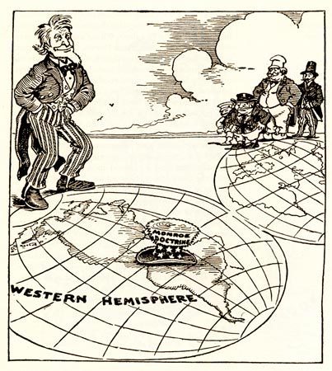
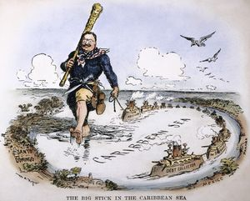
The U.S. Big Stick Diplomacy
The United States would slowly become an imperialist power and took control of parts of Latin America.
Monroe Doctrine - stated only the United States could control the western hemisphere and the Americas.
Mexican American War – we win war and take lands from Mexico.
Spanish American War – we win war and take Spanish colonies.
Cuba, Puerto Rico, Guam, Virgin Islands.
Roosevelt Corollary – extended the Monroe Doctrine stating United States would become a police power, restoring order in Latin America.
“Big stick Diplomacy”

Slide 21
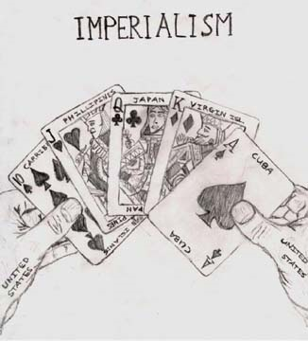
Forms of Imperial Rule
European nations set up colonies in three different ways:
DIRECT RULE: send officials from the mother country to the colony to run the government
Example: Europeans in Africa
PROTECTORATE/INDIRECT RULE: rulers in the colonies stay in place, but European advisers help them to make decisions
Example: Great Britain in India
SPHERE OF INFLUENCE: the mother colony controls all trade and economic decisions in the colony.
Example: Europeans in China

