Slide 1
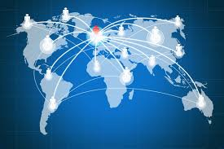
Globalization
Pg 1066 -

Slide 2
Globalization
Globalization – the process by which national economies, politics, cultures, and societies become integrated with those of other nations around the world.
One effect of Globalization is economic interdependence.
Interdependence – dependence of countries on each other for goods, resources, knowledge, and labor from other parts of the world.
This spread of goods and ideas has led to the development of a global culture.

Slide 3
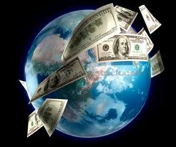
Globalization: TRADE

Slide 4
Globalization
Globalization has encouraged:
Outsourcing- practice of sending work to the developing world in order to save money or increase efficiency.
Many jobs today are outsourced to India, Russia, China, and the Philippines.
Multinational corporations- corporations that have branches and assets in many countries and sell their goods and services throughout the world.

Slide 5
Weaknesses of interdependence
Economic crisis in a country or region can have a global impact.
Ex. 1997- Financial crisis struck Thailand and quickly spread to other Asian countries from Singapore to South Korea.
The World is dependant on Oil
Ex. All nations need Oil for transportation and for products like plastics and fertilizer. In 1973 OPEC limited Oil exports and raised prices, sending economic shock waves around the world.

Slide 6
Free Trade
Free Trade is a key part of global trade today. The UN is an international organization with many responsibilities including promoting international monetary cooperation and encourage global economic growth.
To ensure this balance, treaties and organizations guide global trade:
(WTO) World Trade Organization – sets up global rules to ensure that trade flows as smoothly as possible.
Made up of more than 100 nations.
The Group of 8 (G-8) meets yearly to discuss a wide range of economic issues. It consists of Great Britain, Canada, France, Germany, Italy, Japan, United States, and Russia. (Industrialized nations)

Slide 7
Blocs
Many nations have formed Blocs or groups to promote trade and meet common needs.
NAFTA – North American Free Trade Association
Facilitates trade among U.S., Canada, and Mexico.
APEC – Asia- Pacific Economic Cooperation
Promotes trade along the pacific rim
OPEC – Organization Petroleum Exporting Countries
Represents oil producing countries and regulations the production of oil to stabilize the market.

