Slide 1
Globalization
Pg 1066 -

Slide 2
Human Rights
In 1948 the UN approved the declaration of Human Rights. It stated that all people are entitled to basic rights
“…without distinction of any kind, such as race, colour, sex, language, religion, political or other opinion, national or social origin, property, birth or other status.”
However human rights violations ranging from arbitrary arrest to torture and slavery occur daily around the world. The UN and human rights groups monitor and report human rights violations , from Afghanistan to Bosnia, to Congo.

Slide 3
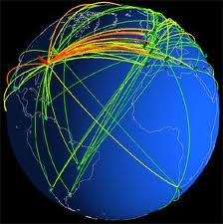
Globalization and Technology

Slide 4
The Space Race
By the second half of the 20th century there were few places on Earth that had not been explored, Space was seen as the “Final Frontier.”
1957- The Soviet Union launched the first artificial satellite, Sputnik, into orbit.
1969- U.S. Apollo program landed the first man on the moon.
1998- Russia, The U.S., Canada, Japan, and many Europeans countries are working on the International Space Station (ISS).

Slide 5
Computers and The Internet
1940’s- First electronic computers, huge and slow.
1970’s- Personal Computers (PCs) became widely available to the public. Due to the silicon chip the computer was reduced in size.
1990’s – The Internet, or World Wide Web (www.) was established via cable and satellites.

Slide 6
Globalization and Security

Slide 7
Security in a Dangerous World
In 1968, the Nuclear Nonproliferation Treaty (NPT) was signed by Russia, The United States, and 60 other countries. By 200, 187 nations had signed the treaty.
The purpose of this treaty was to ensure that nuclear weapons did not proliferate, or rapidly spread, to nations that had no nuclear weapons.
Today, the NPT is the most globally accepted arms control agreement. India, Pakistan, Israel, and Cuba have not signed.
The (IAEA) International Atomic Energy Agency monitors nations regularly to check that they comply with the treaty.

Slide 8
Terrorism
Terrorism- the use of violence, especially against civilians, by groups of extremists to achieve political goals. Sometimes terrorists are funded and protected by governments.
In the last two centuries terrorists have
Bombed buildings
Slaughtered civilians, police, soldiers
Assassinated political leaders

Slide 9
Regional Terrorist Groups
Particular regional terrorist groups have operated for decades:
Irish Republican Army (IRA)- forced British to give up northern Ireland.
The ETA, a Basque terrorist group- seeks to compel the Spanish government to secede part of their territory.
Tamil Tigers- in Sri Lanka use guerrilla warfare to gain territory.
The Shining path- in Peru, use violence to attempt to overthrow the government.

Slide 10
Terrorism in the Middle East
The PLO – Palestine Liberation organization renounced terrorism in 1988, however other Palestinian groups practice terror to achieve their goals.
Hamas
Islamic Jihad
AL-Aqsa Martyrs Brigade
Hezbollah- a Lebanese terrorist organization

Slide 11
Al-Qaeda
One powerful terrorist group lead by Osama Bin Laden, is called Al-Qauda. It is an Islamic Fundamentalist group, standing for “the Base” in Arabic.
Bin Laden helped war lords in Afghanistan drive out the Soviets in the 1980s.
His Goal- to expel American business interests, political influence, and military power from Saudi Arabia and the middle east.
By 2000, he was providing aid, training, and money to scattered terrorist groups from Morocco to Indonesia.
Al-Qaeda terrorists blew up two American Embassies in East Africa in 1998.

Slide 12
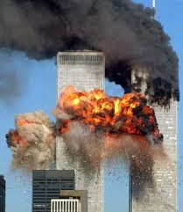
9/11
On September 11th, 2001, Teams of Al Qaeda terrorists hijacked four airplanes on the east coast of the U.S.
Two planes slammed into the twin towers of the World Trade Center in New York.
One plane plunged into the Pentagon in Virginia.
One plane’s passengers challenged the hijackers and led the plane off its target.
The Attacks killed 2,500

Slide 13
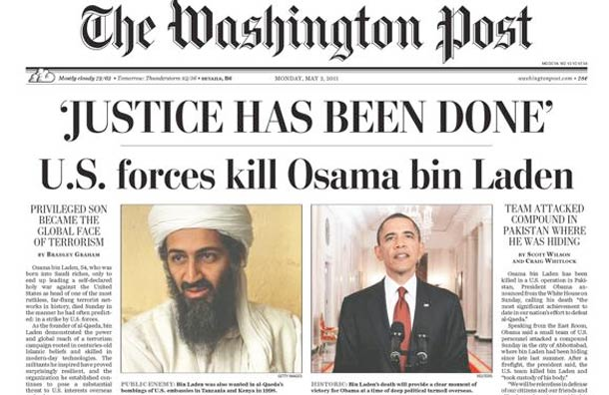
May 1st, 2011

