Slide 1
Gender

Slide 2
Let’s Get Started
Look at the following words, which are masculine words and which are feminine?
Pink
Dog
Cat
Blue
Pepper
Sports Car
Sedan
Mountain
Vanilla
Salt
Office
Beach
Chocolate
Home

Slide 3
Gender and Sex
Gender: Comprises the behavioral and psychological traits considered appropriate for men and women
Sex: Refers to the biological identity of a person
Gender traits are socially created and may vary from culture to culture
Gender determines the majority of the roles men and women play in society

Slide 4
Gender Role and Identity
Gender Roles: Specific behaviors and attitudes that a society establishes for men and women
Traditionally
Women = child-care and domestic duties
Men = Providing economic support and physical safety for the family
Sociologists are concerned with how gender identity is formed and how this identity influences social behavior
Gender Identity: Awareness of being masculine or feminine as those traits are defined by culture
Gender identity and roles have changed in recent decades
The degree to which a person takes on a gender identity affects his or her response to the gender roles established in society

Slide 5
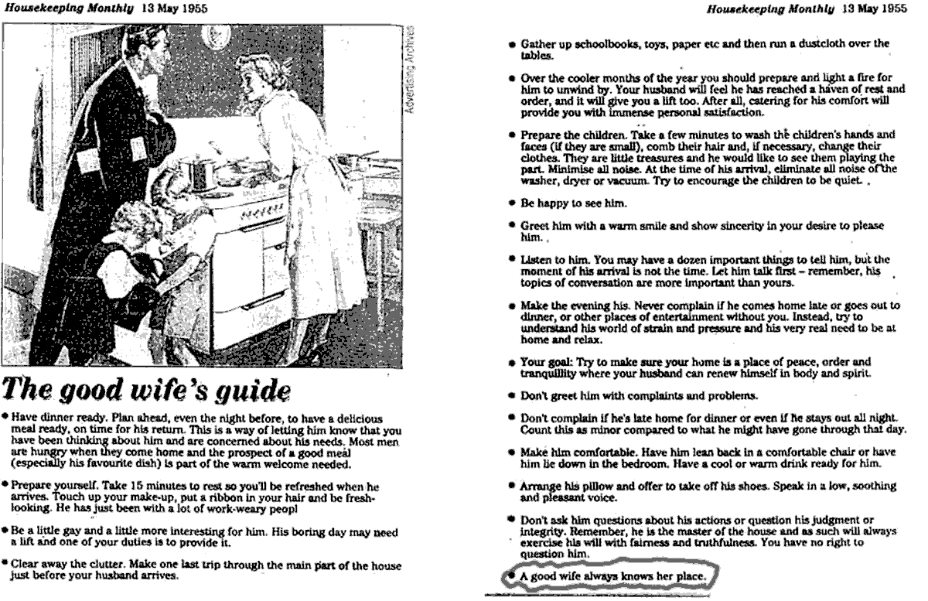

Slide 6
Gender Identity and Roles Between Cultures
Division of labor is usually the same across all societies, but Margaret Mead found exceptions in her study of 3 New Guinea societies
Tchambuli
Men and women care for children
Women were bossy and efficient and wore few adornments
Men were gossipy, artistic, wore cosmetics and curled their hair
Mundugumor
Traditionally masculine trait of aggressiveness was norm of men and women alike
Arapesh
Both men and women were expected to be passive and emotionally warm
Cross-culture variations evidence that gender roles are culturally and socially created rather than biologically based

Slide 7
Gender Identity and Socialization
We learn appropriate gender-role behavior through socialization (interactive process through which individuals learn the basic skills, values, beliefs, and behavior patters of society)
In almost all societies, gender socialization begins at birth and continues
Gender roles are reinforced at birth
Newborns are given very sex-specific clothes, toys, and nursery furnishing
Gender-typing is not seen as much as in the past
Girls are given more opportunities, but boys are still not given feminine things
Family is most power agent of socialization
Schools, media, and peer groups reinforce gender expectations

Slide 8
Nursery Rhyme
What is this nursery rhyme trying to say about society?
What are little boys made of?
What are little boys made of?
Frogs and snails
And puppy-dogs’ tails,
That’s what little boys are made of
What are little girls made of?
What are little girls made of?
Sugar and spice
And all that is nice,
That’s what little girls are made of

Slide 9
On your own…
Prepare a description of female socialization and another description of male socialization
How do you think males are taught to be “men” and females are taught to be “women”?
When you complete this task, fill out the “Gender Socialization” worksheet.
Mark your answers truthfully

Slide 10
Traditional Gender Expectations
Boys
Adventuresome
Aggressive
physically active
good at math and science
Encouraged to prepare for career in school
If passive there is concern
Girls
Polite and gentle
Passive (if too aggressive there are concerns)
Excel in reading, social sciences, and creative arts
Encouraged to marry and have a family in the future
Riley on Marketing

Slide 11
Gender Roles and Social Inequality
In practically every society gender is primary factor used to determine a person’s social standing
One view is that gender inequality is related to the nature of human reproduction
Growth of primitive societies depended on the birth and survival of children
Women bear and raise children
Men became hunters, traders, and warriors to protect and support family
Power relationship developed into a patriarchy (system in which men are dominant over women)
Families in industrial societies are generally small, most people live into their 70s, and women spend much of adulthood free from raising children
Women are seen as more responsible, but are still secondary

Slide 12
Gender Roles and Social Inequality
Explanation for persistence of gender roles is institutionalized discrimination
Certain discriminatory customs based on gender have become part of social structure
Sexism = Belief that one sex is by nature superior to the other
The heart of gender-based discrimination
Has been used to justify a continued male dominance
Sexism becomes self-fulfilling prophecy (prediction that results in behavior that makes the prediction come true)

Slide 13
Leave It to Beaver
The Cleavers are the 1950's 'All-American Family' in this 'feel-good' family sitcom. Parents Ward and June, and older brother Wally, try to keep Theodore ('the Beaver') out of trouble. However, Beaver continues to end up in one kind of jam or another. Unlike real life, these situations are always easily resolved to the satisfaction of all involved and the Beaver gets off with a few stern moralistic words of parental advice. Instigator and troublemaker Eddie Haskell is an older kid who always manages to avoid being caught
Source: http://www.imdb.com/title/tt0050032/plotsummary
While watching the episode, notice how the gender roles are played out
Also compare to sitcoms with families that are on television today

Slide 14
Sociological Perspectives on Gender Inequality
Functional
Believe that it is good for society to assign different tasks to men and women so that women play the expressive roles of bearing children and holding the family together, while men play the instrumental role of working
Conflict
Sexual inequality arose because men were able to exploit women, both economically and sexually
Feminists argue that surrogate motherhood is the ultimate exploitation of women
Symbolic Interaction
Interaction between the sexes reflects as well as reinforces gender inequality
Men talk more than women, interrupt women more than the other way around, boast more, and otherwise reflect inequality
Nonverbal interactions between the sexes also reflect and reinforce gender inequality

Slide 15
Gender Inequalities in the United States
Women have faced discrimination for years, but some American women took steps to end gender discrimination and they were the founders of the women’s movement (held that the sexes were socially, politically, and economically equal)

Slide 16
The Women’s Movement
Seneca Falls Convention
Women’s rights convention issued a Declaration of Sentiment
Declaration of Independence that includes women
Most important reform was suffrage (the right to vote)
19th Amendment gave women the right to vote (1920)
Betty Friedan’s The Feminine Mystique
Friedan rejected the popular notion that women were content with the roles of wife and mother
Argued that the “feminine mystique” (the glorification of gender roles of women) was a ploy to keep women in a secondary position in society
Led women to demand greater educational opportunities and fairer treatment at work
Equal Rights Amendment (ERA) was suggested but not enough states ratified the amendment for it to be added to the Constitution
Congress has passed many acts outlawing gender discrimination in education and in the workplace

Slide 17
Education
Before 1979, women were underrepresented among the ranks of college students and since then women have outnumbered men on college campuses
Differences in degree major
Men: engineering, physical science, and architecture
Women: education, humanities, social science
More and more women are attending graduate school, but women are less likely than men to pursue a doctoral or professional degree
Women’s participation in sports has increased over the past few decades and now women’s athletics is a growing spectator sport

Slide 18
The World of Work
More women have entered the workforce, but there has been little change in the wage gap (level of women’s income relative to that of men)
When compared to men who work in the exact same occupation, women consistently earn less money
Wage gap exists in all age groups at every level of education
Glass Ceiling: Invisible barrier that prevents women from gaining upper-level positions in business
There are beginning to be cracks
Men in traditionally female occupations do not face a glass ceiling, but quickly rise to high-level positions
Arlie Hochschild noted that working wives work a second shift (phenomenon of individuals having to complete household duties after working away from home)
This causes women to also face a “leisure gap” at home

Slide 19
The Political Arena
There is political gender gap in the US
Women outnumber men in the voting-age population
Women are more likely than men to vote
Men dominate the political arena, but many Americans seem open to women occupying public office
Women are being appointed to high office in growing numbers

Slide 20
Gender Stereotypes
Consider and list 5-10 gender stereotypes
Be prepared to share these stereotypes
What are ways in which you can avoid gender stereotyping

Slide 21
Your Gender Scale Rating
Complete the worksheet and find out your gender scale rating
Be prepared to discuss your findings

Slide 22
Ideal Versions of Male and Female
What are some features of an ideal man or woman?
Think of a product that is often advertised on TV, in magazines, or on the radio that demeans men or women. (choose 2; 1 for men and 1 for women)
Make a replacement ad for each product that does not demean men or women
BE APPROPRIATE!!!

