Slide 1
The Decline of Communism
The Fall of the Soviet Union

Slide 2
Setting the Stage
After WWII, The Soviet Union extended its power over much of Eastern Europe.
By the 1960s, it appeared that communism was permanently established in the region. During the 1960s and 1970s, the Soviet Union’s Communist leadership kept tight control over the Soviet people.

Slide 3
Economic Problems in the Soviet Union
The Soviet economy faced severe problems.
Collectivized agriculture remained so unproductive that Russia, a grain exporter, had to import grain to feed its people.
The Soviet command economy could not match western market economies in producing consumer goods. Soviet products were inferior in quality as well.
Soviet economic inferiority made it impossible for the Soviet Union to keep up with the U.S. in the arms race and in military preparedness.

Slide 4
A young Leader
In 1984, Mikail Gorbachev was selected as the next Soviet Premier.
Politburo - the ruling committee of the Communist Party.
Gorbachev’s supporters praised his youth, energy, and political skills. With their backing, Gorbachev became the party’s new general secretary.
In choosing him, Politburo members did not realize they were unleashing another Russian Revolution.

Slide 5
Grobachev
Grobachev made 3 major reforms to the Soviet Union.
Glasnost
Perestroika
Democratization

Slide 6
Glasnost
Gorbachev realized that economic and social reforms could not occur without a free flow of ideas and information.
In 1985, he announced a policy known as glasnost or openness.
Glasnost brought remarkable changes.
The government allowed churches to open.
It allowed the publication of books by previously banned authors.
Reporters investigated problems and criticized officials.

Slide 7
Perestroika
In 1985, Gorbachev introduced the idea of perestroika, or economic restructuring.
Local managers gained greater authority over their farms and factories
people were allowed to open small private businesses.
Gorbachev’s goal was not to throw out communism, but to make the economic system more efficient and productive.

Slide 8
Democratization
In 1987, he unveiled a third new policy, called democratization. This would be a gradual opening of the political system
The plan called for the election of a new legislative body. In the past, voters had merely approved candidates who were handpicked by the Communist Party.
Now, voters could choose from a list of candidates for each office. The election produced many surprises. In several places, voters chose lesser-known candidates and reformers over powerful party bosses.

Slide 9
Rising Tension
Various nationalities in the Soviet Union began to call for their freedom.
More than 100 ethnic groups lived in the Soviet Union. Russians were the largest, most powerful group.
However, non-Russians formed a majority in the 14 Soviet republics other than Russia.
Ethnic tensions brewed beneath the surface of Soviet society.
As reforms loosened central controls, unrest spread across the country. Nationalist groups in Georgia, Ukraine, and Moldavia (now Moldova) demanded self-rule.

Slide 10
Fall of the Soviet Union
1991- Representatives from 11 Soviet republics met and announced that they would no longer be part of the Soviet Union.
(Ukraine, the Russian Federation, Belarus, Armenia, Azerbaijan, Kazakhstan, Kyrgyzstan, Moldova, Turkmenistan, Tajikistan and Uzbekistan)
The once-mighty Soviet Union had fallen, largely due to the great number of radical reforms that Soviet president Mikhail Gorbachev had implemented during his six years as the leader of the USSR.
However, Gorbachev was disappointed in the dissolution of his nation and resigned from his job on December 25.
Notes:
Instead, they declared they would establish a Commonwealth of Independent States. Because the three Baltic republics (Latvia, Lithuania and Estonia) had already declared their independence from the USSR, only one of its 15 republics, Georgia, remained.

Slide 11
Tearing down the Berlin Wall
In 1989, as Soviet communism declined, Germany moved toward reunification.
Without, Soviet backing, East German communist leaders were unable to maintain control, They were forced to reopen their western borders.
Eventually, East Germans demanded reunification with the West.
In 1990, German voters approved reunification.

Slide 12
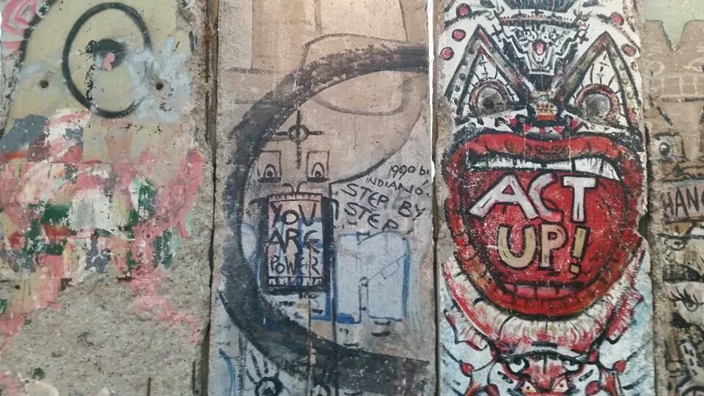
Photo Credit: Faith Campeau

Slide 13
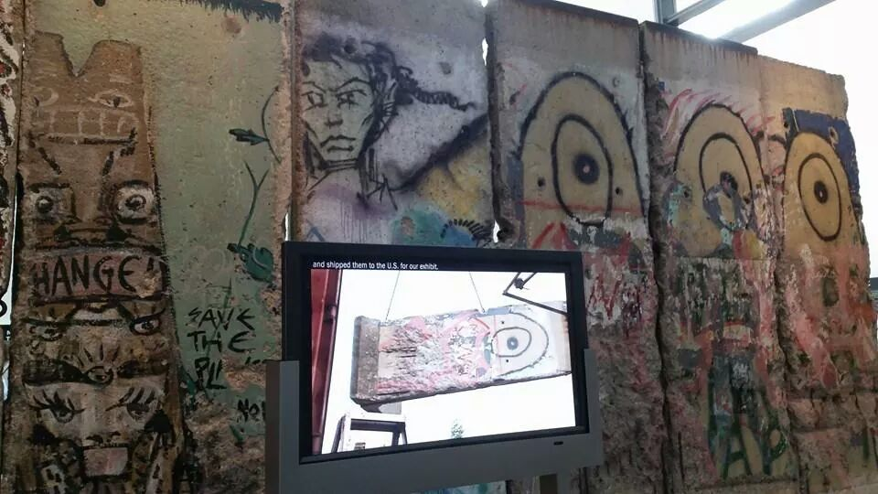
Photo Credit: Faith Campeau

Slide 14
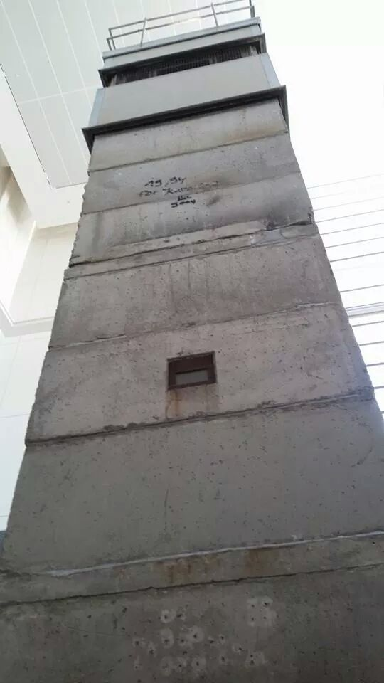
Photo Credit: Faith Campeau

Slide 15
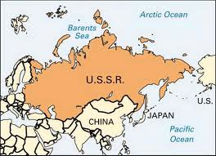
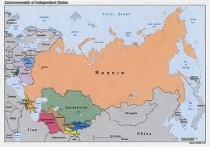

Slide 16
Communism Declines
Slowly, around the world communism began to decline.
Vietnam in the 1990s opened itself to the world and established diplomatic relations with the U.S.
After years of thin budgets, Russia’s armed forces became weak and ineffective.
Thus The U.S. emerged as a sole superpower and leading the world in military power.

