Slide 1
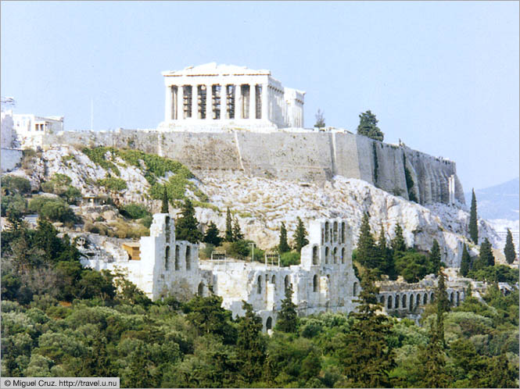
Early Greece

Slide 2
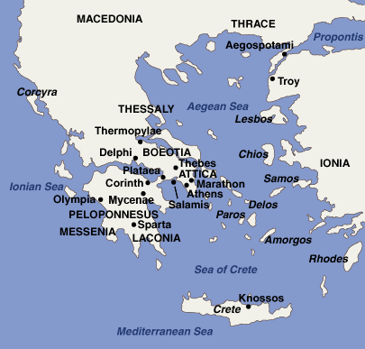
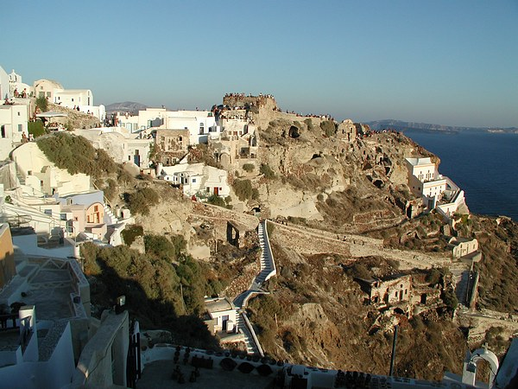
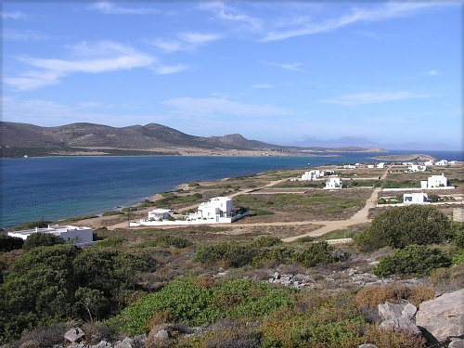
Geography of Greece
While the earliest civilizations developed on fertile river valleys, a very different set of geographic conditions influenced the rise of Greece.
Greece is a small country located on a peninsula in Southern Europe with many islands.
Peninsula ~
area of land surrounded by water on three sides (like Florida).
Greece is surrounded by the Ionian sea, Mediterranean Sea, and Aegean Sea.
Mountains divide the peninsula into isolated valleys that separate the Greek city-states.
The Sea was very important to Ancient Greeks – most people used the sea to make a living.
Most Greeks were fisherman and sea-traders who exported olive oil and wine.

Slide 3
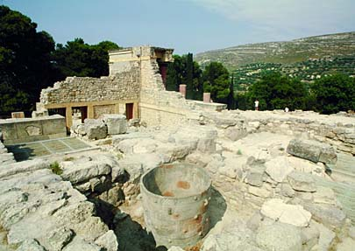
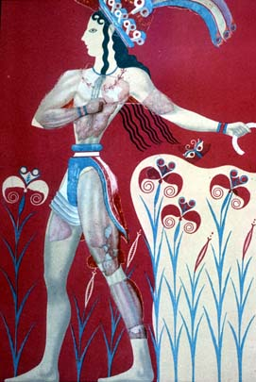
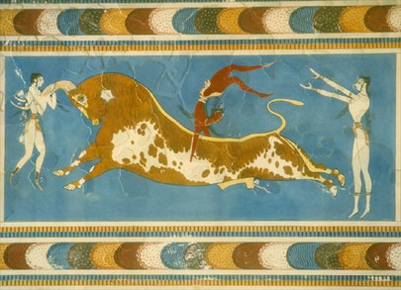
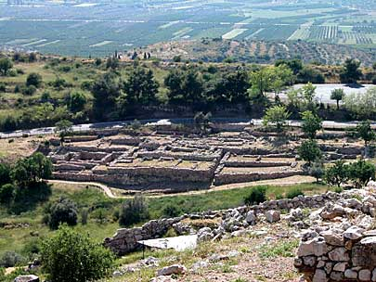
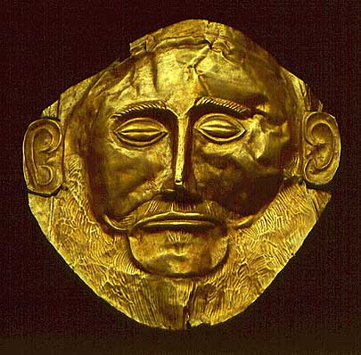
Early People of the Aegean
The earliest civilization to settle in Greece were the Minoans.
The Minoans were successful sea-traders who lived on the Island of Crete.
The Minoans suddenly vanished around 1400 B.C. – probably a volcano or earthquake.
Around 1400 B.C., the Mycenaeans conquered mainland Greece and established a sea-trading empire.
These are the first Greek-speaking people of whom we have a written record.

Slide 4
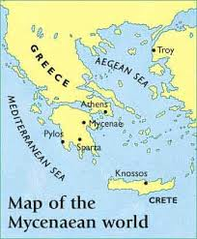
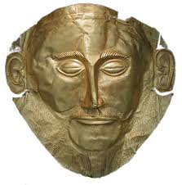
The Mycenaeans
The Mycenaean civilization dominated the Aegean world from 1400 BC to 1200 BC.
They often traveled beyond the Aegean to Sicily, Italy, Egypt, and Mesopotamia. They absorbed Egyptian and Mesopotamian customs, many of which they passed on to the Greeks.
Like the Minoan’s before them, they were also sea traders.
Their Civilization was divided into City States.
A Warrior-King would built a thick-walled Fortress and rule the surrounding villages.

Slide 5
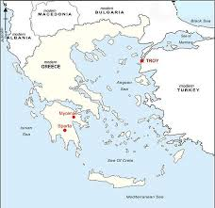

Slide 6
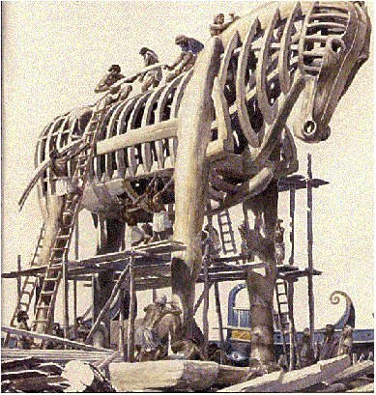
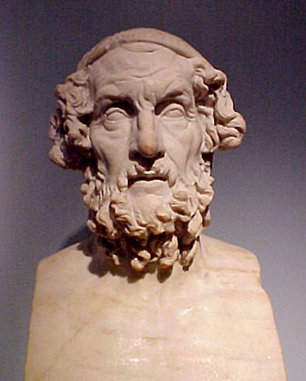
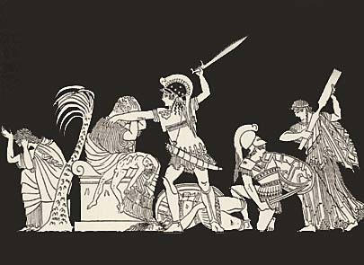
The Trojan War
In 1250 B.C., the Mycenaeans fought the Trojan War against the economic rival Troy (in Turkey).
Economic OR Romantic Motives?
The war lasted 10 years, until the Greeks seized Troy and burned the city to the ground.
Most of what we know about the Trojan War comes from two great epic poems written by Homer, the Iliad and the Odyssey.
The Iliad ~ story of the Trojan War with a talking horse.
The Odyssey ~ tells the story of Odysseus on his way home after the Trojan War to his wife.

Slide 7
The Iliad
Homer’s the Iliad tells the story of the Trojan War. According to Legend, the Trojan War started because a prince from Troy kidnapped the wife of a Greek leader, named Helen, and took her back to Troy. In order to get her back, the Greeks send a huge army to attack Troy.
The war lasted 10 years, until the Greeks eventually defeated the Trojans by tricking them. The Greeks built a huge wooden horse and put it just outside the walls of Troy. Then the Greek soldiers leave their camp outside the city. The Trojans believe that the Greeks have given up and gone home. However, they don’t know that Greek soldiers are hidden inside the wooden horse.
The Trojans decide that the great horse was built to honor the gods. They bring the horse inside Troy to dedicate to the goddess Athena.
That night, while the Trojans are celebrating the end of the war, the Greek soldiers climb down out of the horse. They unlock the city gates to let in the rest of the Greek army Taken by surprise, the Trojans are defeated.

Slide 8
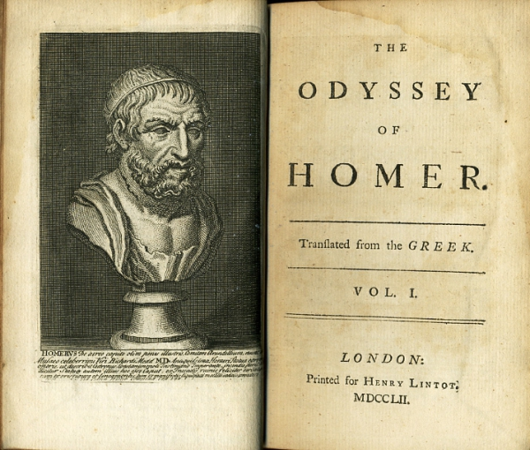
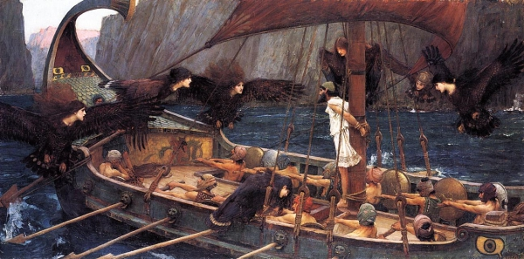
The Odyssey
Homer’s Odyssey tells of the adventures of Odysseus as he tries to make his way home after the Trojan War.
Time and again, events keep Odysseus from getting home. He encounters monsters and half-human creatures.
He battles a one-eyed giant called a Cyclops as well as the sea monster Scylla.
For a time, a goddess keeps him captive on her island.
Finally, 20 years after the fall of Troy, Odysseus returns to Ithaca with the help of the goddess Athena.

Slide 9
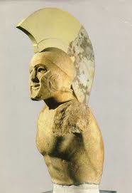
Decline of the Mycenae
Not Long after their victory over Troy, The Mycenaens themselves came under attack from sea raiders (also greek speaking) called the Dorians, invading from the North.
AS Mycenaean power faded, and their cities and trade declined.
People forgot many skills, including the art of writing.
After the Dorian invasions, Greece passed several centuries in obscurity.
The people lived in isolated villages and had little contact with the outside world.
However, over time a new Greek civilization will be forged that will dominate the region and influence the western world.

