Slide 1
Unit 2: Culture
An Introduction to Culture

Slide 2
Competency Goal 2
The learner will demonstrate an understanding of the nature of culture and the role it plays for the individual and for society.
Objectives
2.01 Identify and apply the elements of culture.
2.02 Compare and contrast various cultures of the world.
2.03 Explain how the elements of culture form a whole culture.
2.04 Explore the relationship between language and the transmission of culture.
2.05 Analyze the role that culture plays in determining personality.

Slide 3
Essential Questions
How is culture created and what are the components of culture?
How do sociologist view culture from various perspectives?
Why is culture important in our changing world?
What impact does culture have on people's behavior?
How are subcultures created and how do they distinguish themselves from larger cultural groups?
What shapes American popular culture?
How do sociologists view American culture from various perspectives?
How is American culture shaped by our changing world?
What impact does culture have on Americans behaviors?

Slide 4
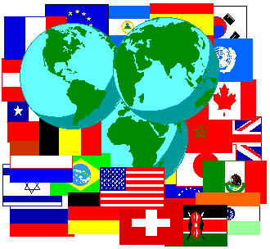
Culture
Culture is the knowledge, language, values, customs, and material objects that are passed from person to person and from one generation to the next in a human group or society.
Society = People
Culture = Ideas, behaviors, and material possessions
Small groups produce culture and reflect it.
Includes: Knowledge (ideas and facts) and Beliefs (subjective, unreliable, or unverifiable ideas)
Notes:
Culture is probably a word you have heard a lot, But what does it mean??
What is Culture in your own words? Write on a sheet of paper and then share your answers with the class.
Can anyone recall what a society is?
A society is made up of people, and culture is made up of idea behaviors, and material possessions.

Slide 5
Material v. Nonmaterial
There are two types of Culture:
Material Culture is comprised of tangible objects.
Examples: clothing, technology…etc.
Nonmaterial culture is non-tangible.
Such as ideas and beliefs. These beliefs are based on tradition, faith, experience, and research.
Notes:
Does anyone know what the word Tangible means?
Things that you can physically touch and see.
The chair would be a tangible object. But my thoughts are non tangible.
What are some examples of material culture that is passed on from generation to generation?

Slide 6
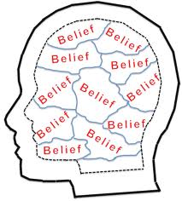
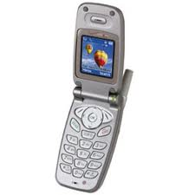
Culture
CULTURE
Non Material
Norms
Values
Symbols
Language
Material
Technology
Notes:
These are the most important aspects of Nonmaterial culture and we are going to look at each of these more in depth this week!

Slide 7
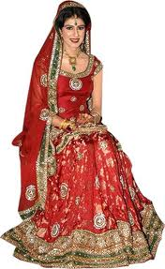
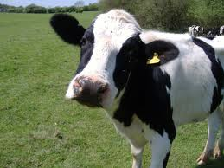
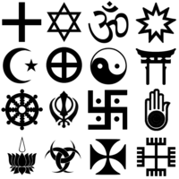
Why is Culture important?
It Shapes who we are and affects our everyday life!
It tells us how to take care of ourselves, how to behave, what to wear, what to eat, which gods to worship, and how to make and spend money.

Slide 8
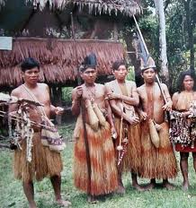
Culture around the world
Communication with other cultures is increasing and the need to understand and appreciate other cultures is increasing.
Culture Shock: The disorientation that people feel when they encounter cultures radically different from their own.
Cannot depend on taken-for-granted assumptions about life.
Notes:
Who has ever traveled to another country?
What was it like?
It is important to understand that not all cultures are the same! Have students read article about Yanoumi tribe in south america.

Slide 9
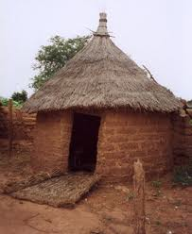
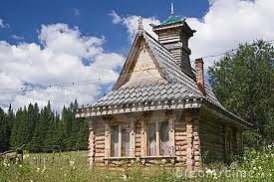
Cultural Universals
Can you think of some material and nonmaterial culture that might be the same in every culture?
Hint: Think of aspects that are necessary for survival.
Customs and practices that occur across all societies.
Notes:
Page 75 list.
George Murdock complied a list of over 70 cultural universals.
-Appearance (hairstyles or bodily adornments)
-Activities (Games, sports, jokes)
-Social Institutions ( law and religion)
Cooking, Hospitality, folklore
SHELTER

Slide 10
Sociobiology
Sociobiology:
Idea that all human social behavior is genetically determined
Argues that cultural universals are rooted in human biology
Sociology:
Believe that cultural universals like the incest taboo have social origins.

Slide 11
Globalization
Extending to other parts of the world
Leads to more and more cultural clashes.
Why is this happening?
Clashes are caused by:
real differences in culture
interaction between people of different cultures
economic modernization
clashes in values.

Slide 12
Ethnocentrism
Tendency to see one’s own culture as superior.
Can be deeply ingrained in our way of life and bodies, and can help hold a society together.
What are some pros and cons to ethnocentrism?

Slide 13
Cultural Relativism
Belief that culture should be judged by their own standards rather than by applying the standards of another culture
Sociologists and anthropologists attempt to adopt this attitude.
Attempt to understand cultural practices from the points of view of the members of the society being studied.

Slide 14
Culture Trait
Individual tool, act, or belief that is related to a particular situation or need.
Ex: Using knives, forks, and spoons when eating

Slide 15
Culture Complexes
Individual culture traits combine for form these
Cluster of interrelated traits
Ex: Game of football (Material traits, like equipment, combined with acts of football, combined with beliefs, etc.)

Slide 16
Culture Patterns
Culture complexes combine to form larger levels
Combination of a number of culture complexes into an interrelated whole
Ex: Separate complexes of baseball, basketball, football, soccer, and tennis combine to form the American athletic pattern

Slide 17
Cultural Competence
Ability to accept, respect, and communicate smoothly with members of different societies
Americans have difficulty with this because of our multicultural society

Slide 18
Sociological Perspectives on Culture
Functionalist
Culture serves the function of meeting human needs and helps explain a variety of cultural practices
Conflict
Culture reflects the interests of the rich and powerful, and protects the status quo
Symbolic interactionism
Culture not only constrains humans but is created and changed by them
Culture enables them to think and change and is a product of human creation

Slide 19
Think!!
Take a minute and think about what makes up your culture. List some material and non-material culture.
Notes:
Now Create a Poster using the magazines that reflects your culture.

Slide 20
Culture Poster
Create a poster that displays YOUR culture.
You can use phrases and pictures.
Be prepared to share your poster with the class.
Notes:
Make your own poster to show the class as an example.

Slide 21
Papua New Guinea Culture
The Huli people of Papua New Guinea live very traditionally in small clans linked by strong family ties. Huli men have traveled to other parts of the world and have seen modern societies. But they go back to their village and live in traditional ways because they prefer the traditional life to the complexities of modern societies.
While viewing the video, make note of the following:
Describe the clothing and makeup the Huli men wear
Identify the 2 possible meanings of the dance performed during the segment
Explain why the Huli people are happy to welcome tourists
State how the elder and the young boy who were interviewed feel about traditions of their people and tourists’ role in keeping their traditions alive.

Slide 22
Papua New Guinea Culture
Imagine that you are sociologists who intend to study the Huli people
Plan a visit to Huli lands to interview members of the group
You make work alone or with a partner
Your plans should include the following:
Write a list of traditional behaviors you hope to observe,, as well as what you expect to see of the group’s daily life
Write 10 or more questions to ask members of the group
Who do you plan to interview (elders, women, children, warriors)
Be prepared to share your plans with the class

Slide 23
Disgusting Foods
Many behaviors and responses to stimuli are socially conditioned by particular cultures rather than being genetic or in-born. As you will learn in this video segment, food preferences and aversions are among such socially conditioned responses. Think about your own food preferences and aversions as you view the video and consider the origins of these responses.
While viewing the video, make note of the following:
List 5 foods mentioned in the segment that usually trigger the disgust response in Americans
Name a food that people of New Guinea find to be disgusting
Contrast perceptions of “good food eaters” and “bad food eaters”
Explain why the disgust response is a socially conditioned reaction to unfamiliar foods rather than a reflection of personal tastes

Slide 24
Disgusting Foods
After viewing:
Make lists of foods that:
You like
Disgust you
You are not sure about but might be persuaded to try
As a class we will analyze your lists to determine whether social conditioning or personal taste is the stronger factor in determining students’ preferences.

