Slide 1
Crime

Slide 2
There ought to be a law against….
Come up with 5 laws you think should be passed.
Think about problems in the community, school, and society as a whole

Slide 3
Crime
Everybody is affected by crime, bust most are affected as bystanders
Crime: Any act that is labeled as such by those in authority, its prohibited by law, and is punishable by the government

Slide 4
Crime Statistics FBI, Uniform Crime Reports (UCR), 2012
Race | Age | Sex
White = 69.3 % | Under 18 = 10.8% | Male = 73.8%
African American = 28.1% | 18-24 = 28.7% | Female = 26.2%
American Indian or Alaskan Native = 1.4% | 25-34 = 27.3%
Asian or Pacific Islander = 1.2% | 35-44 = 16.2%
 | 45-54 = 12%
 | 55 and older = 5%

Slide 5
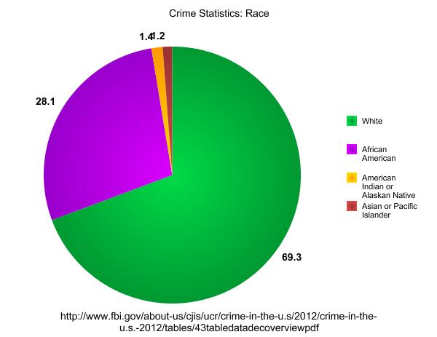

Slide 6
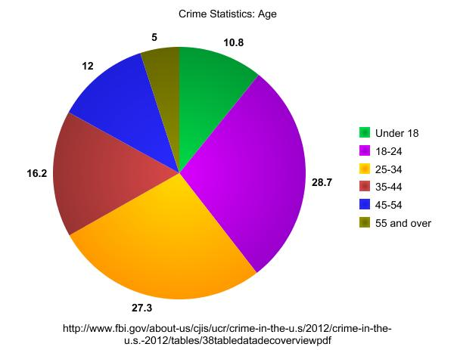

Slide 7
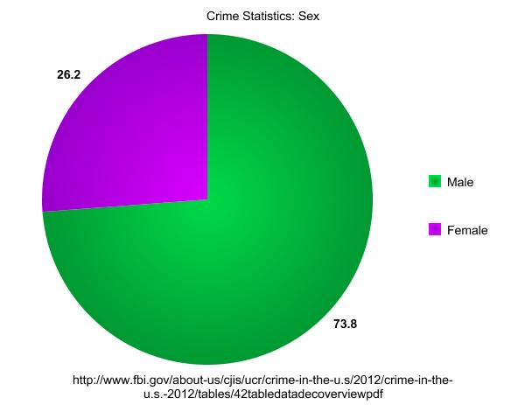

Slide 8
Crime Statistics
Crime statistics have certain limitations
The following characteristics limit the filing of formal crime reports:
Responding officer decide whether or not to file a formal report
Less likely to report crime if family or friend is involved in the act
Police are more likely to file formal reports on serious crimes when the injured parties are members of the higher social classes
Whether an officer files a formal complaint is influenced by the attitude of the individual making the complaint
Certain crimes, like rape, are more likely to go unreported by victims
There are changes in the way statistics are reported
Incorrect reporting

Slide 9
Summer Crime
Crime rates tend to be higher during the summer months
What factors might lead to higher rates of violent crimes during the summer months?

Slide 10
Types of Crime
FBI Organizes crimes reported in the UCR into 5 broad categories:
Violent Crime
Crime Against Property
Victimless Crime
White-Collar Crime
Organized Crime

Slide 11
1: Violent Crime
Make up a very small percentage of all crimes
Examples include: murder, forcible rape, robbery, and aggravated assault
Most victims of violence are African Americans
Majority of murders are committed with guns and other weapons

Slide 12
2: Crime Against Property
Much more common than crimes of violence
Examples include: burglary, larceny (theft other than auto), motor vehicle theft, and arson
All property crimes involve either stealing someone else’s property or intentionally damaging it
Increases in crime rate can be the result of illegal drug use
Expensive drug habits are often financed through crime
Many serious crimes are committed while people are under the influence of drugs

Slide 13
3: Victimless Crime
Termed victimless because these crimes supposedly harm no one but the person committing the act
Examples include: prostitution, illegal gambling, illegal drug use, and vagrancy (begging)
Classification may be somewhat misleading in some of these crimes.
While people other than the offenders may not suffer directly the consequences for society of crimes such as drug abuse can be significant

Slide 14
4: White-Collar Crime
White-Collar Crime: Offenses committed by individuals of high social status in the course of their professional lives
Examples include: misrepresentation, fraud, tax evasion, embezzlement, price fixing, toxic pollution, insider trading, and political corruption
Traditionally the media and public have played down these crimes, but recently these crimes have gotten much attention
Corporation is charged with the crime because they are considered “legal persons”

Slide 15
5: Organized Crime
Some criminals are part of organized crime syndicates (large-scale organizations of professional criminals that controls some vice or business through violence of the threat of violence)
Examples include: Drug trafficking, illegal gambling, unfair labor practices, hijacking of merchandise, and loan-sharking (lending money at very high interest rates)
They pursue crime as a big business
Often use legitimate business as “fronts” for their criminal activities which enables the syndicates to reinvest their money through legal channels

Slide 16
The Criminal Justice System
Criminal Justice System: System of police, courts and corrections
In most states there is a juvenile-justice system to deal with young offenders

Slide 17
Police
Hold the most immediate control over who is arrested for a criminal act
Police have considerable power to decide who is actually arrested (police discretion)
Size of population, number of offenses, and number of full-time officers make it necessary for the police to employ discretion in their decisions involving arrest
Several factors are considered when decided to make an arrest or not:
Seriousness of the offense
The wishes of the victim are taken into consideration
Attitude of the suspect
If bystanders are present (more likely to arrest)
Race – more likely to arrest African Americans than whites
Racial profiling: Practice of assuming that nonwhite Americans are more likely to commit crime than white Americans

Slide 18
Courts
Once a person is arrested, responsibility shifts to the courts
Courts’ role is a twofold process
Court determines the guilt or innocence of an accused person by means of a trial
If there is a guilty finding, the court assigns some form of punishment
Most cases are settled through plea bargaining (process of legal negotiation that allows an accused person to plead guilty to a lesser charge in return for a lighter sentence)

Slide 19
Corrections
People who are found guilty are punished
Corrections: Sanctions used to punish criminals, such as imprisonment, parole, and probation
Sanctions serve 4 basic functions
Retribution: Punishing of a criminal serves as an act of revenge for the victim or society
Deterrence: Corrections are intended to discourage offenders from committing future crimes and to make the rest of society think twice before breaking laws
Rehabilitation: Place in which to reform criminals so that they could return to society as law-abiding citizens
Social protection: By limiting the freedom of offenders, society prevents them from committing additional crimes
Effectiveness of corrections is a topic of heated debate and an indication that corrections is not always effective is in the rate of recidivism (repeated criminal behavior) among convicted criminals
Punishments range from fines to probation to imprisonment

Slide 20
Punishment or Rehabilitation?
Consider the following statement:
“The most important focus of prison should be punishment rather than rehabilitation.”
What are your thoughts on this?

Slide 21
Capital Punishment
What are your thoughts on capital punishment (death penalty)?

Slide 22
Juvenile-Justice System
Laws for juvenile offenses used to be much less specific than those for adults
Hard to punish children because it is thought that because of their age, they cannot be expected to be as responsible as adults
Courts must not provide children with the same legal rights and privileges as adult defendants
In some areas, children can be tried as adults for certain serious offenses

Slide 23
Discussion
How do you feel about the following statement?
Juvenile offenders who commit serious crimes should be tried as adults.

