Slide 1
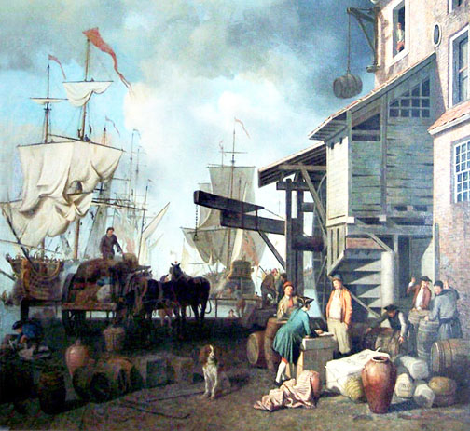
The Columbian Exchange
Mercantilism

Slide 2
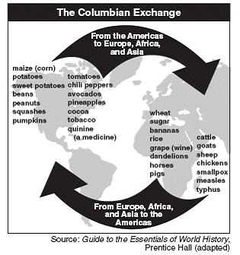
Columbian Exchange
The exchange of plants, people animals, ideas, and diseases between Europe, Africa, and the Americas

Slide 3
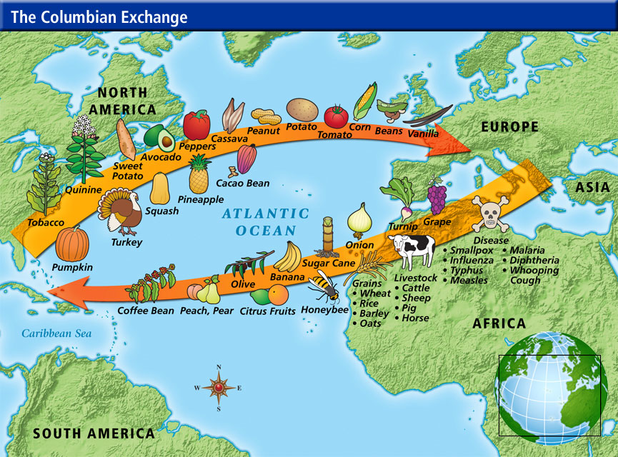

Slide 4
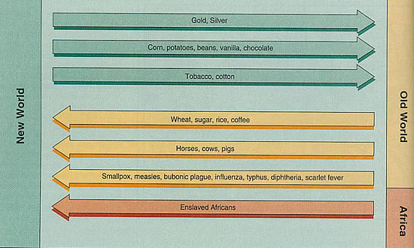

Slide 5
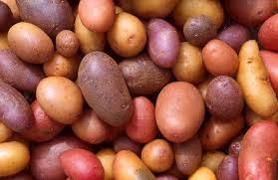
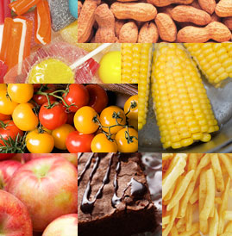
Effects of the Columbian Exchange
Introduction of new crops from the Americas to Europe, Africa, and Asia led to population growth

Slide 6
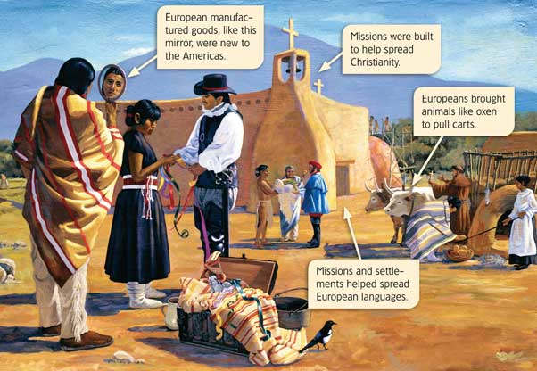
Effects of the Columbian Exchange
Increased cultural diffusion
  Europeans were influenced by Native American foods as well as African farming methods, cooking styles, and music
  Spread of European languages
  Spread of Christianity

Slide 7
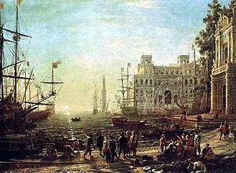
Effects of the Columbian Exchange
The combination of new products and ideas promoted economic growth in Europe

Slide 8
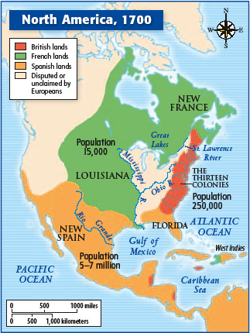
European Compete for Colonies
The success of the Spanish colonization increased European interest in the Americas
  French establish colonies in Canada
  Dutch establish colonies along the Hudson River
  British colonize east coast of U.S.

Slide 9
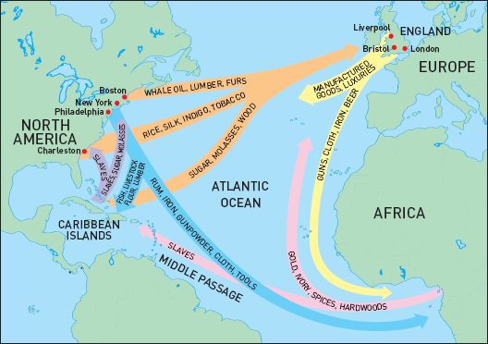
Mercantilism
An economic system in which colonies exist for the benefit of the colonial power
  Europeans looked at their colonies as possessions that existed for their benefit

Slide 10
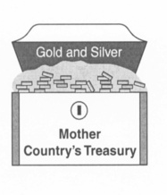
Principles of Mercantilism
Might of a country depends on gaining surpluses of gold and silver

Slide 11
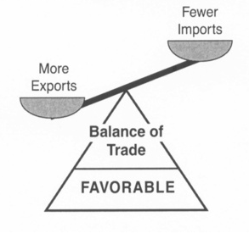
Principles of Mercantilism
A main goal is the creation of a favorable balance of trade
  Exporting more goods than you import

Slide 12
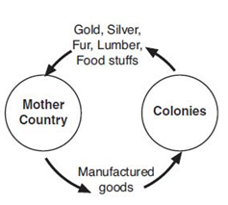
Principles of Mercantilism
The purpose of colonies:
  Ship raw materials to the “mother country” (colonial power)
  Buy finished goods from the colonial power

Slide 13
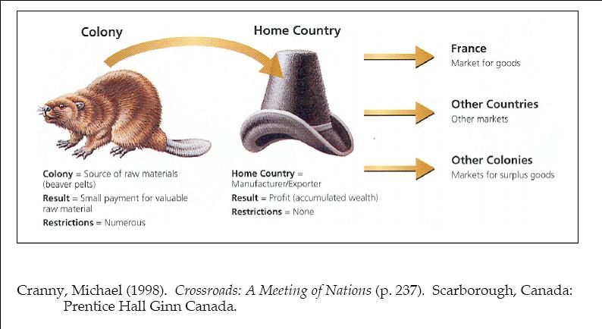

Slide 14
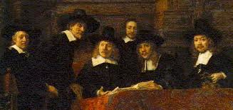
Growth of Capitalism in Europe
Increased trade with colonies encouraged the development of capitalism in Europe.
  People invested money in companies in hopes of making a profit
  Joint stock companies formed to finance overseas expedition
  Led to the growth of the middle class in Europe.

Slide 15
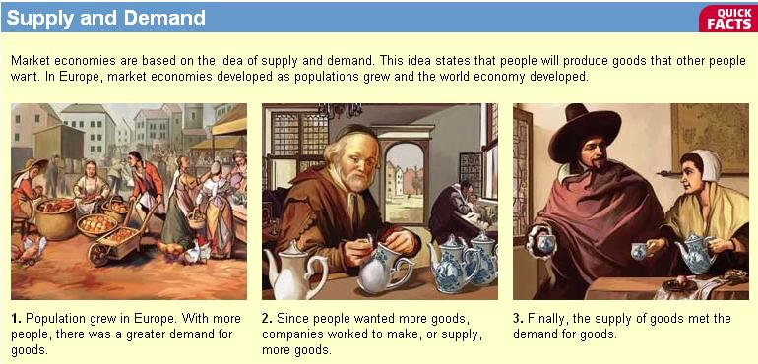

Slide 16
Closure
Define the term Columbian Exchange.
What is mercantilism?
What was one goal of mercantilism?

