Slide 1
Cold War
World History
Mr. Westbrook
Created by: Matthew Washington

Slide 2
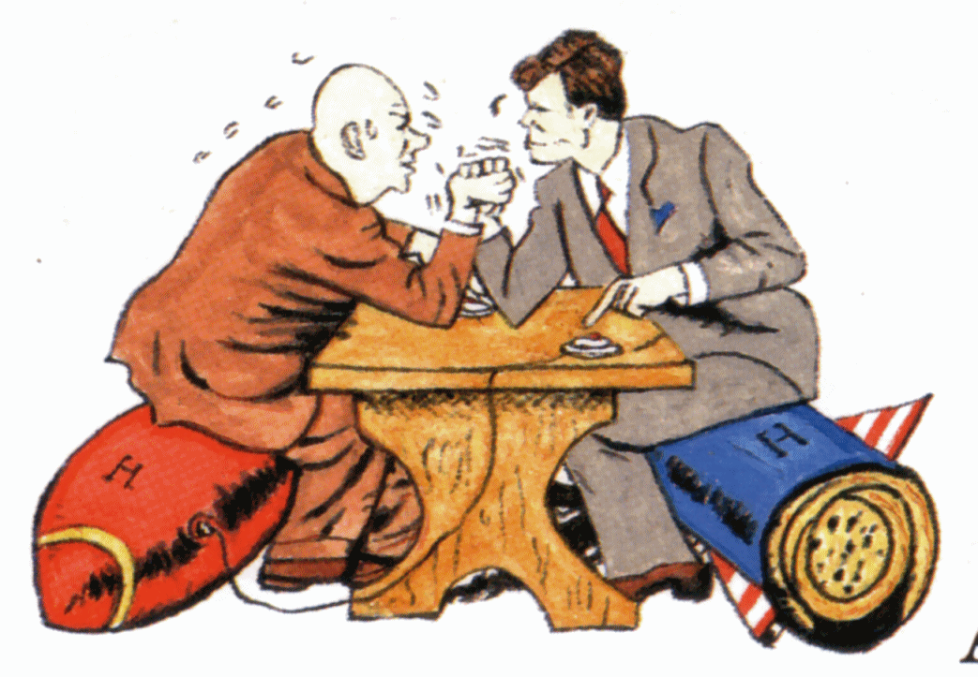
Soviets wanted communism in Eastern European countries
Britain and U.S. opposed
Truman Doctrine: rooted in containment
Limiting communism to areas already under soviet control
Marshall Plan: America funneled food, aid, and economic assistance to Europe to help countries rebuild (in return, U.S. hoped those countries would support democracy)

Slide 3
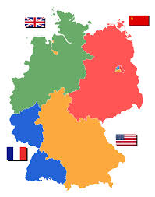
What happened to Germany?
Split into four parts
U.S., British, and French, combine zones and create Western Germany (Democracy), Soviets- Eastern Germany (Communism)
Soviets too reparations by moving factories and resources to Soviet Union
Western Germany also gave reparations, but USA, France, and Britain wanted German economy to recover

