Slide 1
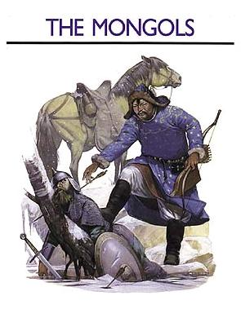
Ancient China & Japan
Outcome: The Mongols

Slide 2
The Mongols
Setting the Stage:
The Mongols were gaining strength in the north in Asia
They prided themselves on their skill on horseback, their discipline, and courage
Mongols were nomadic pastoralists: herded domesticated animals
Mongols traveled together in kinship groups called clans

Slide 3
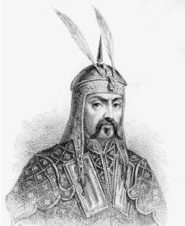
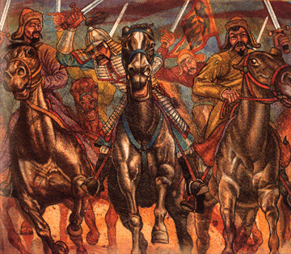
Temujin

Slide 4
The Mongols
The Rise of the Mongols
Temujin sought to unify the Mongols under his leadership around 1200
Slowly Temujin defeated his enemies (and friends) one by one
In 1206 he accepted the title of universal ruler of Genghis Khan
Genghis Khan conquered much of Asia and had goal of invading China
By 1225 Central Asia was under Mongol control

Slide 5
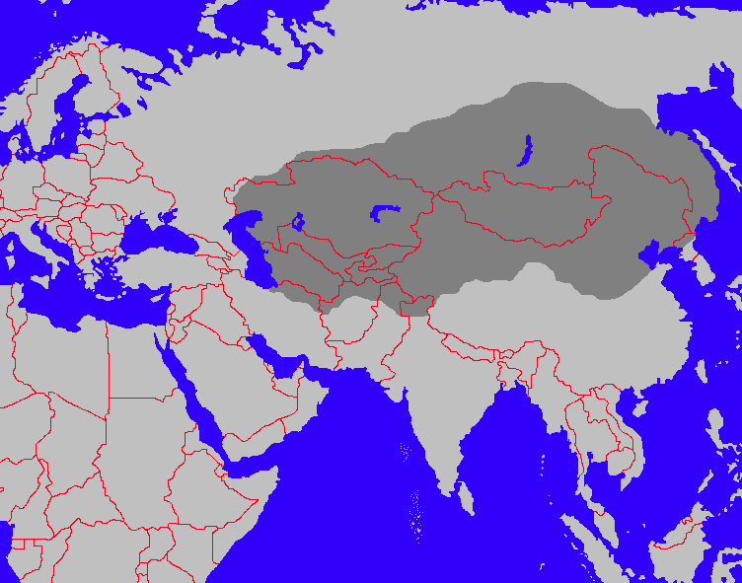
Mongol Empire Under Genghis Khan

Slide 6
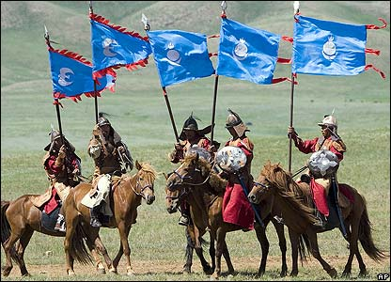
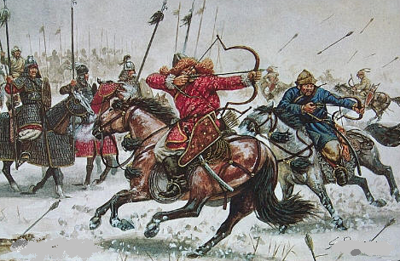
The Mongols
Reasons for Genghis Khan’s successes:
He was a brilliant organizer
Was a gifted strategist
Used cruelty as a weapon

Slide 7
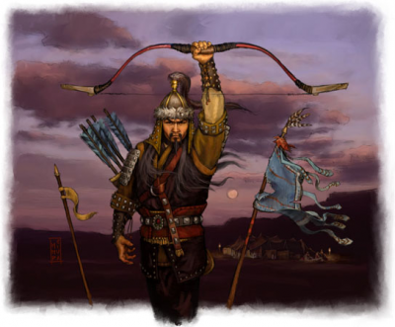
The Mongols
The Mongol Empire
Genghis Khan died in 1227 of illness
His successors continued to conqueror territory eventually having the largest unified land empire in history
Successors divided region up into different territories called khanates.
Had territory from Kiev in the West to China in the East
Mongols destroyed villages, irrigation channels, and decimated populations

Slide 8
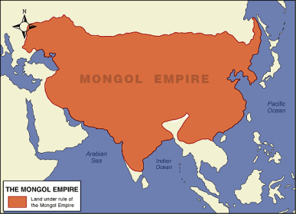
Mongol Empire at its Peak

Slide 9
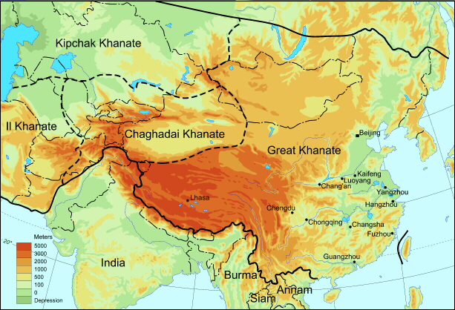
Khanates

Slide 10
The Mongols
Rarely imposed their beliefs on conquered peoples
Even adopted some of the culture of those they ruled
Pax Mongolica: Mongol Peace- time of peace and stability across the Mongol Empire from mid 1200s to mid 1300s
Trade and inventions spread rapidly during Pax Mongolica due to safe travel

Slide 11
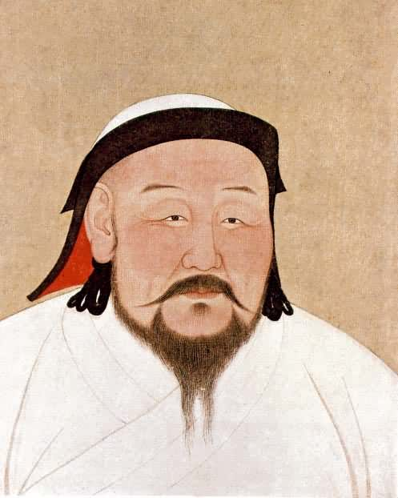
Kublai Khan

Slide 12
The Mongols
Kublai Khan Becomes Emperor
Grandson of Genghis Khan took title in 1260
Wanted to fulfill wish of grandfather: conquer all of China
Started the Yuan Dynasty which ruled from 1279-1368
China was united for first time in nearly 300 years
Kublai Khan’s control opened China up to more trade and foreign contact
Enjoyed living in luxury as Chinese emperor
Attempted to take over Japan but Japanese might and weather halted the invasion
Kublai Khan improved the Grand Canal and added 135 miles to it

Slide 13
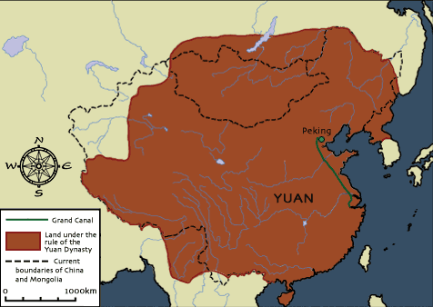
Yuan Empire

Slide 14
The Mongols
Mongol Rule in China
Mongols were hugely outnumbered in China- lived apart from one another
Chinese were not allowed to hold high government office however could serve at local levels
High public office went to Mongols or foreigners- felt foreigners could be trusted due to having no loyalties to the Mongols or Chinese
Mongol Peace extended trade
Traders wanted silk, porcelain, gunpowder, paper currency, and the compass

Slide 15
The Mongols
Invited foreign merchants
Venetian trader Marco Polo came to Kublai Khan’s court around 1275
Worked for Kublai Khan because he learned many Asian languages
While imprisoned, Polo told his story which was later published as a book but most Europeans did not believe It
Genoese

Slide 16
The Mongols
The End of Mongol Rule in China
Kublai Khan’s armies and navies suffered many humiliating defeats at a huge expense of lives and equipment towards the end of his reign
Heavy spending on wars, public works, and Yuan luxuries over burdened the treasury and angered the overtaxed citizens
Kublai Khan died in 1294 and his successors were inept at ruling the dynasty
In 1368 Chinese rebels finally overthrew the Mongols
The Ming Dynasty would be established
With the fall of the Yuan came the disintegration of the Mongol empire in Asia
Japan was on the rise

