Slide 1
China, Korea, & Vietnam
Cold War Conflicts

Slide 2
CHINA

Slide 3
China’s Communist Revolution
By the end of WWII, the Chinese communists had gained control of much of northern china. Communist Forces led by Mao Zedong fought a civil war against nationalists headed by Jiang Jieshi.
Mao Zedong was successful and built a communist one-party totalitarian state in the People’s Republic of China.

Slide 4
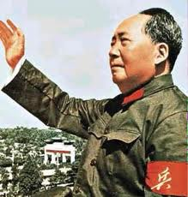
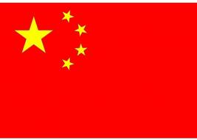

Slide 5
Mao Zedong’s Reforms
Communist Ideology guided the government’s efforts to reshape the Economy and society.
It discouraged Buddhism, Confucianism, and other traditional Chinese beliefs.
The government seized property of citizens.
Those who spoke out against the new government were sent to labor camps or killed.
In an attempt to increase farm and industrial output under his “great leap forward” plan, Zedong created communes to mass produces goods, such as steel.
The Great leap forward was a failure, leading to 55 million Chinese people starving to death.

Slide 6
U.S. viewpoint of China
Initially the U.S. supported the nationalists in the civil war and did not recognize the new People’s republic of China led by Mao Zedong.
However, as the cold war dragged on, the U.S. realized there was a strategic advantage to improving relations with China.
Since the Soviet Union and China had a bitter relationship, The U.S. realized it could further isolate the Soviet Union by creating formal diplomatic relations with China. This is often called “Playing the China Card”

Slide 7
China’s Cultural Revolution

Slide 8
Korea

Slide 9
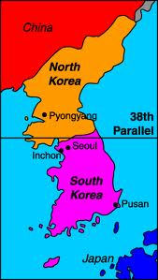
Korea
Like East and West Germany, Korea found itself divided in cold war tension.
The North ruled by dictator Kim II Sung was a communist ally of the Soviet Union, and the South backed by the U.S and led by dictatorial, but noncommunist leader Syngman Rhee
The North and South were divided at the 38th Parallel.

Slide 10
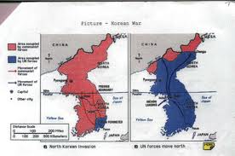
However, Each dictator wanted to rule the entire country. In 1950 a struggle began to unite Korea. The U.S., its allies, and China would eventually become involved in the conflict.
SUMMER 1950:
NORTH KOREA INVADES SOUTH
FALL 1950: THE UN HELPS SOUTH KOREA FIGHT BACK

Slide 11
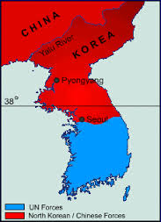
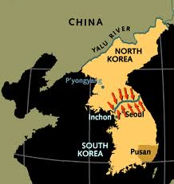
The U.N was driven back when China entered the war. A stalemate lasted from 1951 to 1952. A ceasefire in June 1953 ends the long Stalemate returning the border to the 38th parallel.
Winter 1950: China Enters the war
1951-1953: Stalemate

Slide 12
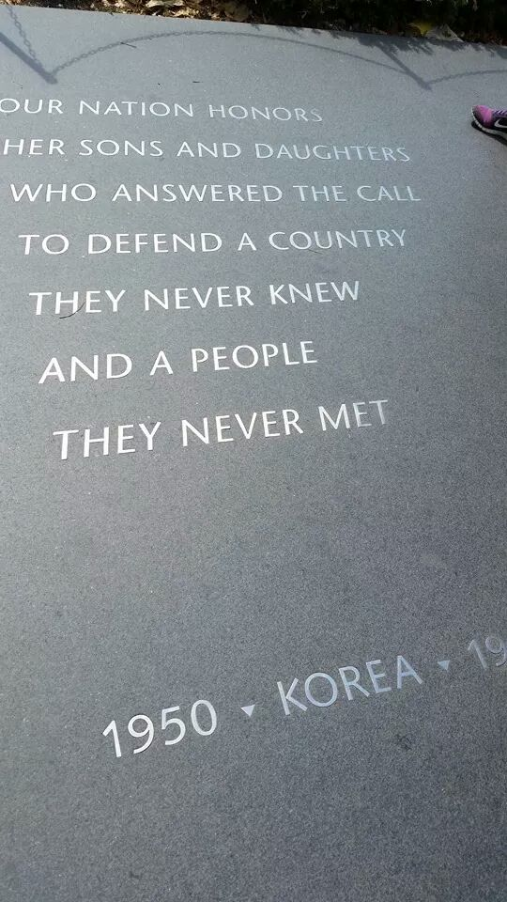

Slide 13
Vietnam

Slide 14
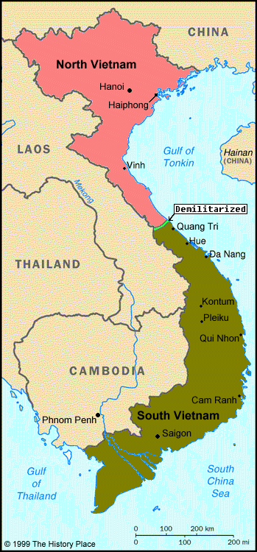
Vietnam
Like Korea, Vietnam was also divided by communism.
In the 1950’s- North Vietnam was was controlled by communists led by Ho Chi Minh.
South Vietnam was controlled by a noncommunist government (backed by the U.S.) led by Ngo Dinh Hiem.

Slide 15
Vietnam
In the 1960’s many Guerrilla fighters appeared in the jungles of south Vietnam. Some of them were south Vietnamese, but they all saw their fight as a nationalist struggle to liberate Vietnam from foreign domination.
Guerrillas – small groups of loosely organized soldiers making surprise raids. Often including farmers and people from local villages.

Slide 16
U.S. involvement in Vietnam
American foreign policy planners saw Vietnam as part of the Cold war Struggle. They developed the Domino theory.
Domino Theory- a communist victory in south Vietnam would cause noncommunist governments across southeast Asia to fall to communism. (like dominoes) The U.S. wanted to prevent this from happening.
Ho Chi Minh continued to Aid the National liberation front or Viet Cong (rebels in south Vietnam)
The U.S. initially sent only supplies and advisors to south Vietnam, but eventually it would send thousands of troops to Vietnam.

Slide 17
American Anti-war sentiment
From 1968 to the 1970’s the struggle continued in Vietnam.
Anti-war sentiment grew in the U.S. because of civilian deaths in Vietnam, growing American Casualties, and many Americans soldiers were MIA or POWs.
Many Americans began to think Vietnam was a quagmire or swamp, in which the U.S. was becoming more and more bogged down.

Slide 18
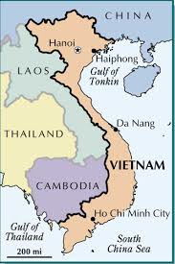
Vietnam ends
President Nixon negotiated the Paris Peace Accord in January 1973, and agreed to end its involvement in Vietnam.
However, two years after the U.S. withdrew, North Vietnam conquered South Vietnam.
The South Vietnamese capital, Saigon, was renamed Ho Chi Minh City in 1976.

