Slide 1
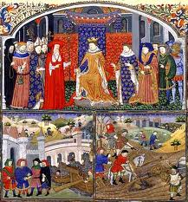
Changes during the Middle Ages

Slide 2
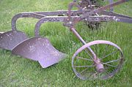
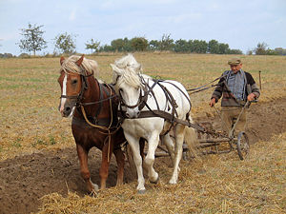
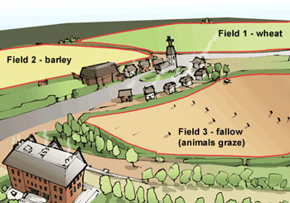
Big Changes for Farmers
New farming methods started a series of changes in medieval Europe. These changes made farming easier and more productive. The result was an agricultural revolution.
Iron Plows
Farmers began to use iron plows instead of wooden plows. This made farming easier!!
Horse Harnesses
A new kind of harness allowed peasants to use horses to pull plows. Horses were much faster and could plow more land – making farming easier and peasants could plant more crops!!
Crop Rotation
Farmers also started to rotate their crops using the 3 Field System. This allowed farmers to produce more food!
With more food available, the population of Europe tripled in size! That is a lot of people…

Slide 3
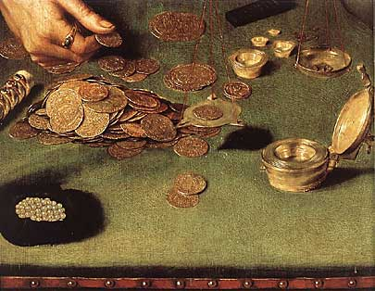
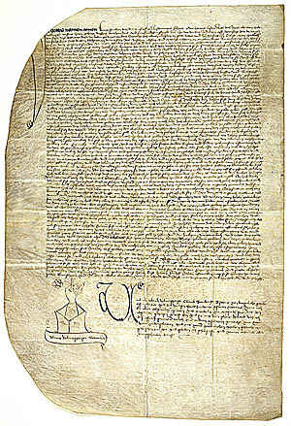
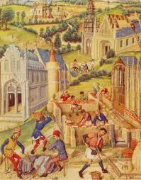
More Trade! More Money!
Trade also improved as invaders and war declined in Medieval Europe.
As nobles and kings became rich from feudalism, they wanted nicer goods.
Merchants began travelling in Caravans to buy Chinese silks, Byzantine gold jewelry, and Asian spices.
Demand for goods and trade continued to expand and trade centers became the first medieval cities.
Merchants in these cities would ask the local lord or King for a Charter, a document establishing rights and privileges for the town.
In return, the Merchants would pay the lord or King a large fee.
Charters gave townspeople more power by letting them choose their own leaders and control their own affairs.

Slide 4
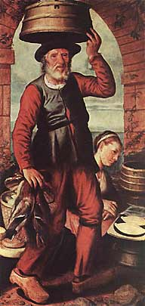
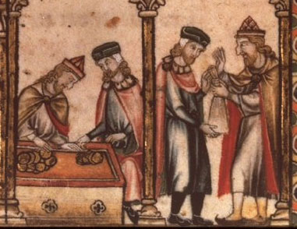
More Money leads to Banks
As trade expanded, new business practices began.
Banks
The need for capital, or money for investment, led to the development of banks.
Also merchants used credit to pay for purchases. This allowed merchants to travel without having to carry gold. Bye, Bye Robbers!
Partnerships
Merchants would join together to form a partnership, pooling their money to finance bigger business projects.
These changes undermined serfdom (using peasants on manors). Peasants could now sell goods, pay their rent in cash, and become tenant farmers, or hired farm workers.

Slide 5
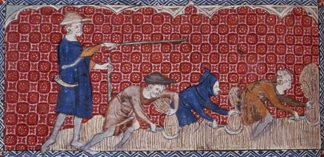
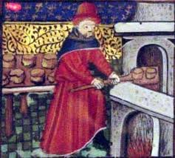
The NEW Middle Class
By 1000, a new social class had formed, called the Middle Class. The middle glass was made up of Merchants, Traders, and Artisans.
The middle class fell between the nobles and peasants.
The nobles and church HATED the new middle class.
Guilds
In medieval towns, the middle class gained power by establishing guilds. Guilds allowed people to control and protect their businesses (like unions).
There were guilds for MANY jobs including: weavers, bakers, and goldsmiths.
To become a guild members, people started in early childhood as apprentices. After seven years, they could become a journeyman (salaried worker). Women were also allowed to join guilds and had their own guilds!

Slide 6
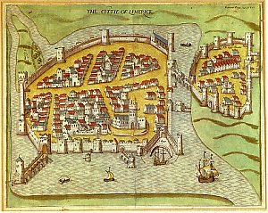
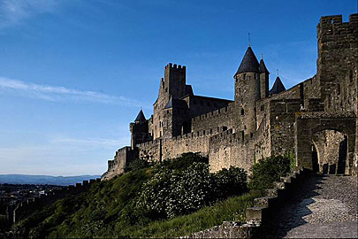
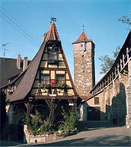
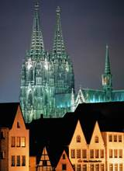
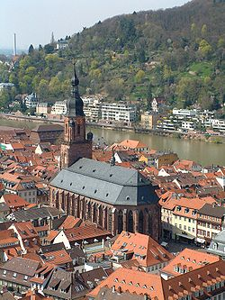
Town and City Life
Medieval towns and cities were surrounded by a high protective wall. As the population grew, these cities became very crowded!
Because of overcrowding, city dwellers added 2nd and 3rd floors to their houses. These floors jutted out over the narrow street making them very dark and dangerous.
In addition, fires were a constant problem…
In the center of the city, there was usually a great cathedral or a guild hall.
The cities were VERY dirty, smelly and crowded. They had no garbage or sewer systems. Residents simply flung their waste into the street…watch out below!
Cities were the perfect breeding ground for disease…

Slide 7
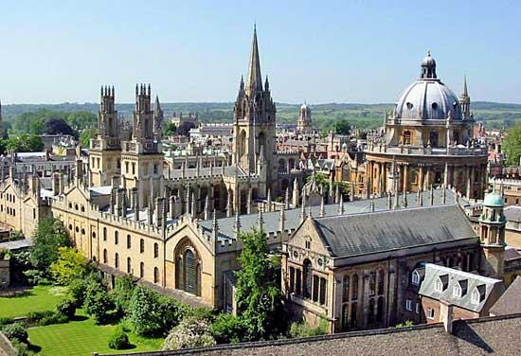
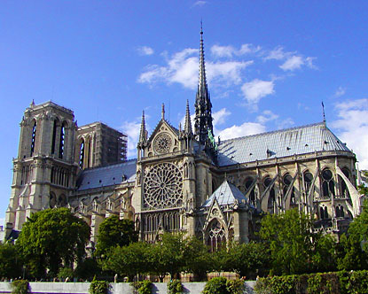
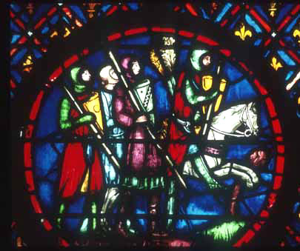
Learning and Culture Flourish
As life improved during the High Middle Ages (late Middle Ages), the need for education expanded.
The first Universities were formed at Oxford University (England), Bologna University (Italy), and Paris University (France).
In addition to increased knowledge, people of the late Middle Ages made some cultural advancements.
New writings during the Middle Ages were in the vernacular, or everyday language of ordinary people (French, English, German).
New forms of architecture developed during the Middle Ages: Gothic Architecture.
With stained glass windows and flying buttresses.

Slide 8
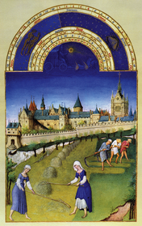
Decline of Feudalism
The improvements during the late Middle Ages slowly undermined feudalism. However, three key events further contributed to the decline of feudalism in the 12th through the 15th centuries.
The 3 main causes for the breakdown of the feudal system were:
Political Changes in England
Bubonic Plague
Hundred Years War
How did such different events contribute to the decline of Feudalism?

Slide 9
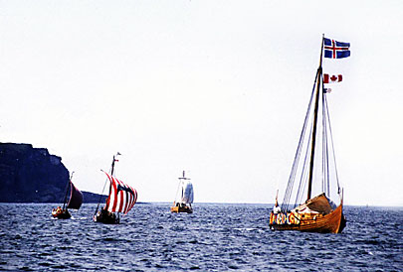
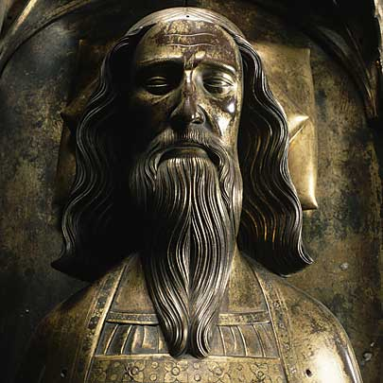
Germanic Kingdoms of England
For centuries, Anglo-Saxons ruled England bringing their own ways of life and culture.
In the 800s, England was battered by the Vikings. The Vikings were so feared that the English said a special prayer in church:
“ God deliver us from the fury of the Norsemen.”
Alfred the Great (871-899) managed to turn back the invaders and united the kingdom under one rule – calling it England “Land of the Angles.”
King Canute conquered England in 1016 and combined Anglo-Saxons and Vikings into one people.
In 1066, King Edward the Confessor, died without an heir. This led to a great struggle, one last invasion, and powerful English kings.

Slide 10
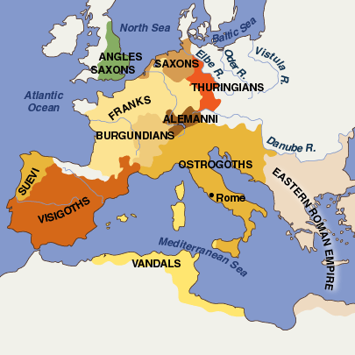
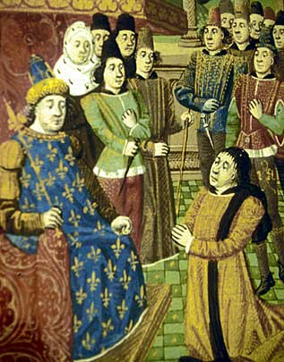
Royal Power Grows
By the early 800s, many small Germanic kingdoms covered Europe – including the Franks, Anglo-Saxons, Visigoths, Ostrogoths, and Vandals.
After the death of Charlemagne in 814, the Carolingian Empire became a system of feudal states ruled by lords.
Gradually, as the Middle Ages advanced towns and villages were created through charters, and this led to a more centralized form of government.
A centralized form of government is ruled by one person or governing body (like a monarch or parliament).
The earliest nations in Europe to develop a strong unified government were England and France.

Slide 11
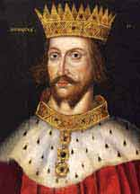
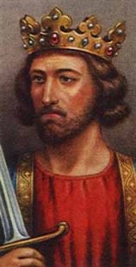
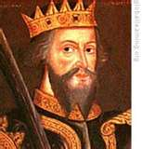
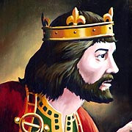
Important English Kings
Four important English Kings would increase royal power during their reigns.
William the Conqueror – invades England and becomes King.
King Henry II – created juries and Common Law
King John – signed the Magna Carta.
King Edward I – created Parliament

Slide 12
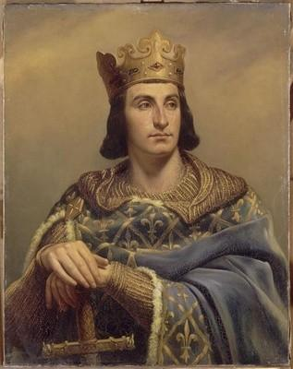
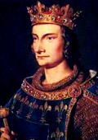
Important French Kings
Two Important French Kings would increase the power of the King during their rule.
Philip II – bailiffs to preside over courts and collect taxes.
Philip IV – adds 3rd Estate to the Estates General

Slide 13
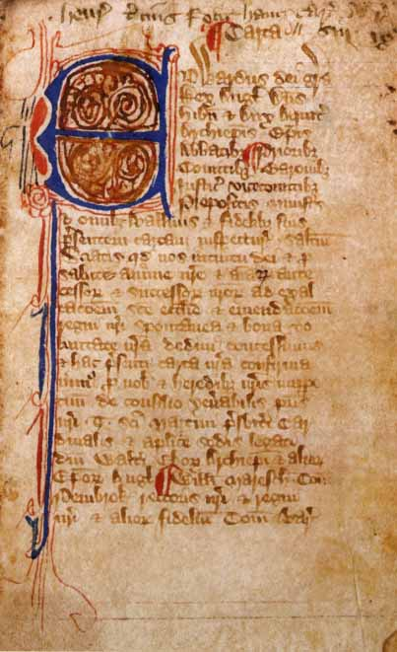
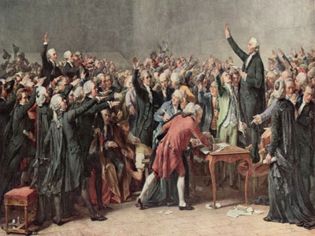
Beginnings of Democracy
England and France were just beginning to establish a democratic tradition. This tradition relied on creating a centralized government that would be able to govern widespread lands.
The creation of Common Law and Courts were the first step towards increased central government.
Including commoners in the decision-making process of government was also an important step in the direction of democratic rule.

Slide 14
King Hall of Fame
You and your group are going to create a poster and a presentation that will convince the class that your King played the most influential role in increasing royal power in medieval Europe. Make sure your poster includes:
What is the King’s Name?
When did the King Rule?
What country did your king rule?
How they increase royal power? (or for King John how was his power limited?)
1 images that represent their reign

