Slide 1
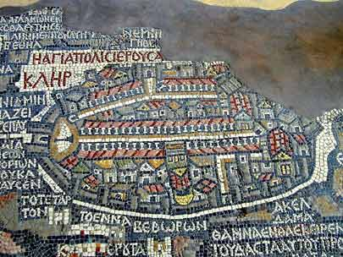
The Byzantine Empire

Slide 2
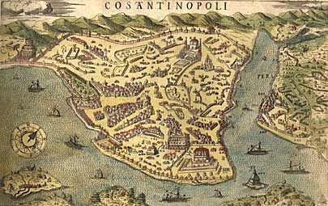
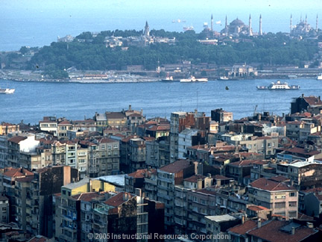
Constantine and Constantinople
Germanic invaders pummeled the Western Roman Empire, and the Roman Emperor Constantine and his successors shifted the capital of Rome to Constantinople.
Constantinople was located on the Bosporus Strait. This provided an excellent harbor and guarded the city on 3 sides by water.
Constantinople was the perfect location for the Byzantine Empire because it was easy to defend and it was at the crossroads of many sea and overland trade routes.
For centuries, the city’s location made it Europe’s busiest marketplace.

Slide 3
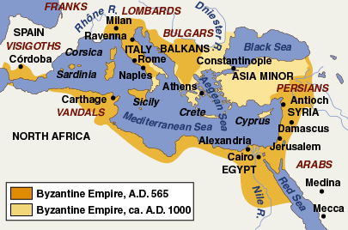

Slide 4
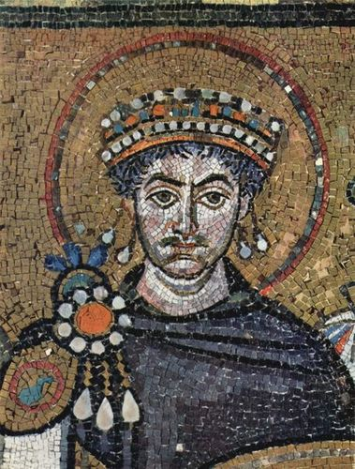
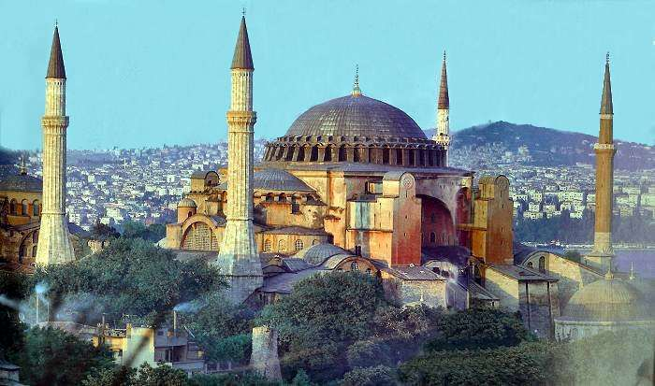
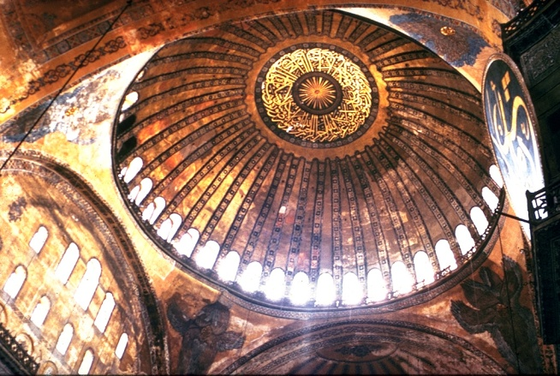
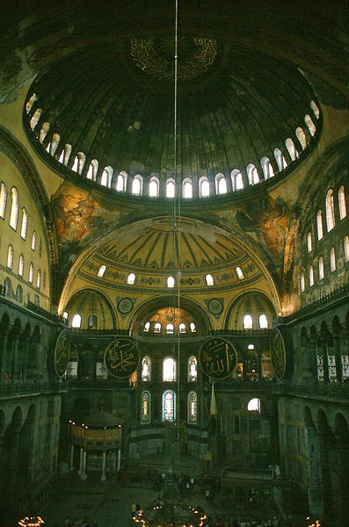
The Reign of Justinian I
The Byzantine Empire reached its peak under the emperor Justinian, who ruled from 527 to 565.
Justinian was a very good Emperor with many accomplishments:
#1 He recovered Roman lands that had been lost to invaders including North Africa, Italy, and Spain.
#2 He rebuilt Constantinople after it was destroyed by Fire. The most beautiful building was the church called the Hagia Sophia meaning “Holy Wisdom.”
#3 He reformed the law and called it Justinian’s Code. This was one of the largest bodies of civil laws!
Later, European Kings and Queens would base their laws on Justinian’s Code and it is still used in international law today!

Slide 5
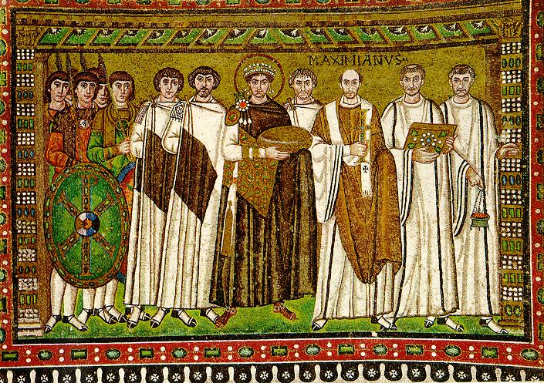
Reign of Justinian
Justinian used his Code to unify the empire under his control. He ruled as an autocrat, or sole ruler with complete authority.
The Byzantine Emperor not only had power over the empire, but also power over the church. He was considered Christ’s co-ruler on Earth.
“The Emperor is equal to all men in the nature of his body, but in the authority of his rank he is similar to God, who rules all.”
The Byzantine Empire flourished under a strong central government – trade and industry flourished!
They also had one of the strongest military forces in the world – Greek fire was their most feared weapon!

Slide 6
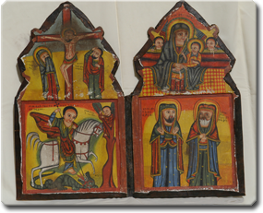
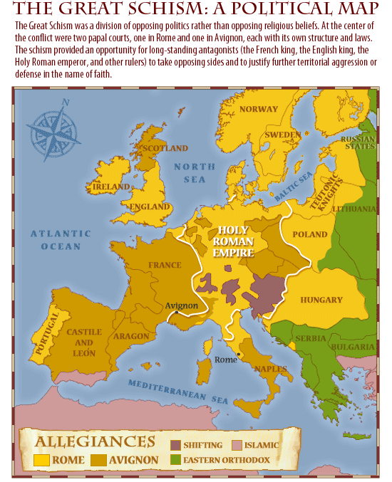
Byzantine Christianity
Since early Christian times, differences had emerged over Church leadership. Although the Byzantine Emperor was not a priest, he controlled church affairs and appointed the patriarch, or highest church official.
During the Middle Ages, a dispute over the use of icons, or holy images, led to a split in Christianity.
In the 700s, a Byzantine Emperor outlawed the use of icons, this led to violent battles.
As a result of this controversy, in 1054 the eastern and western Christian church divided into two separate branches known as the Great Schism.
Byzantine/Eastern = Eastern Orthodox Church (Greek)
Western Branch = Roman Catholic Church

Slide 8
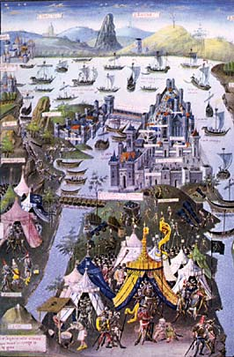
Fall of the Byzantine Empire
By the time of the Great Schism, the Byzantine Empire was in decline. Struggles over succession to the throne, court intrigues, and constant wars weakened the empire.
Beginning in the 1090s, the Byzantine Empire fought the Islamic Seljuk Turks during the Crusades (wars between Christians and Muslims).
In 1204, Constantinople was plundered…
In 1453, Ottoman forces took the city of Constantinople under their ruler Mehmet II. They renamed the city Istanbul and it became the capital of the Ottoman Empire.

Slide 9
Byzantine Postcard
Imagine it is 550 and you are visiting Constantinople. You are writing a postcard to your family in ______________(you choose a location). Your postcard should describe the following:
1. The Geography of Constantinople
2. The Government of Constantinople (Emperor Justinian)
3. The religion of Constantinople (and the Great Schism)
4. Daily Life in Constantinople
Decorate the front with pictures of Constantinople…maybe the Hagia Sophia or other features of the city.

