Slide 1
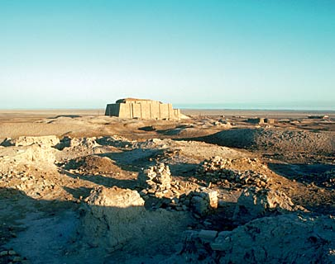
Beginnings of Civilization

Slide 2
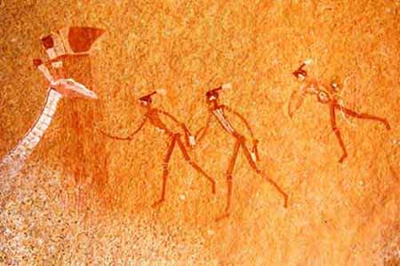
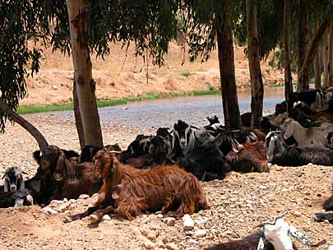
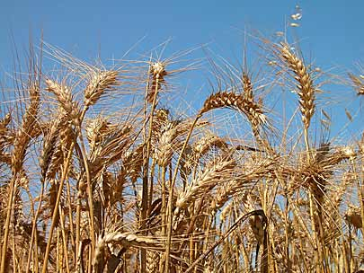
Quick Recap!
Prehistory is divided into two categories, the Paleolithic Period and Neolithic Period.
During the Paleolithic period, people were nomadic hunters and gatherers who developed stone tools.
However, during the Neolithic period, people learned how to farm and domesticate animals.
These changes became known as the Neolithic revolution and led to the development of civilizations.

Slide 3
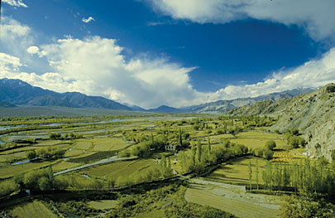
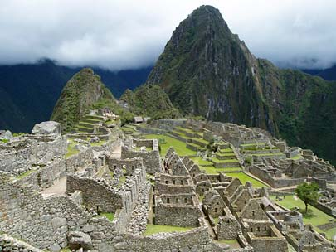
The First Civilizations
Civilization ~ a complex, highly organized social order.
First civilizations were all located on rivers.
Rivers provided regular water supply, transportation, food, and fertile land for farming.
Rich conditions allowed farmers to produce a surplus of food.
Surplus ~ more than necessary.
This allowed for population growth and the start of cities.

Slide 4
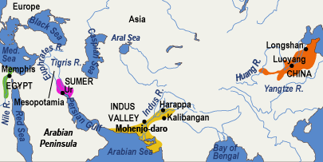
River Valley Civilizations
The first civilizations began in the river valleys of Africa and Asia. The river valley civilizations are:
Tigris and Euphrates River
Yellow River
Indus River
Nile River

Slide 5
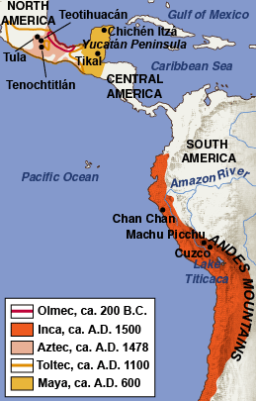
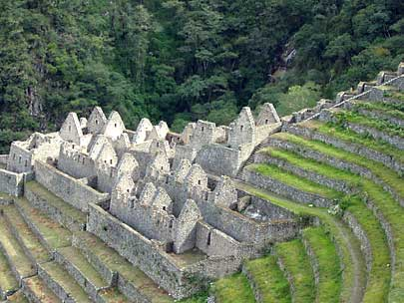
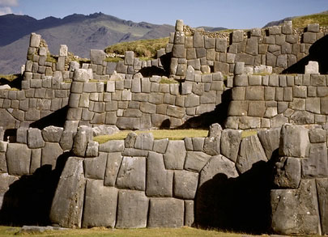
Other Civilizations
Unlike the first civilizations in Asia and Africa, civilizations in the Americas began in the mountains.
These civilizations learned how to farm on the mountains and fill in swamps with land for farming.
They created great cities and civilizations like the Inca at Machu Picchu.

Slide 6
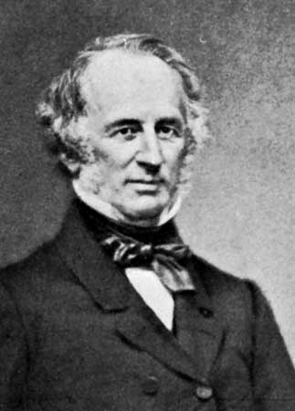
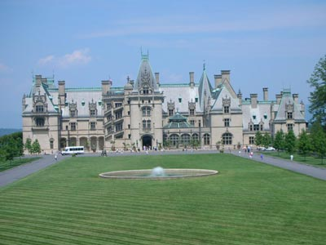
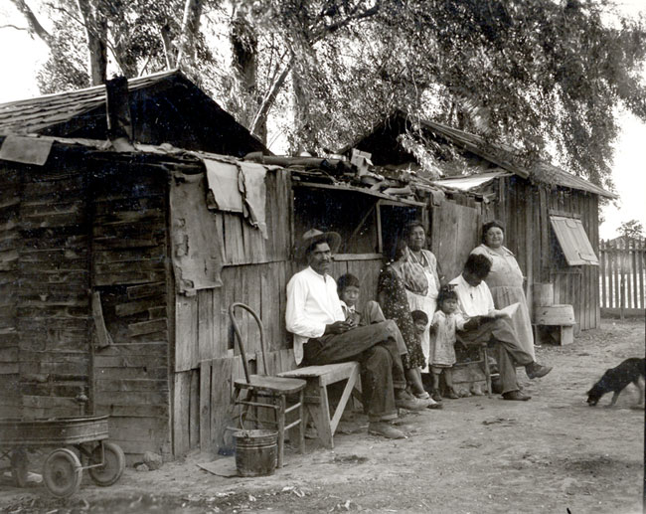
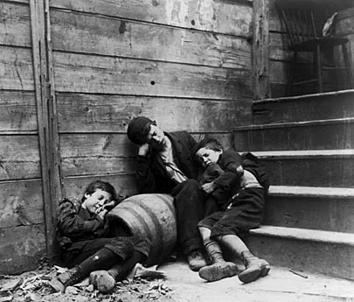
7 Basic Features of Civilization
#1 Stable Food Supply
Civilizations need a stable food supply. A complex society can only survive if there is enough food for everyone.
#2 Social Structure
Civilizations rank people by their job, income, etc.
Some civilizations use a caste system where you are born into a social class and will never leave that class.

Slide 7
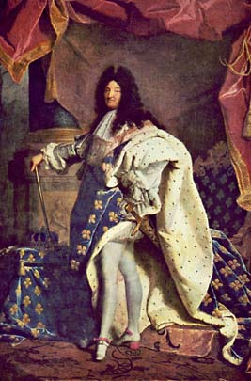
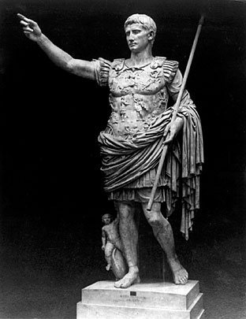
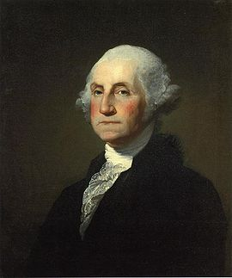
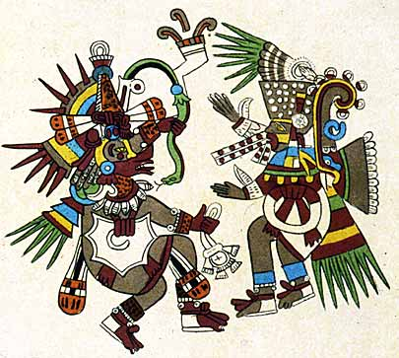
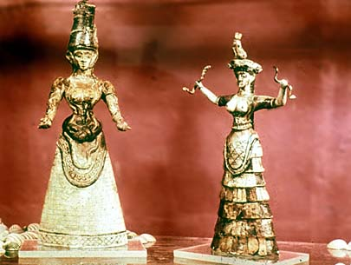
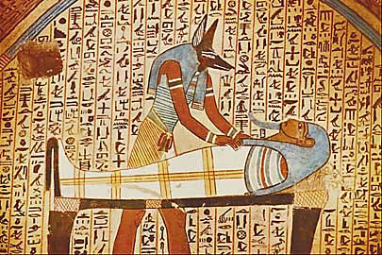
#3 Government
Civilizations have rulers, such as a King or President and usually other “branches,” such as parliament or congress
Governments establish and enforce laws, build an army, provide free schools, and maintain safety for their citizens.
#4 Religion
Civilizations have a system of religious beliefs that usually include rituals and worships of the gods.
Monotheistic ~ worship ONE god
Polytheistic ~ worship many gods

Slide 8
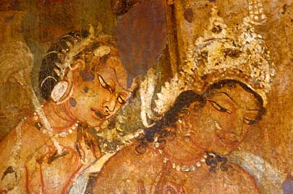
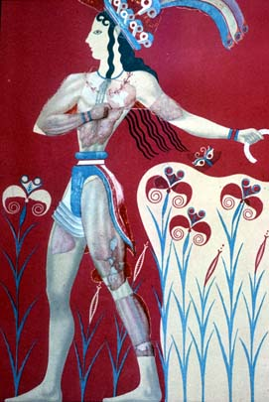
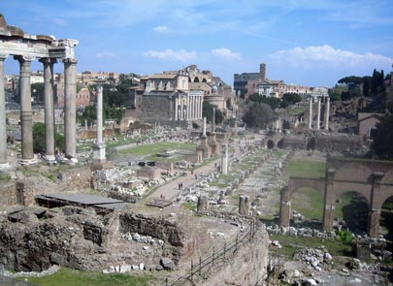
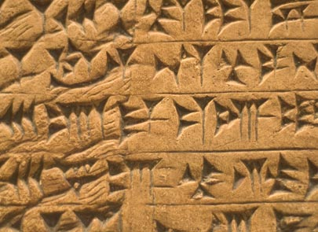
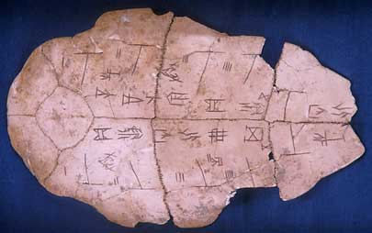
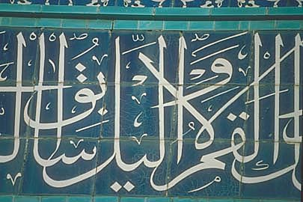
#5 Highly Developed Culture
Civilizations develop art, music, and literature to express the talents, beliefs, and values of their people.
#6 Technology/Specialization of Labor
Civilizations make advances in technology that benefit the people such as bridges, schools, sewers, etc.
#7 Written language
Civilizations develop a system of writing to record important information

Slide 9
Was Ancient Sumer a Civilization?
Today we are going to examine ancient Sumer and evaluate whether Sumer had the characteristics of a civilization.
Follow these steps to analyze the artifacts from ancient Sumer:
Roll the dice to determine which characteristic of civilization you will read about. If you have already read this section roll again.
Read the corresponding section in your reading “Was Ancient Sumer a Civilization?”
Carefully examine the artifacts posted around the room and read the archeologist's notes. Find as many artifacts as possible that are examples of the characteristic of civilization you just read about.
For each artifact you choose, make a simple sketch and complete about how it relates to that characteristic of civilization.
Repeat steps 1-4 for each characteristic of civilization.

