Slide 1
Review
What did the Berlin Wall divide?
Who Led Cuba’s Communist revolution?
What was the result?
What was the Bay of Pigs Invasion?
What was the result?
Explain the Cuban Missile Crisis in your own words.

Slide 2
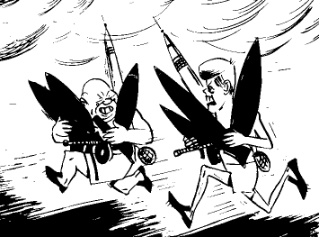
The Cold War: A Dangerous Arms Race

Slide 3
Arms Race
One of the most terrifying aspects of the cold war was the arms race.
At first the U.S. was the only nuclear power, but by 1949, the Soviet Union has also developed nuclear weapons.
By 1953, Each superpower had developed the hydrogen bomb, much more destructive than the Atomic bomb.

Slide 4
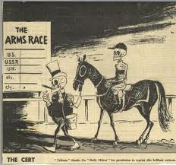
The threat of Nuclear War
Critics argued that a nuclear war would destroy both sides.
Yet, each super power wanted to deter the other from launching its nuclear weapons, so each side engaged in a race to match the other’s new weapons. The result was a “balance of terror.”
The world’s people lived in constant fear of Nuclear doom.

Slide 5
Disarmament Talks
To reduce the threat of nuclear war, both sides met to discuss disarmament. Their mutual distrust slowed progress.
IN 1969 The U.S. and Soviet Union began Strategic Arms Limitation Talks (SALT) to limit the number of nuclear weapons held by each side. In 1972 and 1979 both sides signed agreements setting these limits.

Slide 6
ABMs
One agreement of the limitations talks was limiting Anti-ballistic missiles (ABMs).
Anti-ballistic missiles-missiles that could shoot down other missiles from hostile countries.
The theory was that ABMs were dangerous to the balance of terror because by giving one side some protection against the other, it might encourage the protected side to attack.

Slide 7
Détente
These disarmament talks led to an era of détente – or relaxation of tensions during the 1970’s.
The American strategy under détente was to restrain the Soviet Union though diplomatic agreements rather than by military means.
Détente ended in 1979 when the Soviet Union invaded Afghanistan.

Slide 8
The Cold War goes Global
By the late 1960’s Britain, France, and China had developed their own nuclear weapons.
To keep the Arms race from spreading any further, in 1968 many nations signed the Nuclear Non-Proliferation Treaty (NPT).
Nuclear Non-Proliferation Treaty (NPT) -Nations agreed not to develop nuclear weapons or to stop the proliferation, or spread of nuclear weapons.

Slide 9
Alliances Form
In addition to NATO, the U.S. and its Allies formed:
Southeast-Asia Treaty Organization (SEATO) including: U.S., Britain, France, Australia, Pakistan, Thailand, New Zealand, and the Philippines
Central Treaty Organization (CENTO) Britain, Turkey, Iran, Pakistan.
The U.S. also formed military Alliances with individual nations like Japan and South Korea.
In addition to the Warsaw pact, The Soviet Union formed:
Alliances with the governments in Africa and Asia.
An alliance with communist China from 1949-1960
The Soviet Union and its Allies were known as the Soviet Bloc.

Slide 10
The American global Presence
Unlike the Soviets, The Americans established army, navy, and air forces bases around the globe. By the end of the Cold war, the Soviets faced military nightmare of encirclement by an enemy.
American army camps, naval stations, and air bases spread across Europe, Asia, North American, and the Pacific islands, while American fleets patrolled the world’s oceans.

