Slide 1
Aftermath of War
World History
Mr. Westbrook

Slide 2
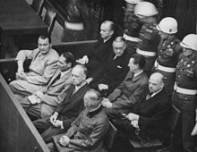
Results
75 million died (worldwide)
38 million in Europe
22 million Soviets
War Crimes Trials (Nurembeurg)
Axis leaders charged with “crimes against humanity”
124 leaders found guilty
Top 20 killed
Political leaders held accountable for actions at war

Slide 3
United Nations
5 Permanent members (U.S., Russia, China, France, Britain)
Peacekeeping, prevent outbreak of disease, improve educations, and protect refugees

Slide 4
Cold War (USSR V.S. USA)
*Communism V.S. Democracy*
State of tension & hostility among nations w/o armed conflict
Soviets wanted to spread communism/ U.S. Democracy
Arms Race
USA had atomic bomb
40 years both developed new/deadlier nuclear weapons
Improved “delivery system” (bombers, missiles, subs

