Slide 1
Groups and Formal Organizations

Slide 2
Goals to be Met
Goal 4: The learner will demonstrate an understanding of the importance of groups and organizations in society.
Objectives
4.01 Distinguish between social groups and formal organizations.
4.02 Classify types of social groups that exist in society.
4.03 Analyze group dynamics and assess its effects on group behavior.
4.04 Evaluate the nature of bureaucracies.

Slide 3
What is a Group?
Groups have 4 major features
2 or more people
Interaction
Shared expectations
Common identity
Aggregate: People gather in the same place at the same time, but lack organization or lasting patterns of interaction
Ex: Passengers on a bus
Social Category: Means of classifying people according to shared trait or common status
Ex: Students

Slide 4
Group Differences
Size
Dyad: Group with 2 members
Decision-making can be difficult
Triad: 3 members
Decision-making is easier
Small Group: Few enough member that everyone is able to interact on face-to-face basis
15 is the largest number that can work well
Time
Regardless of types of group, interaction is not continuous
Meet once and never again or meet frequently
Organization
Formal Group: Structure, goals, and activities are clearly defined
Informal Group: No official structure or rules of conduct

Slide 5
Types of Groups
Primary Group
Secondary Group
Reference
In-Group
Out-Group
E-Communities
Social Networks

Slide 6
Primary and Secondary Groups
Primary Groups: Small group who interact over a relatively long period of time on a direct and personal basis
Entire personality of the individual is taken into account
Relationships are intimate and often face-to-face
Family relationships are most common
Secondary Groups: Interaction is impersonal and temporary in nature
Casual and limited in personal involvement
Generally organized around specific goals
Possible for primary and secondary relationships to exist in same group
Ex: At your job you have mostly secondary relationships, but can form primary relationships because you enjoy these people

Slide 7
Reference Groups
Reference Group: Any group with whom individuals identify and whose attitudes and values they adopt
Ex: Groups of friend or school clubs
Can have both positive and negative effects on behavior
Can have:
Normative effect: one’s self-esteem matches members of a group
Comparison effect: Where one sees oneself in comparison to another
Associate effect: One is pleased to be associated with members of a group

Slide 8
In-Groups and Out-Groups
In-Groups: Group the person belongs to and identifies with
Most exhibit 2 characteristics
Members tend to separate themselves (Ex: Badge as an ID)
Members view themselves positively and often view out-groups in negative terms
Out-Groups: Group that person does not belong to or identify with
In-Groups compete with out-groups even to the point of engaging in conflict

Slide 9
E-communities
Came about due to computer technology
E-community: People interact with one another regularly on the Internet

Slide 10
Social Networks
Social Network: Web of relationships that is formed by the sum total of a person’s interactions with other people
Include both direct and indirect relationships
Do not have boundaries and do not give rise to common sense of identity

Slide 11
Group Characteristics
Leaders: People influence attitudes and opinions to others
Instrumental Leaders: Task-oriented
Find specific means that will help group reach its goal
Expressive Leaders: Emotion-oriented
Find ways to keep the group together to maintain morale
Laissez-Faire Leaders: Let others do their work more or less on their own
Idosyncratic Credit: Leaders are given the privilege to deviate from the group’s norms
Groupthink: Tendency to maintain consensus and ignore the truth

Slide 12
Formal Organizations

Slide 13
Structure of Formal Organizations
Formal Organization: Large, complex secondary group that has been established to achieve specific goals
Bureaucracy: Ranked authority structure that operates according to specific rules and procedures
Rationalization: Process by which every feature of human behavior becomes subject to calculations, measurement, and control
Bureaucracies were created to rationally organize groups to complete goals

Slide 14
Weber’s Model of Bureaucracies
Bureaucracies have following characteristics:
Division of Labor: Work divided among specialists
Ranking of Authority: Clear cut lines of responsibility
Employment Based on Formal Qualifications
Rules and Regulations
Specific Lines of Promotion and Advancement
Ideal type
Voluntary Association: Typically a nonprofit organization formed to pursue some common interest
Ex: service club, charity

Slide 15
Effectiveness of Bureaucracies
Important weaknesses
Lose sight of original goals
Tend to encourage development of bureaucratic personality
Tendency to result in oligarchies (few people rule many)
Iron Law of Oligarchy: Tendency of organizations to become increasingly dominated by small groups of people (Robert Michels)

Slide 16
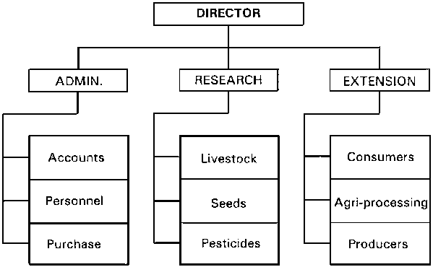

Slide 17
Athens Drive as a Bureaucracy
Write down an organization chart of Athens Drive.
Analyze how the size of your school influences this chart.
Describe the division of labor, including the place of students in it.
Describe how well defined the management is and state the qualifications needed to enter different positions.

